Slide 1



Case study 4: The Bumblebee: Habitat Loss, Pollution & climate change
Suitable for TRANSITION YEAR SCIENCE
NARRATOR: Keith Kennedy, Tara Ryan
EPI•STEM, University of Limerick
THIS IS A HEA FUNDED CPD PROJECT WITH EPI•STEM:

Slide 2

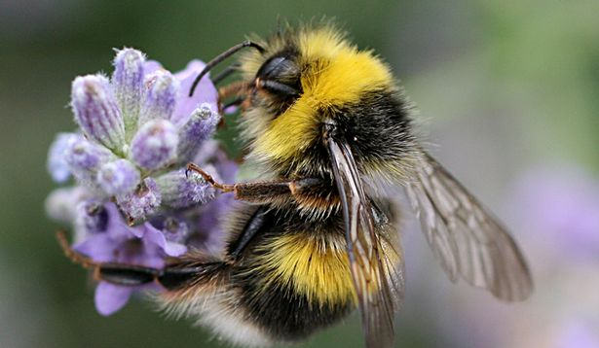

The Bumblebee
Irish Name: Beacha Bumble
English Name: Bumblebee
Latin Name: Bombus
Identifying Feature: Bumblebees are large yellow and black flying insects with a distinct buzz. Bumblebees have four wings.
Number of Young: The queen bee lays all of the eggs in a colony.
Diet: Bumblebees harvest nectar (carbohydrates) and pollen (protein) from flowering plants.
Habitat: Hedgerows near orchards provide food and shelter for pollinators like bumblebees.

Slide 3
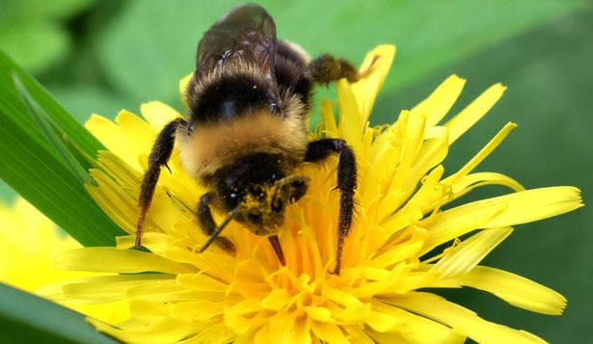
The Bumblebee
There is variation in coloration among bumblebees and some species have bands of red, yellow and black. They have stocky bodies that are covered with many hairs to which pollen adheres.
Bumblebees have four wings, the two rear wings are small and usually attached to the fore wings by a row of hooks called hamuli. The wings move rapidly, at 130-240 beats per second.
Beneficial insects: The bumblebee's commercial value is as a pollinator of crops without them plants and crops would die!

Slide 4
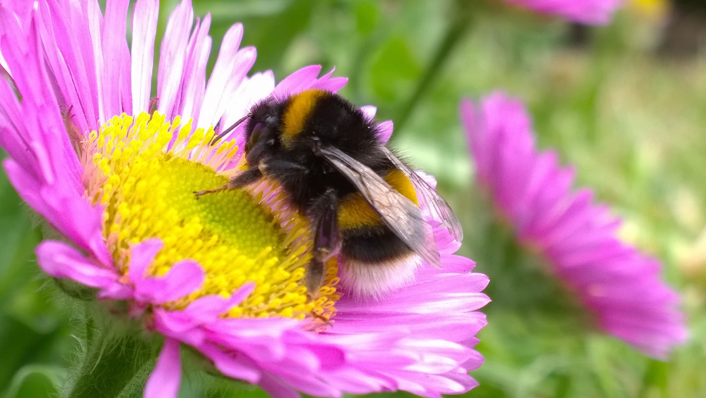
Habitat Loss
The declines in bumblebee populations have occurred mainly because of large-scale changes to the way the countryside is managed.
First the mechanisation of agriculture, then later the public demand for cheap food and the need for ever-greater quantities of food and crops have conspired to hugely reduce the nationwide density of the flowering plants that bumblebees feed on, as well as the sheltered corners that they nest and overwinter in.
Humans cut down the flowers the bumblebees feed on to grow our own food!

Slide 5
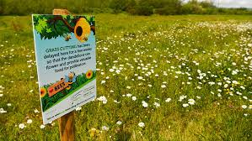
Habitat Loss
In recent years we have realized that we need to leave some areas of plants and flowers uncut. These meadows are left for the bees to feed and pollinate in peace!

Slide 6
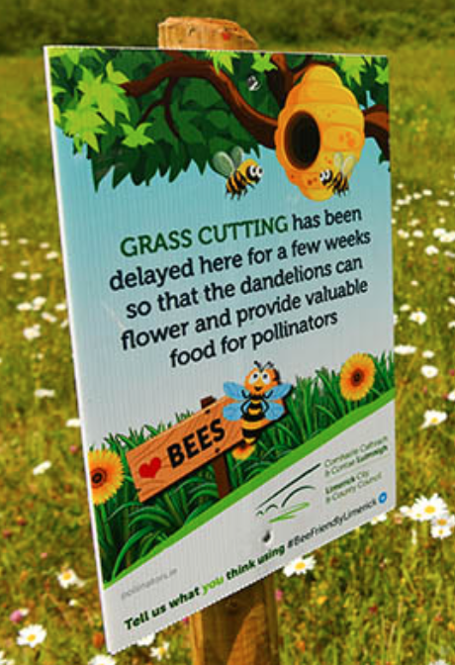
Habitat loss
Don’t Mow, Let it Grow!
This is an initiative being run in Limerick to help out our bees!
One of the simplest actions that can be taken to help pollinators is to do nothing! If areas of grass are left unmown during the growing season or mown less frequently, they will gradually develop into wildflower meadows.

Slide 7
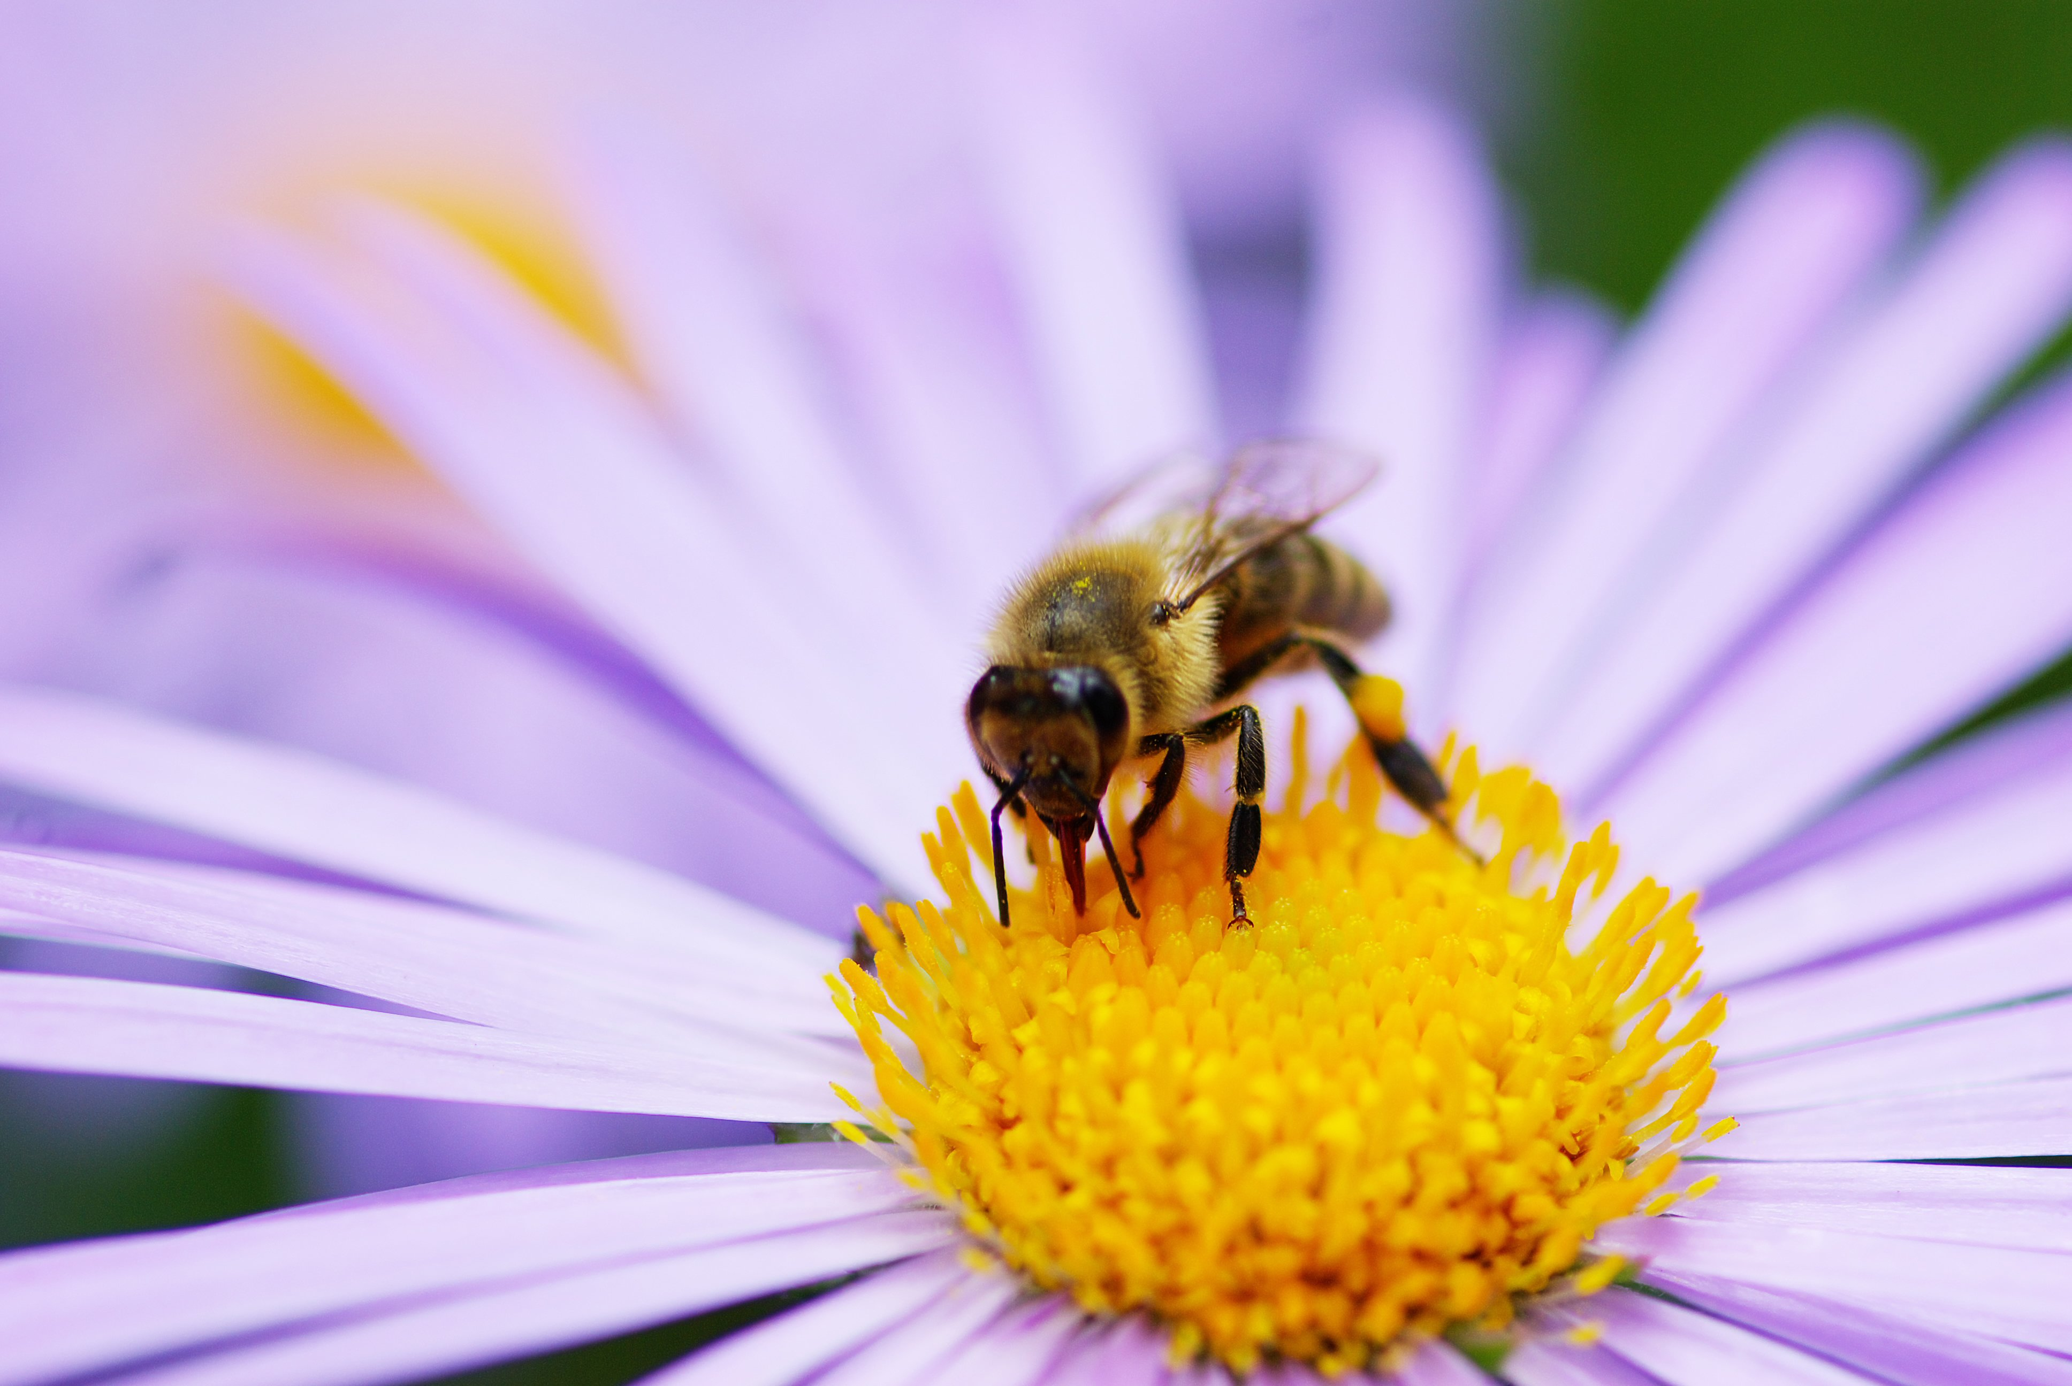
Climate change
Pesticides, habitat loss, and pathogens have already hit bumblebee populations hard. A new study, however, is able to isolate the effect that hotter temperatures are having on bumblebees.
Sadly, bees are having a hard time adapting to a warming world. Tomatoes, squash, and berries are just some of the crops we can thank bees for pollinating. Animal pollinators like bees, birds, and butterflies could be responsible for up to 1 out of every 3 bites of food we eat, the US Department of Agriculture says.

Slide 8
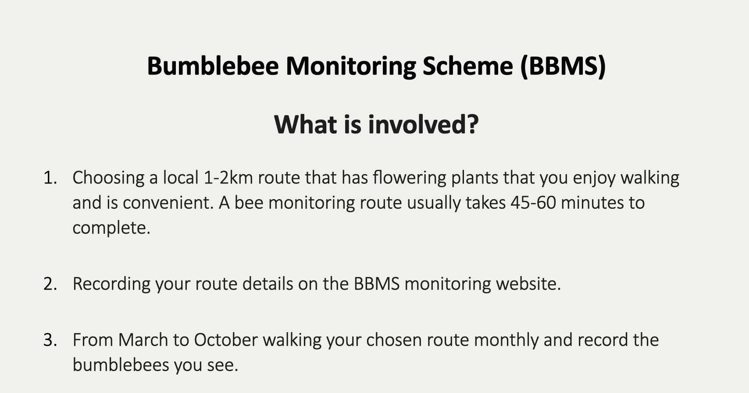
Bumblebee monitoring scheme

Slide 9
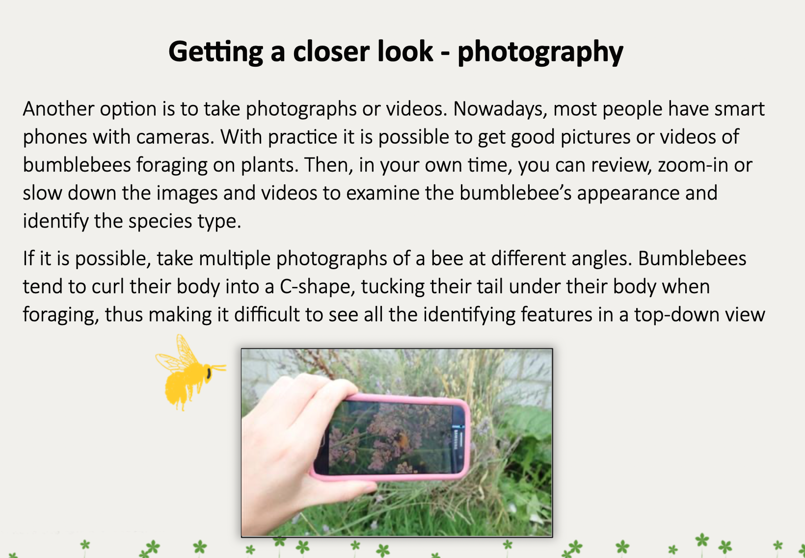
photography

Slide 10
Bumblebee record sheet

Slide 11
Contact Details
Register for on-line CPD resources: https://epistem.ie
EPI•STEM project: Resources
Contact: Helen Fitzgerald, Senior Executive Administrator
Email: helen.fitzgerald@ul.ie
This on-line CPD project [HEA funded] is an initiative with EPI•STEM for science and mathematics secondary teachers in Ireland. The research-led development team include:
Geraldine Mooney Simmie, Niamh O’Meara, Merrilyn Goos, Stephen Comiskey, Ciara Lane, Tracey O’Connell, Vo Van De, Tara E. Ryan, Martina Scully, Jack Nealon, Daniel Casey, Keith Kennedy, Annette Forster, Céren O’Connell, Martha Cosgrave, Martina Ryan, Veronica Ryan, Gemma Henstock

