Slide 1
Why Study Biology? Biology - Transition Year
Narrator: Céren O’Connell
THIS IS A HEA FUNDED CPD PROJECT WITH EPI•STEM

Slide 2
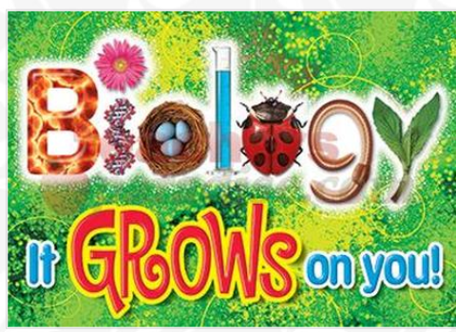
Notes:
We all want to get across the importance of biology to society in our teaching it helps enthuse and motivate our students. These resource aim to engage students to explore topics in Biology with everyday applications, spark curiosity to engage in critical thinking, to engage in ethical thinking so that the students can build up the skills to appreciate the importance of all that they are studying and not just the specific application contexts of a specification.
This should help build student motivation for all topics in biology, encourage more of them into further study and possibly a biology related career.

Slide 3
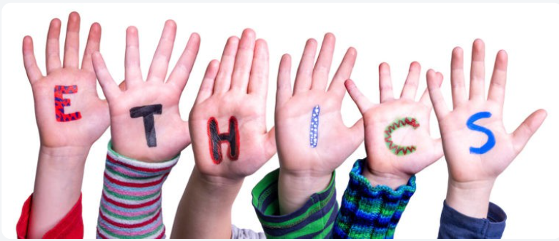
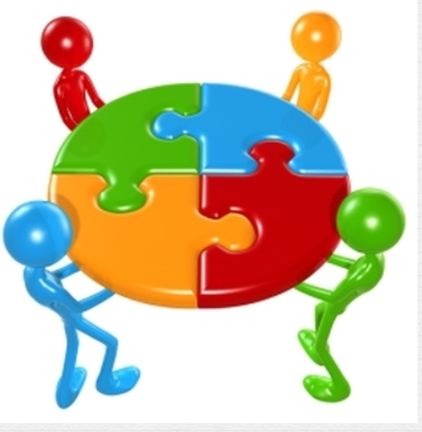
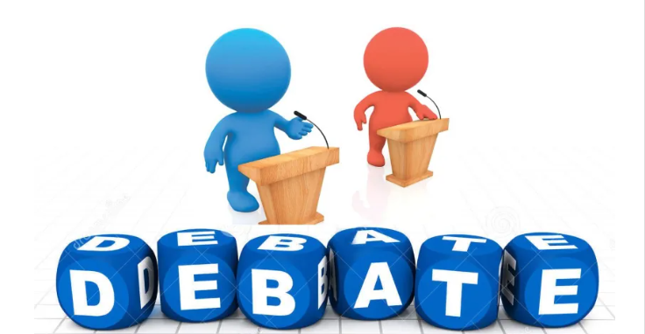
Teaching Strategies
There are great opportunities to involve students in ethical thinking and in aiding their social and emotional learning through responsible decision making, incorporating real world examples, encouraging student choice and providing opportunities for developing creativity and collaborative peer teams.
Article on ethical thinking in STEM .Click here
A variety of teaching methods can be used with these resources for example.
The Jigsaw method. Support material here
Students debate. Click here.
Notes:
To access further material on the topics covered please click on any of the highlighted words to read the supporting material.

Slide 4
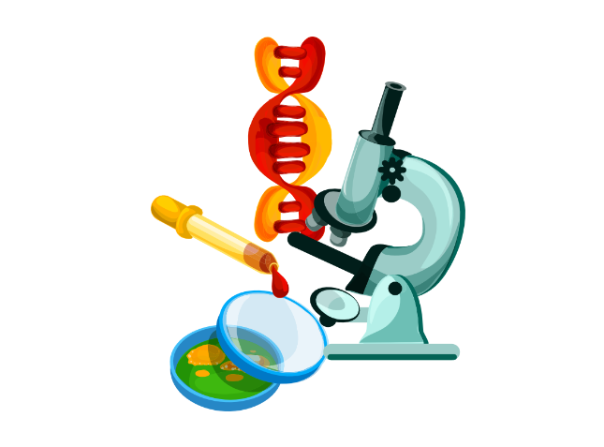
Why Study Biology? A framework
This framework from saps.org.uk provides a framework that teachers can use with students throughout biology courses so that the students can build up the skills to appreciate the importance of all that they are studying and not just the specific application contexts of a specification. Full article available here
Notes:
We all want to get across the importance of biology to society in our teaching, it helps enthuse and motivate our students. There isn’t, however, the requirement to teach students a framework for this that allows them to see the importance of biology for themselves in a novel context.
This resource aims to provide a framework that teachers can use with students throughout biology courses so that the students can build up the skills to appreciate the importance of all that they are studying and not just the specific application contexts of a specification.
The framework explores and provides some example contexts for the following reasons for studying biology: to bring joy; to inform intervention; to develop tools; to trigger inspiration; to inform decisions; and to find answers. A copy of the full article is available here. The framework is not designed to be rigid or sequential.

Slide 5
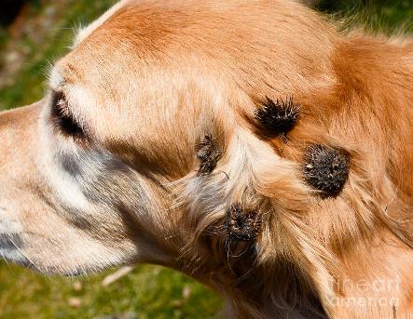
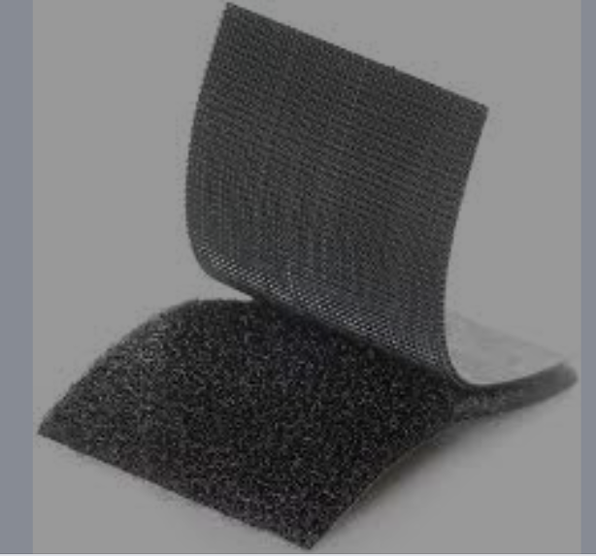
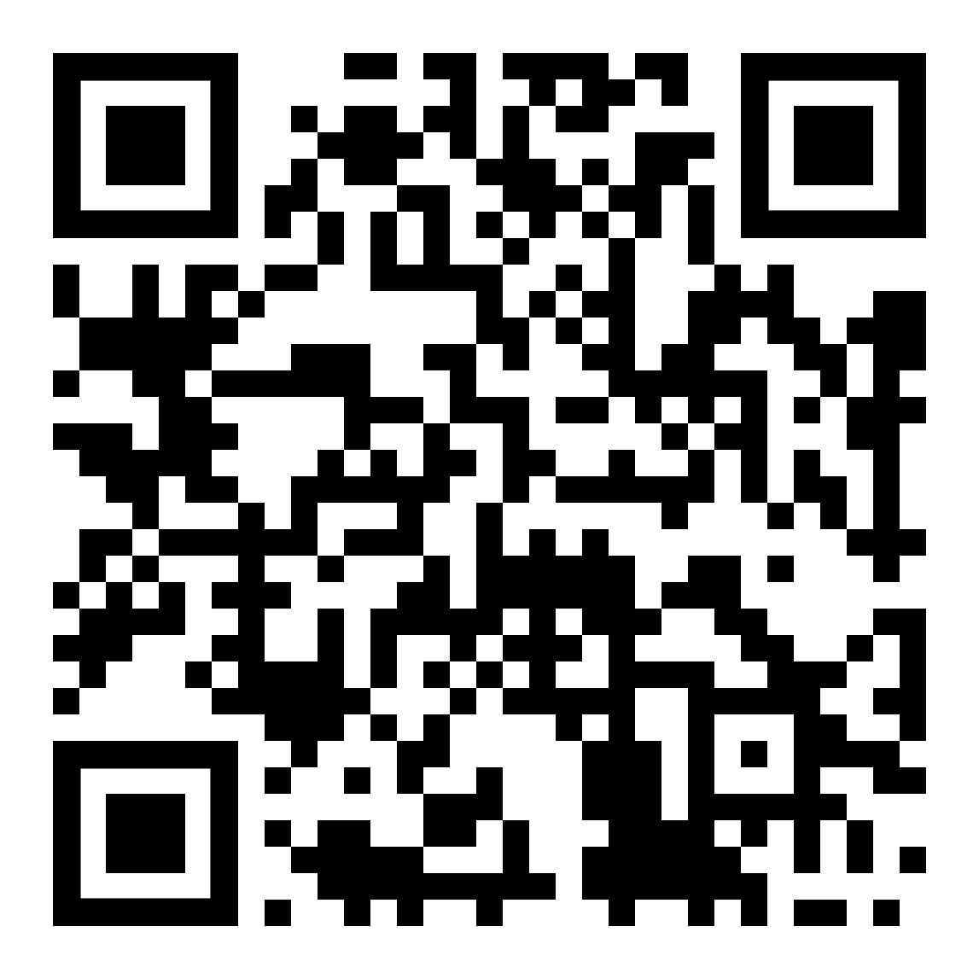
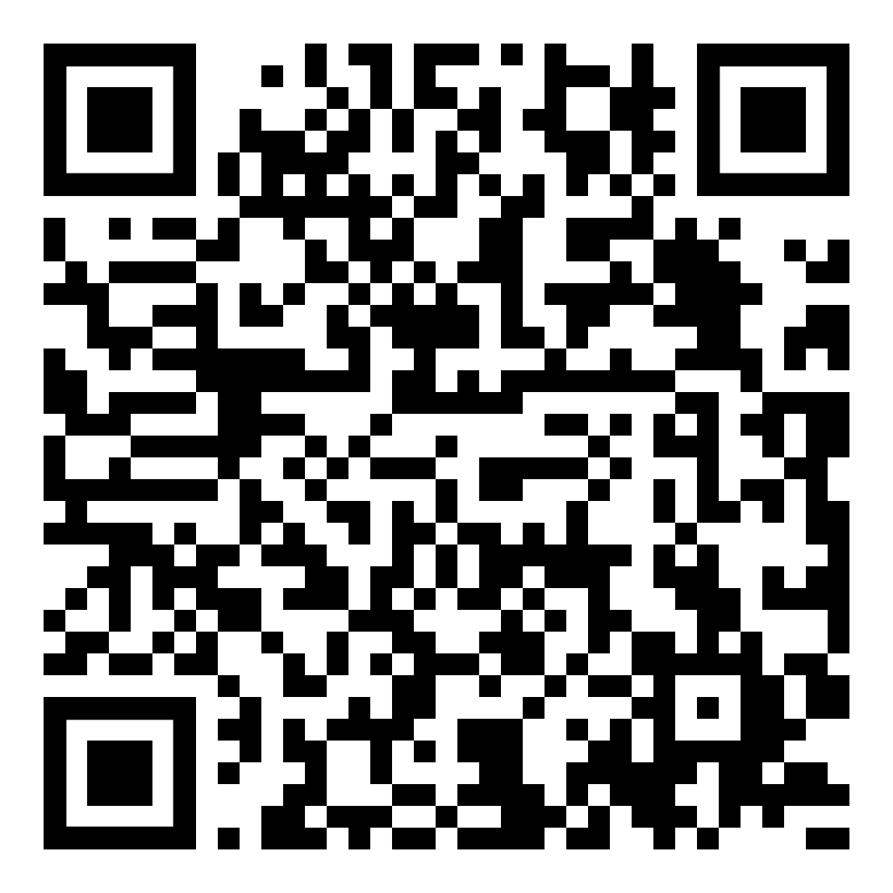
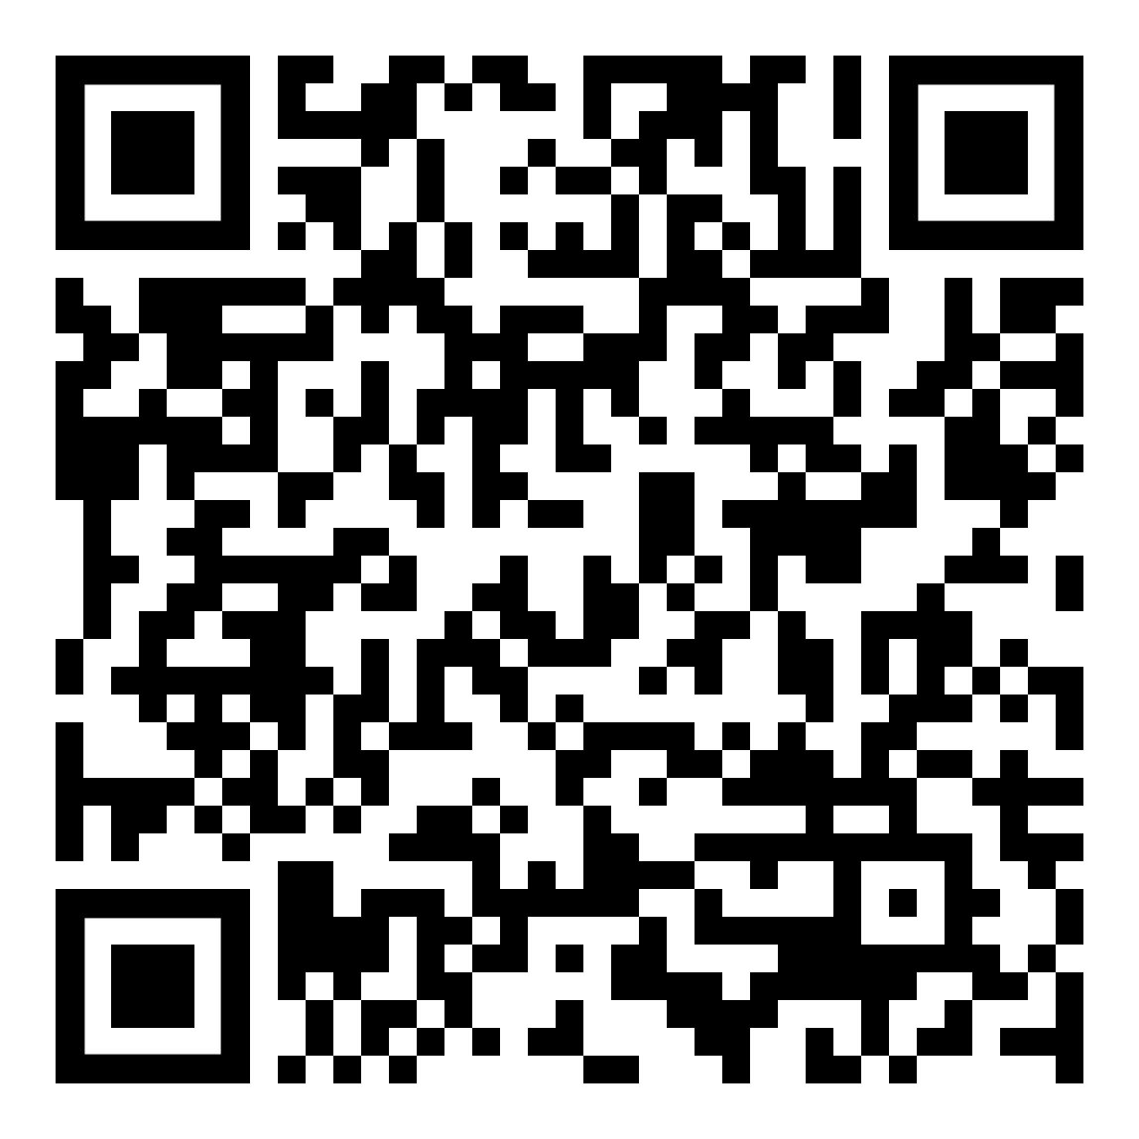
The story of Velcro.
Triggering inspiration and Developing tools: Burdock seeds and Velcro
Velcro, a trade name is used for a wide variety of purposes from hospital use to space missions. In the early 1960s Apollo astronauts used it to secure pens, food packets and equipment they didn't want floating away. Hospitals affixed Velcro to everything from blood pressure gauges (it's on the band that nurses strap to your arm) to patient gowns. It showed up in cars (underneath floor mats) home decor (as fasteners for slipcovers and drapes), even on airplanes (seat cushions used as flotation devices). But how was it invented? This is a great resource to show the importance of scientific observation.
The history of Velcro ®. Click here
How Velcro ® fasteners were invented. Click here.
An article on the US army use of Velcro ®. Click here
Click here for resource Pack.
Notes:
The classic story of biology inspiring invention is that of George de Mestral, his dog, burdock seeds and the invention of Velcro. Whilst on a hunting trip in 1941 de Mestral noticed the burrs (seed heads) of the burdock plant sticking to his trousers and the fur of his dog, Milka¹. He was certainly not the first person to see this but he was the first person to run with it.
He started by investigating how the burrs attached to fur and clothing. By using a microscope, he saw that there are hooks on the seeds that catch onto loops of hair or fibres allowing the burr to latch on, be pulled off, and reattach to the fabric or fur².
Developing two materials, a hooked one and a looped one, was not straightforward but eventually de Mestral patented Velcro in 1955². It is now exceptionally widespread in its use and the original Velcro has inspired many more “hook and loop fastener” products. Velcro has been used to great effect in health care, in the military, and was even used in the Apollo space missions to secure pens and other objects they didn’t want floating around³.
The inspiring aspect of this story is that George de Mestral was observant, inquisitive, open-minded enough to see that what he saw in nature could be reproduced artificially, and ingenious and persistent enough to work through the development process to come up with Velcro. I’m sure we would all hope that our work as teachers helps develop these qualities in our students.
QR codes are included in the slides to allow students access material directly.

Slide 6
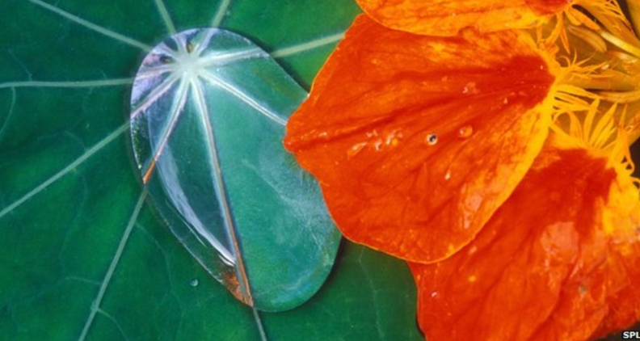
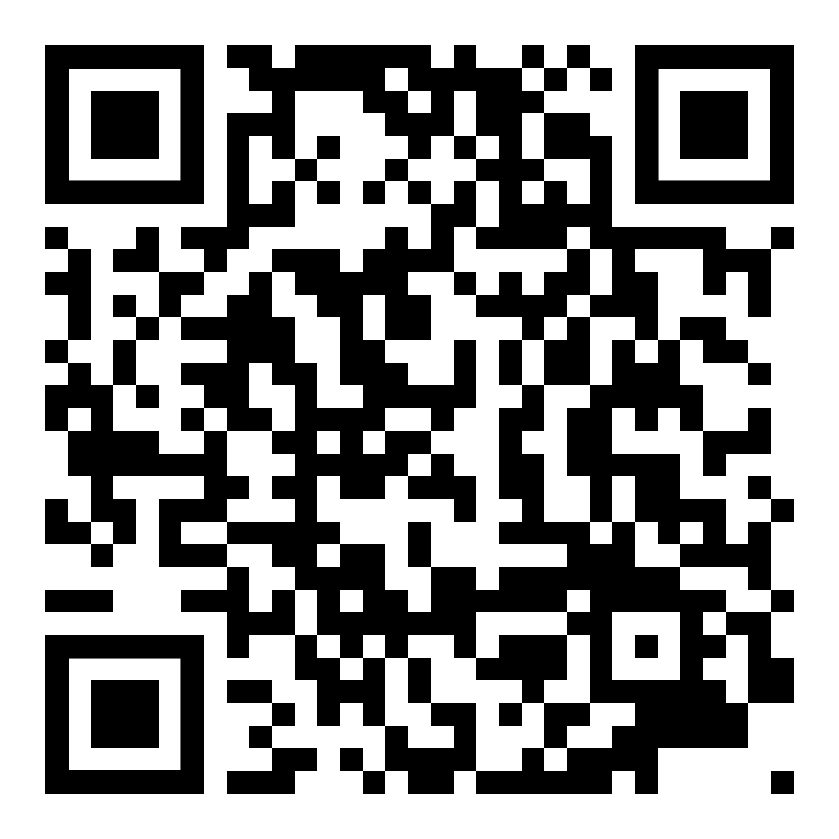
Creating new Waterproof materials.
Triggering inspiration and Developing tools.
US engineers have created the "most waterproof material ever" - inspired by nasturtium leaves and butterfly wings.
The new "super-hydrophobic" surface could keep clothes dry and stop aircraft engines icing over, they say.
The lotus leaf was thought to be the gold standard for staying dry in nature, but now a team from MIT in Boston say they have surpassed it.
Adding tiny ridges to a silicon surface made water bounce off it 40% faster than the previous "limit".
Similar ridges are found in nature on the wings of the Morpho butterfly and the veins of nasturtium leaves.
By applying these patterns to metals, fabrics and ceramics, the scientists hope to inspire a new generation of moisture-resistant products - from tents to wind turbines. Full Article here
Notes:
Build students’ enthusiasm with little “nuggets” that can be used to enrich a topic.

Slide 7
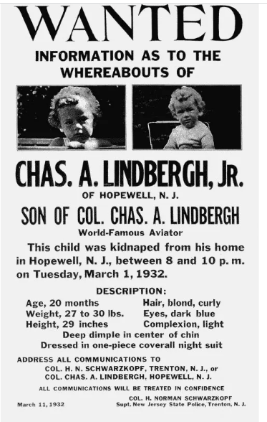
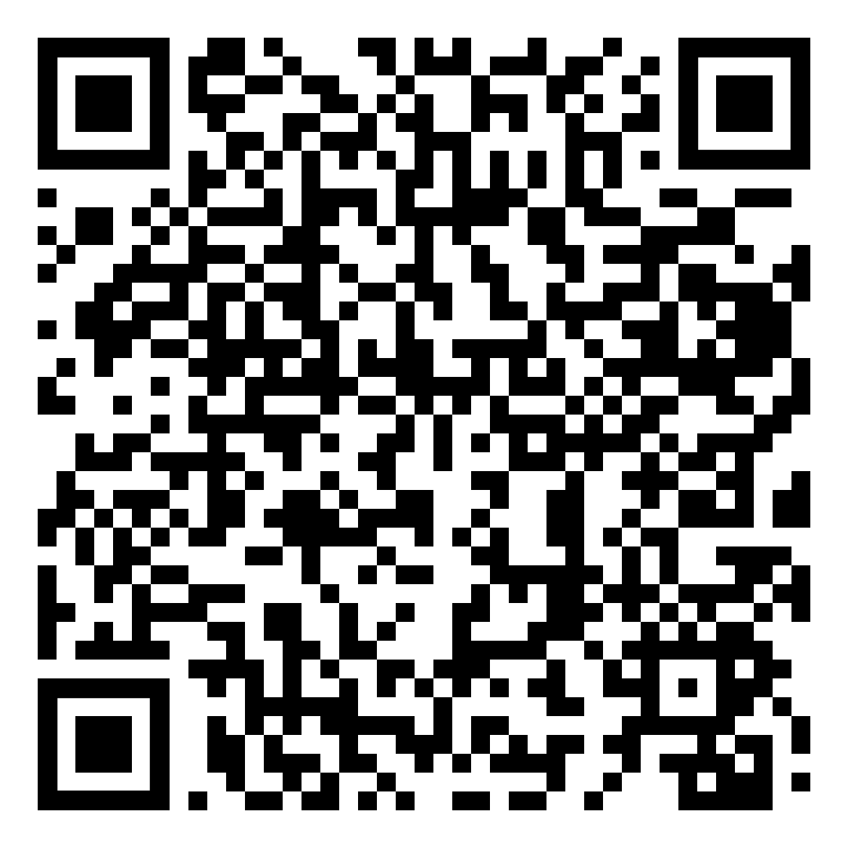
How can the microscopic structure of the wood of a ladder help catch a kidnapper?
Informing Decisions and Finding answers:
In the journal article forensic botany is examined in a real world scenario through examining the contribution of a man named Arthur Koehler who in 1935 gave evidence in the case of the kidnapping of the young son of aviation hero Charles Lindbergh and his wife Anne. What was unique about the particular testimony he was about to give was that it dealt with the structure of wood, namely the wood of the ladder used by the kidnapper. Since that trial, what is termed forensic botany, or the use of plant remains to help solve crimes or other legal problems, has been widely accepted as valid scientific evidence by the courts. Two other cases where forensic botany have been used in New Zealand and London are explored.
Click here for the article.
Click here.
Notes:
This resource explores three cases where forensic botany was used to solve cases. The first which focuses on the kidnapping of the lindenbergh baby adopts a real life CSI approach.

Slide 8
Why do smart phones have a “night mode”?
Informing Intervention.
Smart phones often have a “night mode” that switches the display to warmer colour tones and away from the blue end of the spectrum. There is some debate about whether this is actually useful (see the Guardian news article by Tim Dowling, 17 Dec 20191) because the science behind it is still developing, but why was this “night mode” invented? The resources allow students explore articles that help answer this question and debate the benefits.
Resources here
Notes:
A full explanation and a historical perspective is provided along with a variety of resources from news paper articles to scientific journal allow students explore this question. The variety of resources are useful with mixed ability groups and are useful for a jigsaw approach to addressing the topic.

Slide 9
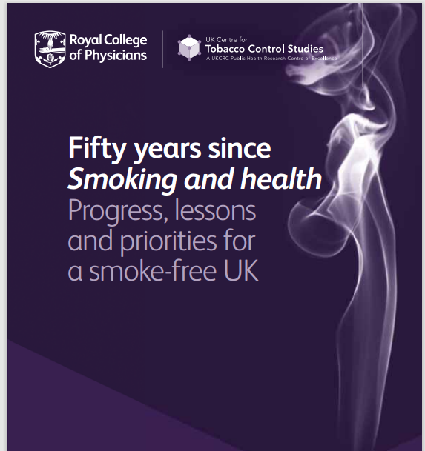
Smoking
To Inform Decisions and Inform Intervention
Based on a publication from the Royal College of Physicians in the UK. This publication looks at the progress, lessons and priorities for a smoke free UK in the last 50 years. The publication looks at research on the effect of smoking and passive smoking and how it has resulted in changes in the law.
The areas covered are:
Smoking and health implications for the future.
Preventing smoking. Promotion , price and access.
Helping smokers who want to quit and protecting others from smoke and smoking.
Smoking and health: Industry and practice.
1962. A world suffocated by the swirling clouds of tobacco smoke, in pubs, cinemas, trains, buses, on the streets, and even in hospitals and schools. Around 70% of men and 40% of women smoked. Smoking was omnipresent, accepted, established.
2012. A world in which smoking is no longer the norm. Our schools, hospitals, pubs, cinemas and public transport are subject to smoke-free legislation. Only 21% of the population smokes. Government, media and society have largely accepted the need to protect people, particularly children, from much of the harm associated with tobacco smoke.
Notes:
This resources written by medical researchers explores the topic of smoking and health implications. Smoking prevention programmes help those who want to quit and its practices and interventions are evidence based. The resource provides ample material to engage students in a jigsaw approach to the topics and to engage in ethical debates regarding the industry and its current focus in advertising and market developments in developing countries. This also provides an opportunity to engage in Global Citizenship education.

Slide 10
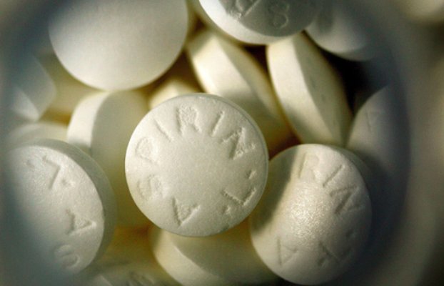
From a tree, a 'miracle' called Aspirin
Informing Decisions.
If you take aspirin, you've got a pain reliever, heart attack preventer and possible cancer preventer rolled into one tablet. You might think that whoever invented aspirin is a genius, but the truth is humans have been taking its natural equivalent for thousands of years.
The article looks at Aspirin from the writings of Hippocrates to modern day research.
Notes:
This article is very useful in developing critical literacy, allows students enter ethical debate and see how research should be used to inform our decision making on health related issues.

Slide 11
Bibliography
Saps.org.uk
Images:
Developing Ethical Thinking in STEM - TeachHUB
https://ryanarciero.weebly.com/cooperative-teaching-strategies-blog/jigsaw-cooperative-learning-strategy
https://grade9-unita-biodiversity-nixont.weebly.com/introduction.html
https://www.yottavolt.com/biology/
https://fineartamerica.com/featured/3-burdock-burs-photo-researchers.html
https://www.plasticmetall.com/pm-hook-loop-tape-velcro-fastener-detachable-mounting-systems.html
https://www.britannica.com/event/Lindbergh-baby-kidnapping
From a tree, a 'miracle' called aspirin - CNN.com
.

Slide 12
Contact Details
Register for on-line CPD resources: https://epistem.ie
EPI•STEM project: Resources
Contact: Helen Fitzgerald, Senior Executive Administrator
Email: helen.fitzgerald@ul.ie
This on-line CPD project [HEA funded] is an initiative with EPI•STEM for science and mathematics secondary teachers in Ireland. The research-led development team include:
Geraldine Mooney Simmie, Niamh O’Meara, Merrilyn Goos, Stephen Comiskey, Ciara Lane, Tracey O’Connell, Vo Van De, Tara E. Ryan, Martina Scully, Jack Nealon, Daniel Casey, Keith Kennedy, Annette Forster, Céren O’Connell, Martha Cosgrave, Martina Ryan, Veronica Ryan, Gemma Henstock,.

