Slide 1
Waves Suitable for Leaving Certificate Physics
NARRATOR: Martha Cosgrave, EPI•STEM, University of Limerick
THIS IS A HEA FUNDED CPD PROJECT WITH EPI•STEM:

Slide 3
Stationary Waves
A standing wave occurs when two periodic travelling waves of the same frequency moving in opposite directions meet, they interfere with each other.
Nodes – Point of the wave at rest.
Antinodes – Points where the wave is a maximum amplitude.
Simulation here!!
Notes:
A standing wave or stationary wave occurs when two periodic travelling waves of the same frequency moving in opposite direction meet, these waves interfere with each other.
A standing waves is composed of two types of points, nides are the point of the wave that are a rest while the antinode is the point where the wave is at a maximum amplitude.
On the slide there is a link to a simulation that shows the movement of a stationary wave.

Slide 4
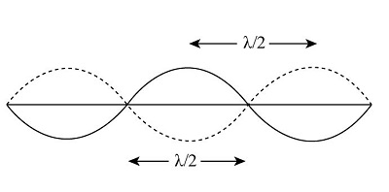
Frequency and Wavelength of a Stationary wave.
Every vibrating particle in a stationary wave has the same frequency of vibration.
A stationary waves frequency is the same as the frequency of the travelling wave producing it.
When λ is the wavelength of a travelling wave that is causing a stationary wave then:
Distance between 2 consecutive nodes is $\frac{\text{λ}}{2}$
Distance between 2 consecutive antinodes is $\frac{\text{λ}}{2}$
Distance between the antinode and the next node is $\frac{\text{λ}}{4}$
Notes:
On a stationary wave the particles are all vibrating. All of these vibrating particles have the same frequency of vibration. The frequency of that stationary wave also equals the frequency of the wave which is producing it.
If λ is the wavelength of the travelling wave then the distance between two consecutive nodes is $\frac{\text{λ}}{2}$, the distance between the 2 consecutive antinodes is also $\frac{\text{λ}}{2}$. The distance between the antinode and the next node is $\frac{\text{λ}}{4}$.

Slide 5
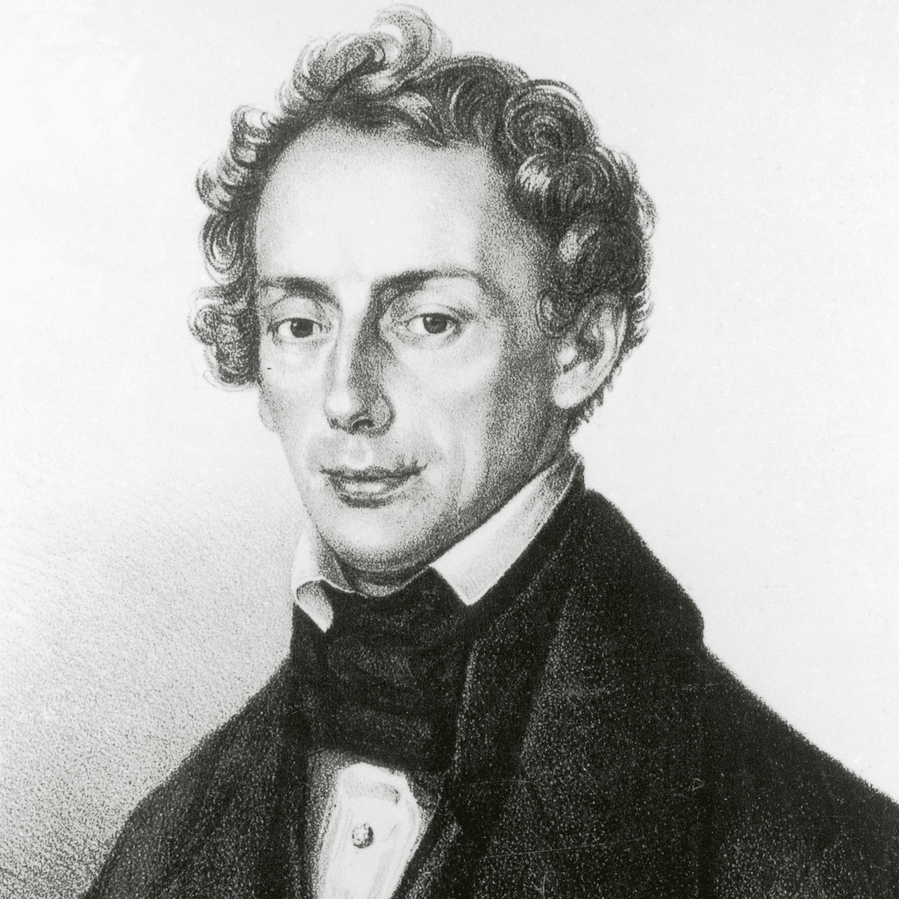
Christian Doppler
1803-1853
Austrian mathematician and physicist.
Suffered from poor health from a young age.
Studied physics, mathematics, mechanics and astronomy.
Notes:
Christian Doppler is the Austrian mathematician and physicist who discovered the Doppler effect. Doppler lived from 1803 to 1853. Doppler suffered with poor health for a long time although he still managed to study physics, mathematic, mechanics and astronomy.

Slide 6
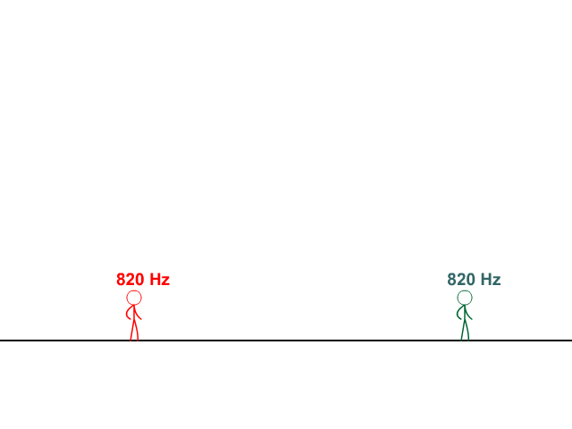
The Doppler effect
Is the apparent change in frequency of waves due to the motion of the source or the observer.
Example of the Doppler effect: as one approaches a blowing horn, the perceived pitch is higher until reaching the horn and then lowers as the horn passes.
Example of Doppler effect
Notes:
The Doppler effect is the apparent change frequency of waves due to the motion of the source or of the observer. This can be hard to grasp but when we link the doppler effect the an example it becomes more straight forward. If you think approaching a loud noise such as a horn blowing, as you approach the sound is perceived at a higher pitch. As you move passed the sound the pitch alters and changes to a lower pitch. On this slide is a YouTube clip which demonstrates the doppler effect.

Slide 7
The Doppler effect.
Ahead of the moving source:
Crests are closer.
Smaller wavelength.
Frequency of wavelength is greater.
Behind the moving source:
Crests are further apart.
Wavelength is greater.
Frequency is less.
Notes:
If we analyse the sound waves associated with the moving sound we will note that:
Ahead of the moving source: Crests are closer, Smaller wavelength and the Frequency of wavelength is greater.
Behind the moving source: Crests are further apart, Wavelength is greater and the frequency is less.

Slide 8
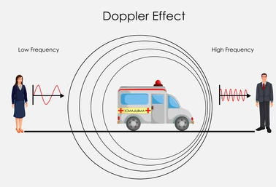
The Doppler effect
If a source emits waves with a frequency of f the observed frequency f’ will be:
Greater than f if: If the sources moves towards the observer or the observer moves towards the source.
Less than f if: if the source moves away from the observer or the observer moves away from the source.
Notes:
If a source emits waves with a frequency of f the observed frequency f’ will be:
Greater than f if: If the sources moves towards the observer or the observer moves towards the source.
Less than f if: if the source moves away from the observer or the observer moves away from the source.

Slide 9
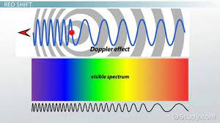
Electromagnetic Waves and the Doppler effect
The Doppler effect occurs for Light waves and other electromagnetic waves.
Notes:
The Doppler effect can be used to determine the speed at which stars and galaxies are from towards or away from us.
Light from a luminous object undergoes a Doppler-like shift if the source is moving relative to us.
Light from these stars and galaxies shifts to a longer wavelength – These wavelengths are in the red region and are therefore referred to as a red shift.

Slide 10
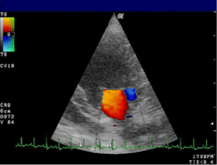
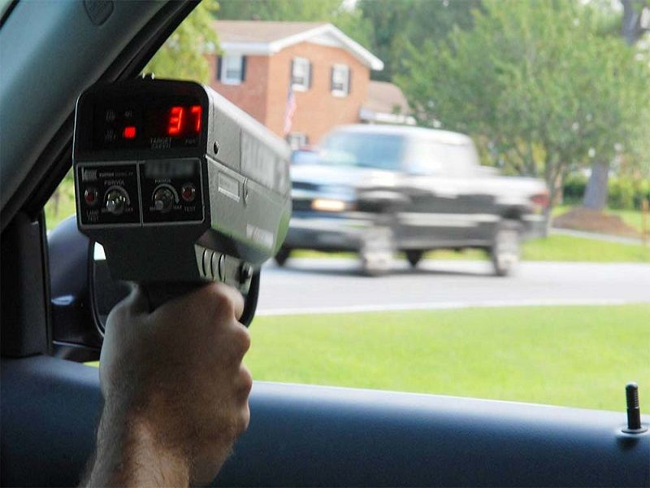
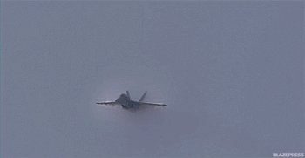
Everyday Doppler effect examples.
Police speed guns.
Doppler echocardiogram
Sonic Boom
Notes:
The doppler effect is an everyday occurrence. There are everyday examples of this effect such as, police speed guns, doppler endocardium and the sonic boom.

Slide 11
Frequency of waves from a moving source.
f’ - Observed frequency
f - Actual frequency
u - Speed of the source
c - Speed of waves in the medium
Source moving towards observer:
f’ = $\frac{fc}{c−u }$
Source moving away from observer:
f’ = $\frac{fc}{c+u }$
Notes:
We can use a simple formula to find the frequency of waves from a moving source. This formula can be manipulated to find the frequency of a source moving towards an observer and finding the frequency of a source moving away from an observer.
The quantities involved in this formula are:
f’ - Observed frequency
f - Actual frequency
u - Speed of the source
c - Speed of waves in the medium.
The formula is as follows:
Source moving towards observer:
f’ = $\frac{fc}{c−u }$
Source moving away from observer:
f’ = $\frac{fc}{c+u }$

Slide 12
Image Sources
https://homework.study.com/explanation/the-wavelength-of-a-stationary-wave-is-36-0cm-what-is-the-distance-between-a-node-and-the-next-antinode.html
https://stickmanphysics.com/stickman-physics-home/unit-10-waves/doppler-effect/
https://www.microcontrollertips.com/the-doppler-effect-from-highly-ridiculed-to-absolutely-indispensable-part-1/
https://study.com/learn/lesson/red-shift-theory-explanation.html
https://studiousguy.com/doppler-effect-examples/

Slide 13
Contact Details
Register for on-line CPD resources: https://epistem.ie
EPI•STEM project: Resources
Contact: Helen Fitzgerald, Senior Executive Administrator
Email: helen.fitzgerald@ul.ie
This on-line CPD project [HEA funded] is an initiative with EPI•STEM for science and mathematics secondary teachers in Ireland. The research-led development team include:
Geraldine Mooney Simmie, Niamh O’Meara, Merrilyn Goos, Stephen Comiskey, Ciara Lane, Tracey O’Connell, Vo Van De, Tara Ryan, Martina Scully, Jack Nealon, Daniel Casey, Keith Kennedy, Annette Forster, Céren O’Connell, Martha Cosgrave, Veronica Ryan, Gemma Henstock

