Slide 1
Waves Suitable for Leaving Certificate Physics
NARRATOR: Martha Cosgrave, EPI•STEM, University of Limerick
THIS IS A HEA FUNDED CPD PROJECT WITH EPI•STEM:

Slide 3
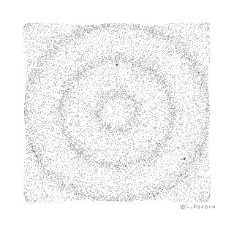
Wave Phenomena
The different types of waves have different properties in common.
Properties:
Reflection
Refraction
Diffraction
Interference
Polarisation
Notes:
When we look at waves from a physics perspective we look at certain properties they have in common.
These properties are reflection, refraction, diffraction, interference and polarisation.

Slide 4
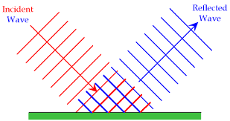
Reflection
Reflection is the bouncing of waves off of an obstacle in their path.
Example:
Light waves from a mirror.
An echo is sound waves being reflected from a building.
When parallel waves or plane waves strike a flat obstacle they reflect back at the same angle
Notes:
Reflection is the bouncing of waves off of an obstacle in their path.
Example:
Light waves from a mirror.
An echo is sound waves being reflected from a building.
When parallel waves or plane waves strike a flat obstacle they reflect back at the same angle.
This is an opportunity to ask students for example of reflection which they have heard of. The important aspect of this is the angle at which the reflection occurs.

Slide 5
Waves change speed
When waves travel from one medium to another they change speed.
Although the velocity of the wave changes the frequency of the waves remains the same.
As we know:
c = f λ
As the waves velocity increases the wavelength increases.
As the waves velocity decreases the wavelength decreases.
Notes:
As waves travel from one medium to another the speed of the wave can change. The velocity of the wave changes however the frequency of the wave remain the same. If we refer back to the formula for wave velocity we have already encountered c = f λ . We can same that as the waves velocity increases the wavelength increases and as the waves velocity decreases the wavelength decreases.

Slide 6
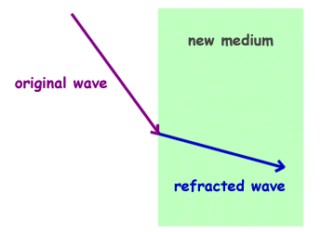
Refraction
Refraction of waves is the changing direction of a wave when it enters a region where its speed changes.
The frequency of the wave does not change!!
Simulation here
Notes:
Refraction of waves is the changing direction of a wave when it enters a region where its speed changes. The waves changes direction as it moves into the different medium. As the wave enters a slower medium the speed of the wave decreases.
The frequency of the wave does not change!!

Slide 7
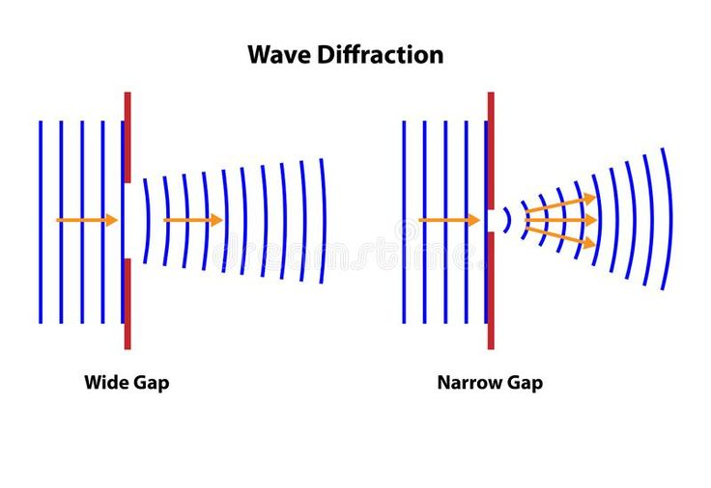
Diffraction
Diffraction is the sideways spreading of waves into the region beyond a gap or around an obstacle.
Occurs for sound waves, this is why we can hear around corners.
Notes:
The definition of diffraction is the sideways spreading of waves into the region beyond a gap or around and obstacle. This is most noticeable if the obstacle in the path of the wave is small relative to the wavelength of the wave involved. The phenomenon of diffraction occurs for sound waves and this is what explains us hearing around corners.

Slide 8
Interference
Interference of waves is when waves from two sources meet, a new wave is produced. The displacement produced at any point by this wave is the algebraic sum of the displacements that each wave would produce on its own.
All wave types will undergo interference.
Notes:
Interference of waves is when waves from two sources meet, a new wave is produced. The displacement produced at any point by this wave is the algebraic sum of the displacements that each wave would produce on its own.
All wave types will undergo interference.
We can sub categorises interference into constructive interference and destructive interference.

Slide 9
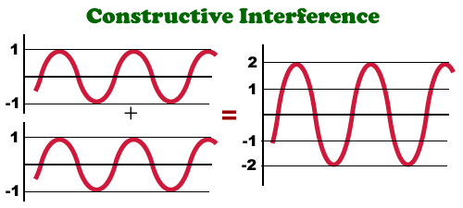
Constructive interference
When waves from two sources meet and the amplitude if the resulting wave is greater than the amplitude of the amplitudes of the individual waves.
Notes:
Constructive interference occurs when waves from two sources meet and the amplitude if the resulting wave is greater than the amplitude of the amplitudes of the individual waves. The original waves are said to be in phase with each other.

Slide 10
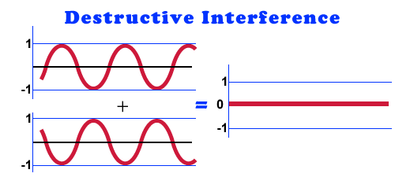
Destructive interference
When waves from two sources meet and the amplitude of the resulting wave is less than the amplitude of each of the individual waves.
Notes:
Destructive interference occurs when waves from two sources meet and the amplitude of the resulting wave is less than the amplitude of each of the individual waves. This can result in the wave being cancelled out.
Waves that arrive out of step with each other are said to be completely out of phase. When these waves occur one wave is set to be one half wavelength ahead of the other.

Slide 11
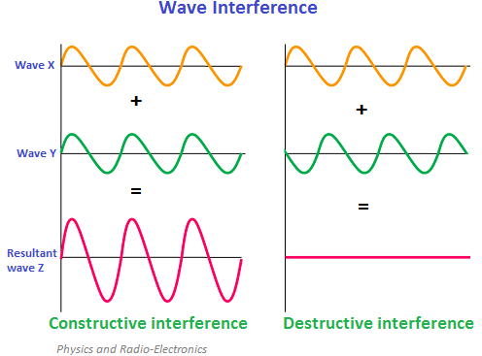
Interference
YouTube links:
Constructive interference
Destructive interference
Notes:
This slide provides two YouTube links which depict both constructive interferences and destructive interference.

Slide 12
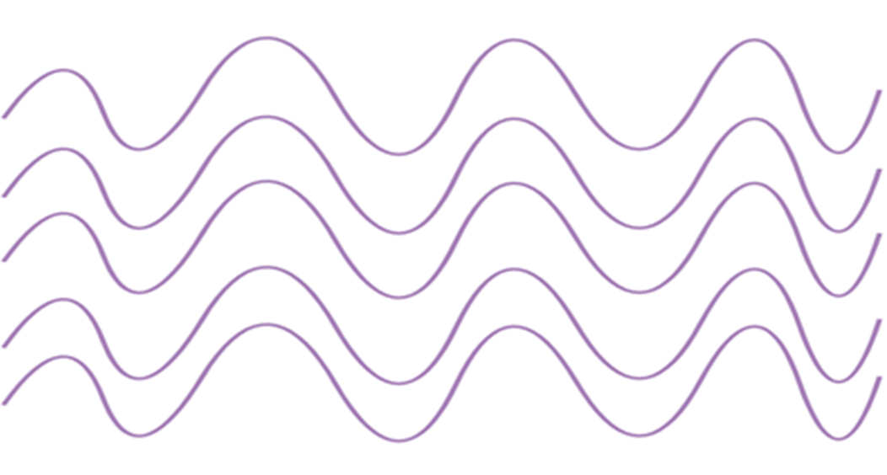
Interference
Sources are said to be coherent when two sources of periodic waves are in phase or if there is a constant phase difference between waves for each of the sources. If this is so the sources must also have the same frequency.
Notes:
Sources are said to be coherent when two sources of periodic waves are in phase or if there is a constant phase difference between waves for each of the sources. If this is so the sources must also have the same frequency.

Slide 13
Interference.
Notes:
Interference patterns from two point sources cause both constructive interference and destructive interference.
Constructive interference: The crest from one source always meets they crest from another. This means that the trough of the same waves meet. Constructive interference occurs along these lines and they are known as antinodal lines.
Destructive interference occurs when the crest from one wave meets the trough from another. At these points the water remains undisturbed. These lines are called nodal lines.

Slide 14
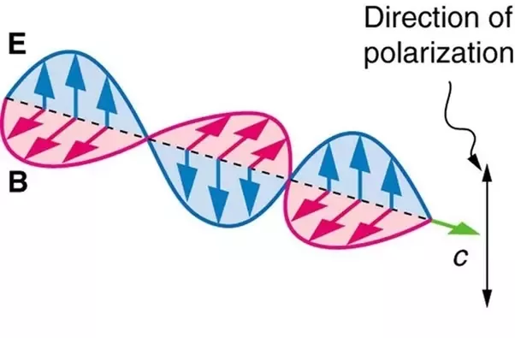
Polarisation
Only transverse waves can be polarised.
Polarisation of a wave can only occur when the wave is vibrating on one plane only.
Horizontal plane
Vertical plane
Simulation
Notes:
Only transverse waves can be polarised.
Polarisation of a wave can only occur when the wave is vibrating on one plane only.
This can be either the Horizontal plane or the Vertical plane
The displacement of a transverse wave can be in any direction in the plane that is perpendicular to the propagation direction. If the displacements of a transverse wave are restricted to one line, then we say it is (linearly) polarised.

Slide 15
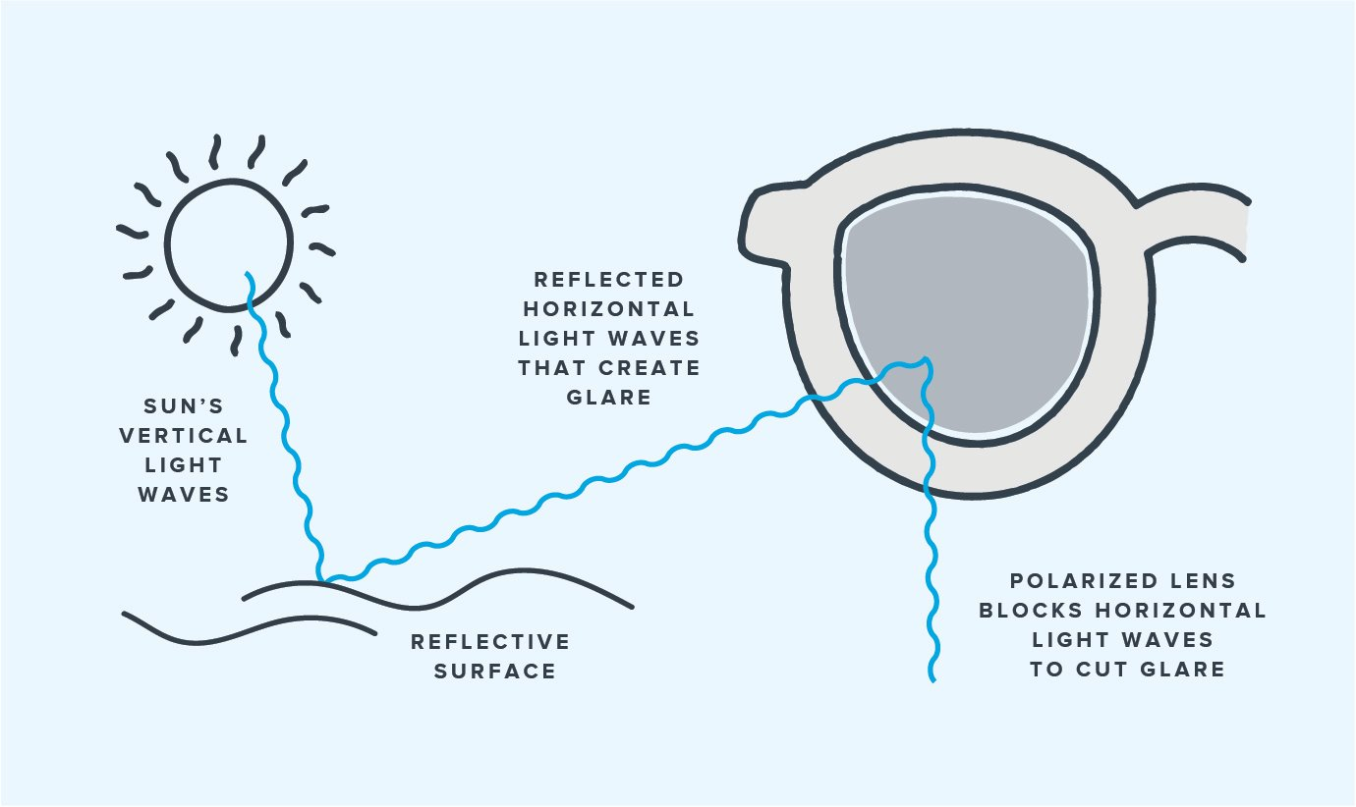
How Polaroid sunglasses work.
YouTube clip.
Notes:
Polarized lenses mitigate glare by using a chemical film either applied to or embedded in the lenses. The chemical filter on polarized sunglasses removes glare by absorbing the incoming horizontal light, while still allowing vertical light. What we perceived as glare is usually reflected horizontal light.
This slide provides a YouTube link that explains how polarisation occurs and is used in sunglasses.

Slide 16
References
Constructive and destructive interference http://sdsu-physics.org/physics180/physics180B/Topics/light/phys180Bch24.html
Refraction https://www.ducksters.com/science/physics/wave_behavior.php
Antinodal and nodal lines http://fizik-fizik.blogspot.com/2010/01/nodes-and-antinodes.html
Polaroid sunglasses https://www.warbyparker.com/learn/polarized-vs-non-polarized-sunglasses

Slide 17
Contact Details
Register for on-line CPD resources: https://epistem.ie
EPI•STEM project: Resources
Contact: Helen Fitzgerald, Senior Executive Administrator
Email: helen.fitzgerald@ul.ie
This on-line CPD project [HEA funded] is an initiative with EPI•STEM for science and mathematics secondary teachers in Ireland. The research-led development team include:
Geraldine Mooney Simmie, Niamh O’Meara, Merrilyn Goos, Stephen Comiskey, Ciara Lane, Tracey O’Connell, Vo Van De, Tara Ryan, Martina Scully, Jack Nealon, Daniel Casey, Keith Kennedy, Annette Forster, Céren O’Connell, Martha Cosgrave, Veronica Ryan, Gemma Henstock

