Slide 1
How do our Bodies Fight Viruses? Suitable for Senior Cycle Biology
NARRATOR: Tara Ryan, EPI•STEM, University of Limerick
THIS IS A HEA FUNDED CPD PROJECT WITH EPI•STEM:

Slide 2
Overview of Topics
How do our Bodies Fight Viruses?
How do Phagocytes Work?
Immunity to Viruses
Autoimmune Diseases
How does a Vaccine Work?

Slide 3
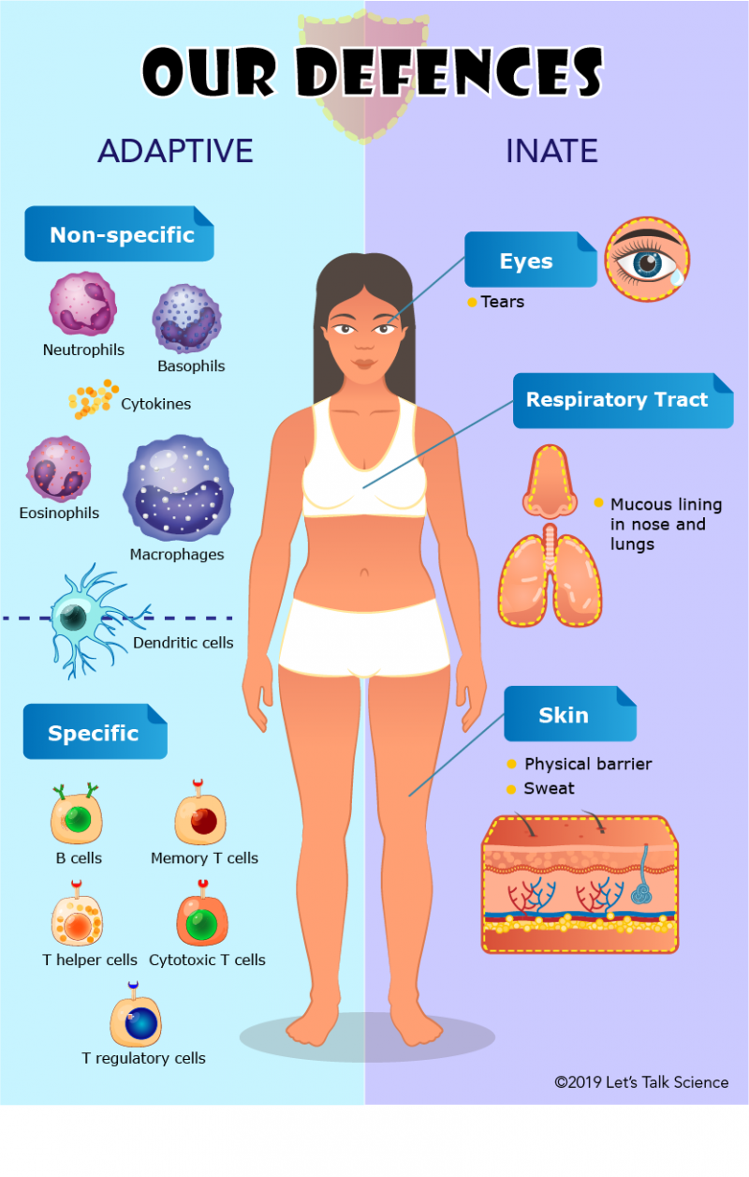
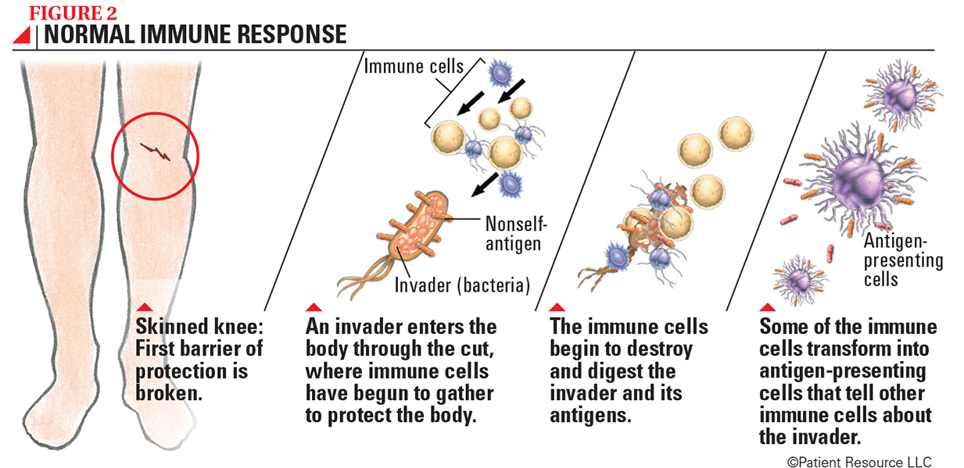
How do our Bodies Fight Viruses?
Notes:
The human defense system protects the body from bacteria, fungi, and viruses that cause disease. A pathogen is an organism that causes disease. Immunity is the ability resist infection. The human defense system is composed of the general and specific defense system.
The general defense system is non-specific, meaning that it will fight against all pathogens. The general defense system consists of skin and mucous membranes to prevent the entry of pathogens, and white blood cells to destroy any cells that have already penetrated the body.
The specific defense system, also called the immune system, attacks a particular pathogen by producing antibodies or killing the infected cell. An antigen is a foreign molecule that stimulates the production of antibodies. An antibody is a protein produced by a type of white blood cells called lymphocytes in response to an antigen.

Slide 4
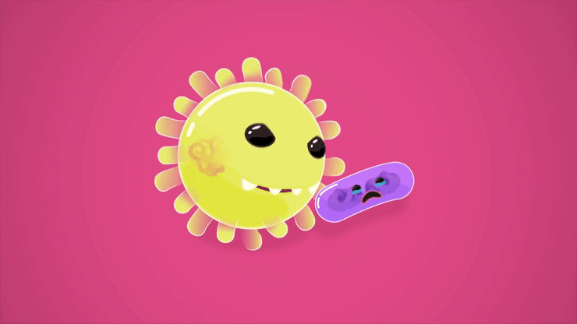
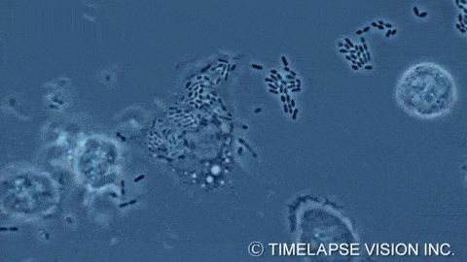
How do Phagocytes Work?
Notes:
White blood cells, or phagocytes, surround and attack pathogens that have entered the body.
A collection of proteins called complement is present in plasma. The activation of complement by an infection results in the rupture of bacterial cell walls.
Another group of proteins are interferons. They are created by bodily cells that have contracted viral infections. Interferons stop viruses from multiplying.
Heat, redness, and swelling around the infection site are signs of inflammation. As a result, there are more white blood cells in the infected region. It is called a fever if the body is experiencing widespread inflammation.

Slide 5
Immunity to Viruses
Notes:
Immunity is the ability to resist infection. The different types of immunity are as follows.
Induced immunity is the ability to resist disease caused by a specific pathogen by the production of antibodies. This can be achieved two ways.
The first is active immunity, which involves the production of a person's own antibodies in response to antigens that enter the body. Active immunity occurs either naturally after a person has already gotten sick, or artificially when a pathogen is medically induced into the body in the form of a vaccine.
Immunity can also be achieved passively. Passive immunity occurs when a person is given antibodies that were formed by another organism.
This can also occur naturally when a child receives antibodies from its mother, or artificially when a person is given an injection containing antibodies made by another organism.

Slide 6
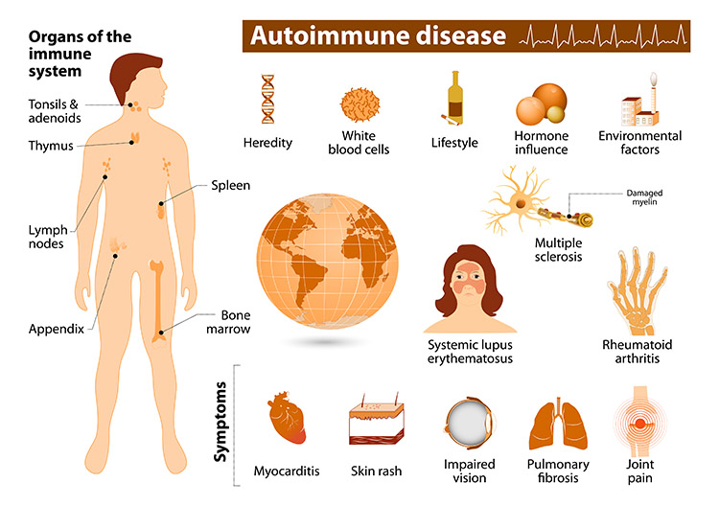
Autoimmune Diseases
Notes:
An autoimmune disease is a condition in which your immune system attacks your body.
The immune system usually guards against bacteria and viruses. When it senses these foreign invaders, it sends out an army of fighter cells to attack them.
Usually, the immune system can tell the difference between foreign cells and your own cells.
In an autoimmune disease, the immune system mistakes part of your body, like your joints or skin, as foreign. It releases proteins called autoantibodies that attack healthy cells. This makes it even more difficult for a person's body to fight actual foreign cells like viruses.
Some autoimmune diseases target only one organ. Type 1 diabetes damages the pancreas. Other diseases, like lupus, can affect the whole body.
1. Type 1 diabetes
The pancreas produces the hormone insulin, which helps regulate blood sugar levels. In type 1 diabetes mellitus, the immune system attacks and destroys insulin-producing cells in the pancreas.
High blood sugar results can damage the blood vessels and organs, including the heart, kidneys, eyes, and nerves.
2. Rheumatoid arthritis (RA)
In rheumatoid arthritis (RA), the immune system attacks the joints. This attack causes redness, warmth, soreness, and stiffness in the joints.

Slide 7
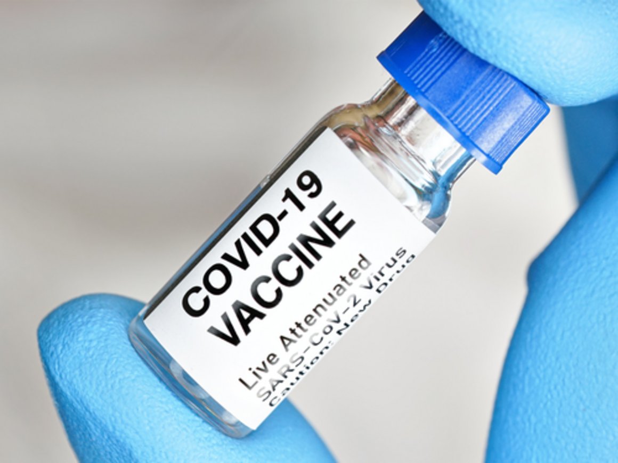
How does a Vaccine Work?
Notes:
A vaccine is a non-disease-causing dose of a pathogen or its toxin, which triggers the production of antibodies.
A vaccine may contain pathogens that have been killed or rendered incapable of reproducing. In certain instances, the pathogen's exterior wall or coat is all that is required because it contains the antigens that make antibodies.
A vaccination induces the production of antibodies without causing the recipient to experience all of the infection's symptoms. Long-term immunity is provided by the body's ability to produce these antibodies. To improve the impact of the initial treatment, booster immunizations may be advised.

Slide 8
Bibliography
https://gifs.com/gif/bacterial-phagocytosis-by-macrophage-m2Vabq
https://gfycat.com/lawfulpitifuljavalina
https://www.news-medical.net/life-sciences/What-is-the-difference-Between-a-Phagocyte-Macrophage-Neutrophil-and-Eosinophil.aspx
https://www.khanacademy.org/test-prep/mcat/organ-systems/the-immune-system/a/innate-immunity
https://www.natgeokids.com/ie/discover/science/general-science/what-is-coronavirus/​
https://www.youtube.com/watch?v=MVvVTDhGqaA​
https://stock.adobe.com/ie/search?k=cough+cartoon ​
https://www.shutterstock.com/image-vector/loss-sense-smell-woman-does-not-2049737765​
https://www.alamy.com/covid-19-virus-protection-tips-corona-virus-alert-prevention-icons-set-of-illustration-in-cartoon-style-image424822582.html​
https://www2.hse.ie/screening-and-vaccinations/covid-19-vaccine/get-the-vaccine/how-covid-19-vaccines-work/​
https://www.niehs.nih.gov/health/topics/conditions/autoimmune/index.cfm​
https://www.healthline.com/health/autoimmune-disorders#common-autoimmune-diseases​
https://slideplayer.com/slide/3861947/​
http://leavingbio.net/human-defence-system/ ​
https://www.sitcancer.org/connectedold/p/patient/resources/melanoma-guide/immune-system

Slide 9
Contact Details
Register for on-line CPD resources: https://epistem.ie
EPI•STEM project: Resources
Contact: Helen Fitzgerald, Senior Executive Administrator
Email: helen.fitzgerald@ul.ie
This on-line CPD project [HEA funded] is an initiative with EPI•STEM for science and mathematics secondary teachers in Ireland. The research-led development team include:
Geraldine Mooney Simmie, Niamh O’Meara, Merrilyn Goos, Stephen Comiskey, Ciara Lane, Tracey O’Connell, Vo Van De, Tara E. Ryan, Martina Scully, Jack Nealon, Daniel Casey, Keith Kennedy, Annette Forster, Céren O’Connell, Martha Cosgrave, Martina Ryan, Veronica Ryan, Gemma Henstock

