Slide 1
Virus Exam Questions Suitable for Senior Cycle Biology
NARRATOR: Tara Ryan, EPI•STEM, University of Limerick
THIS IS A HEA FUNDED CPD PROJECT WITH EPI•STEM:

Slide 2
List of Exam Questions
Higher Level
2017 | 2015 | 2013 | 2010 | 2008 | 2007 | 2005 | 2002 | 2001
14 a,b | 3 | 12a | 6 | 15b | 14b | 15a | 14c | 11a
Ordinary Level
2021 | 2019 | 2016 | 2011 | 2009 | 2002
5 | 14a | 15b | 15c | 12c | 10c
Notes:
Provided here are lists of exam questions for both higher and ordinary levels.

Slide 3
Overview of Topics
Higher Level
Ordinary Level
Exam Question
Exam Question

Slide 4
2017 Q14 a) HL
Notes:
Shown here is question 14 a) taken from the 2017 higher level exam.

Slide 5
(i) Pregnant Women Advised Against
Notes:
The first part of the question asks students why the world health organisation advised pregnant women against travelling to areas where the Zika virus outbreaks were occurring.
Any time there is a passage of text before a question, we would advise students to read it, as it is usually helpful when answering the questions below.
The paragraph above informs students that there may be a potential link between a zika virus infection and cases in microcephaly, which is a condition that causes babies heads to be small.

Slide 6
(ii) 2 Precautions to Prevent Zika Transmission
Examples of Answers
Protect against mosquito bites: Nets Protective clothing Repellent spray
Avoid being outside when mosquitos are most prevalent: Early morning Late afternoon/ evening
Prevent pregnancy: Use contraception Avoid sex
Notes:
The student was then asked to give 2 precautions that could be taken to avoid the transmission of zika virus.
Some examples are:
Protect against mosquito bites using nets, clothing or repellent spray.
Avoid being outside when mosquitos are most prevalent, such as early morning or evening time.
Or prevent conception by using contraception or by avoiding sex.

Slide 7
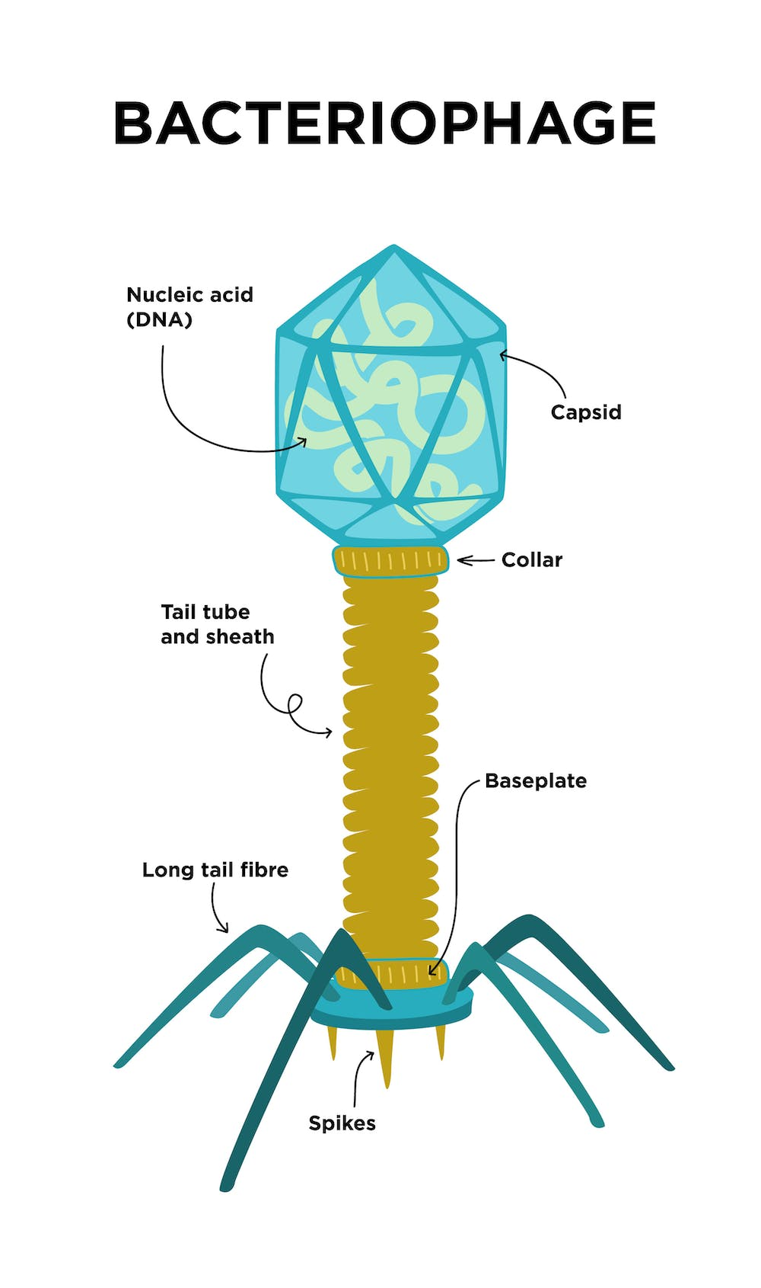
(iii) Example of Beneficial Virus
Bacteriophages
Kill bacteria.
Used to treat tumours.
Vectors: Gene therapy Genetic engineering
Notes:
The third part of the question asks students to give an example of a virus that can be beneficial. Students could have chosen any relevant virus.
The example we selected was bacteriophages, as they can be used to kill bacteria, treat tumours, or as vectors in gene therapy and genetic engineering.

Slide 8
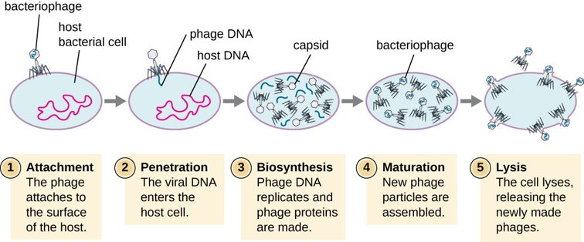
(iv) How do Viruses Replicate?
Notes:
A virus will go through five stages during its life cycle. ​
​
Shown here, is a bacteriophage first attaching to the surface of the host cell. ​
The long phage tails will then penetrate the host cell and inject it with its own DNA. ​
During biosynthesis, the phage DNA replicates within the host cell and will then consume the host cell's DNA and reassemble during maturation. Finally, the host cell will burst during lysis and the newly made phages are released to repeat the process all over again.

Slide 9
(v) Reasons why Virus are Not Considered Living
Examples of Answers
Cannot reproduce independently Obligate parasites Need host to replicate
Non cellular No cell organelles
No metabolism
Only 1 type of nucleic acid

Slide 10
2017 Q14 b) HL
Notes:
Part b of the same question is also related to viruses.

Slide 11
(i) High Risk People if Exposed to Measles
Examples of Answers
Weak immune systems.
Unvaccinated.
Babies.
Notes:
Firstly, the student is ask to give some examples of people most at risk if they were exposed to measles. They could have said those with weak immune systems, the unvaccinated, or babies.

Slide 12
(ii) Explain Vaccines
Define Vaccines | How it Provides Immunity
A non-disease-causing dose of a pathogen (or antigen). | The introduction of the antigen stimulates the bodies production of antibodies.
Notes:
Secondly, students are asked to define vaccines and explain how they function.
A vaccine is a non-disease causing dose of a pathogen or antigen.
It provides immunity to the recipient by introducing the antigen, which stimulates the body to produce antibodies.

Slide 13
(iii) & (iv) Types & Role of T Lymphocyte Cells
Type of T Lymphocyte Cell | Role
Helper | Recognise antigens or activate killer cells or secrete interferon or stimulate B- cells or stimulate antibody production.
Killer | Recognise (or attack or burst) infected cells (or cancer or antigen) or secrete perforin.
Suppressor | s Stop immune response or inhibit B (or T) cell (production).
Memory | Remember antigens or long-term protection.
Notes:
Finally, the last 2 parts asked the student to list any 3 types of T Lymphocyte cells and describe their role.

Slide 14
Overview of Topics
Higher Level
Ordinary Level
Exam Question
Exam Question

Slide 15
2021 Q5 OL
Notes:
Next, we will look at an ordinary level paper from 2021 and examine Q5.

Slide 16
(a) Why are Viruses Not Considered Living?
Examples of Answers
Cannot reproduce independently Obligate parasites Need host to replicate
Non cellular No cell organelles
No metabolism
Only 1 type of nucleic acid

Slide 17
(b) Label the Diagram
Label | Part of Virus
A | Protein/ Capsid
B | DNA/ RNA/ Nucleic Acid
Notes:
The second part of the question asks the student to identify the labels on the diagram.
Component A is a protein or capsid
And part B is DNA/ RNA/ Nucleic acid.

Slide 18
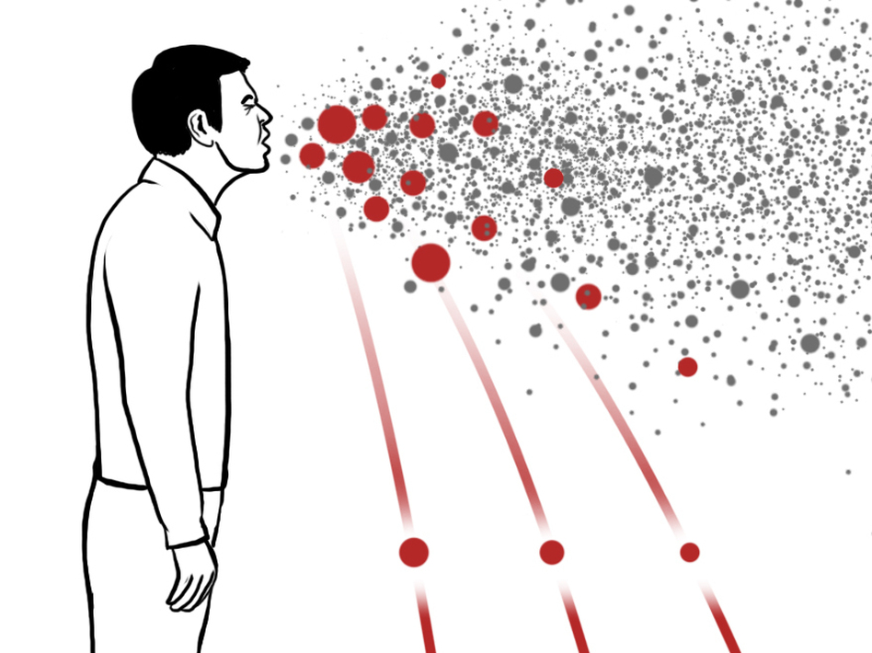
(c) Describe 1 Way Viruses Can Spread
Examples of Answers
Coughing.
Sneezing.
Touching contaminated surfaces.
Shaking hands with an infected person.
Notes:
Coughing or sneezing or droplets through the air or shaking hands or touching contaminated surfaces

Slide 19
(d) State 1 Way Body can Defend Itself
Barrier System | Immune System
Skin | White blood cells
Mucus | Antibodies

Slide 20
(e) Example of Beneficial Virus
Bacteriophages
Kill bacteria.
Used to treat tumours.
Vectors: Gene therapy Genetic engineering
Notes:
Part E of the question asks students to give an example of a virus that can be beneficial. Students could have chosen any relevant virus.
The example we selected was bacteriophages, as they can be used to kill bacteria, treat tumours, or as vectors in gene therepy and genetic engineering.

Slide 21
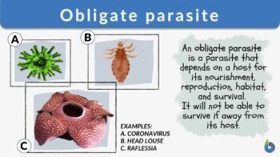
(f) Viruses are Obligate Parasites
Notes:
Finally, the student is asked to explain why viruses are described as being obligate parasites. Viruses are only able to replicate in a living host cell.

Slide 22
Overview of Topics
Higher Level
Ordinary Level
Exam Question
Exam Question

Slide 23
Bibliography
https://www.examinations.ie/exammaterialarchive/
https://theconversation.com/viruses-are-both-the-villains-and-heroes-of-life-as-we-know-it-169131
https://www.npr.org/sections/goatsandsoda/2014/12/01/364749313/ebola-in-the-air-what-science-says-about-how-the-virus-spreads
https://www.pfizer.com/news/articles/how_the_immune_system_protects_you_from_infection
https://www.biologyonline.com/dictionary/obligate-parasite

Slide 24
Contact Details
Register for on-line CPD resources: https://epistem.ie
EPI•STEM project: Resources
Contact: Helen Fitzgerald, Senior Executive Administrator
Email: helen.fitzgerald@ul.ie
This on-line CPD project [HEA funded] is an initiative with EPI•STEM for science and mathematics secondary teachers in Ireland. The research-led development team include:
Geraldine Mooney Simmie, Niamh O’Meara, Merrilyn Goos, Stephen Comiskey, Ciara Lane, Tracey O’Connell, Vo Van De, Tara E. Ryan, Martina Scully, Jack Nealon, Daniel Casey, Keith Kennedy, Annette Forster, Céren O’Connell, Martha Cosgrave, Martina Ryan, Veronica Ryan, Gemma Henstock

