Slide 1
Sound Suitable for Leaving Certificate Physics
NARRATOR: Marth Cosgrave, EPI•STEM, University of Limerick
THIS IS A HEA FUNDED CPD PROJECT WITH EPI•STEM:

Slide 3
What do we already know?
Sound comes from the vibration of an object.
Sound travels in waves.
Frequency is the number of cycles per second.
Unit for Frequency is Hertz.

Slide 4
Familiar Terms
Frequency
Wavelength
Amplitude
Reflection
Refraction
Diffraction
Interference
Compression
Rarefaction
Longitudinal waves
Transverse waves
Medium
Notes:
Students should be familiar with theses terms from the introduction to waves and wave phenomena. A refresher of these terms can be useful for students to identify the links between their past learning and future learning. A kahoot quiz could be used for this activity and can boost engagement.

Slide 5
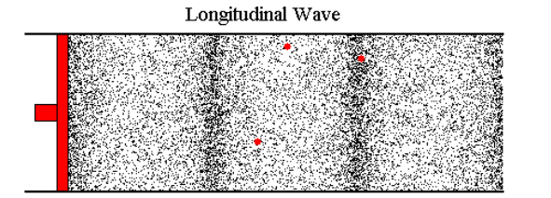
Sound is a Wave
As we know sound travels through a medium as waves.
Therefore sound can undergo:
Reflection
Refraction
Diffraction
Interference
Notes:
As sound travels in waves we can then refer back to the Wave phenomena which students would have previously encountered. Sound waves are longitudinal. Because sound waves are longitudinal waves polarisation does not apply.
Everyday examples of these waves phenomena can be seen across these headings.
Reflection of waves can be heard through an echo where sound waves reflect off a surface.
Refraction of sound waves occurs when the sound wave move from one medium to another and the speed of the wave changes. An example of this is when you go underwater and hear different sounds.
Diffraction of sound occurs when the sound wave reaches an obstacle. Such as a doorway or open window. This particular wave phenomena allows us to hear around corners.
Interference of sound waves occurs because sound is a wave of motion. Noise cancelling headphones work on the principle of destructive interference where the headphone detect the unwanted sounds around you and then emit a sound waves that destructively interferes with that sound wave.

Slide 6
Vibrating objects produce sound
The vibration of the object causes the molecules within the medium to vibrate.
The vibration of molecules causes compression and rarefaction.
Notes:
As we have previously discussed when an object vibrates it causes the molecules within a medium to vibrate. This vibration causes a series of evenly spaced compression and rarefaction as the vibration moves out along the molecules. Once the vibrations occur close to the ear it causes the eardrum to vibrate. The eardrum vibrates at the same frequency as the molecules in the medium. This results in us hearing a sound.
The frequency of a sound wave is the same as that of the vibrating source which produces the wave.

Slide 7
Experiment To show the interference of sound.
Notes:
This mandatory experiment shows the interference of sound and that sound is a wave of motion .
The signal generator is attached to two loud speakers. Once the apparatus is set up the signal generator can be turned on.
Ask the students to walk from A to B slowly. The students should note that the loudness of the sound increases and decreases as they move.
The sound waves from each source produces both constructive and destructive interference between A and B.
This interference is evidence that sound is a wave.
Students could be asked to interpret the results of this before the teacher gives explanation. We could ask the students to draw what we think happens and how the waves are behaving.

Slide 8
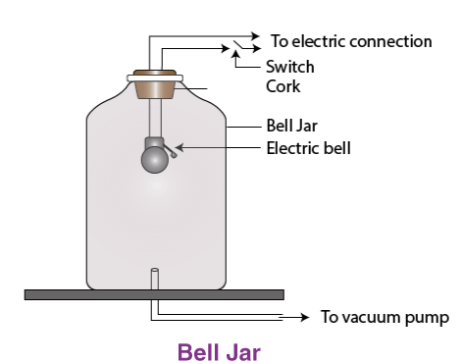
Sound needs a medium.
Sound is produced by vibrations moving from molecule to molecule.
Therefore sound requires a medium which it can pass through.
How can we prove this?
Notes:
As we know already sound is produced by vibrations moving from molecule to molecule. We therefore say that sound requires a medium to travel through.
If we pose the question to our students. How can we prove this? Can you think of anyway that we could do this? F
Give the students time to brainstorm as a group and identify a method of proving this theory.
An interactive whiteboard or menti meter can be used to get the students idea.
So how can we prove this??
A bell jar can be used to show that sound requires a medium to pass through.
If we set up the apparatus shown on the slide. Start to ring the bell.
As the vacuum removes the air from the bell jar the volume of the sound decreases until the sound is barely audible. Once the air is allowed back into the jar the sound increases.

Slide 9
Speed of sound.
The speed of sound is dependent on the medium in which the sound is travelling in.
The medium differ in density and elasticity.
Temperature also effects the speed at which sound travels.
Medium | Speed (ms⁻¹)
Air (0⁰C) | 331
Helium | 970
Pure water | 1493
Sea water | 1533
Aluminium | 5100
Notes:
The speed of sound is dependent on the medium in which the sound is travelling in.
The medium differ in density and elasticity. In general it is said that the higher the density of the medium the fast the sound travels.
As temperature increases so does the speed of the sound travelling through the medium. The temperature can also cause refraction of the sound waves. For example on a warm day the air near the ground is warmer than the air higher up. This means that the sound travels faster near the ground which causes the sound waves to be refracted upwards. At night as the air temperature nearer to the ground cools the sound waves are refracted downwards. Therefore we can say that the sounds can be heard clearer on a cold night than on a warm day.

Slide 10
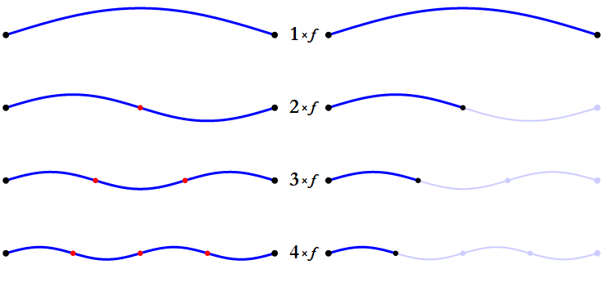
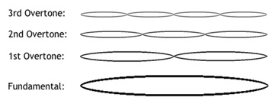
Overtones
Overtones are frequencies which are multiples of a certain frequency.
If f is a given frequency then:
2f is its first overtone
3f is its second overtone
Notes:
A vibrating object can give out a sound with a frequency (f) however this object can also give out frequencies of which are multiples of that frequency. These frequencies are know as overtones. The original frequency is know as the fundamental frequency or f. The frequency 2f is the first overtone, the frequency 3f is the second overtone. And this continues on.

Slide 11
Characteristics of Notes
A note has 3 main characteristics.
Loudness
Pitch
Quality
Notes:
A note has three main characteristics, these are loudness, pitch and quality.
The loudness of a sound depends on the amplitude of the sounds wave. The greater the amplitude the greater the loudness.
The pitch of a note us dependent on he frequency of the sound wave. The higher the frequency the higher the pitch and the lower the frequency the lower the pitch.
The quality of a musical note depends on the number of overtones present. In the note and the relative strengths of the different overtones present.

Slide 12
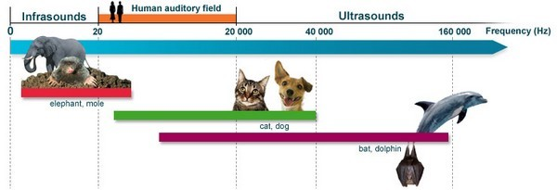
Frequency limits of audibility.
The highest and lowest frequencies that can be heard by a human.
20 Hz to 20,000 Hz. Click here!!!
Notes:
As humans to hear a sound wave it must be in a frequency range of 20Hz to 20,000Hz. These frequencies are called the frequencies of audibility. Most adults cannot hear the whole range as the upper frequency limit decreases with age.
Different animals can hear different frequencies. Dogs, cats, dolphins and bats can hear sound of much higher frequencies. The frequencies above 20,000Hz are ultrasonic frequencies. Elephants can hear lower frequencies than human which are below 20Hz. These frequencies are infrasonic.
On the slide there is a link o a video which plays the frequencies from 20Hz to 20,000 Hz this can be used as an activity to play with the class. Ask all the class to listen to the frequency. As the students hear the frequency they raise their hands. When the students no longer hear the frequency they lower their hands. The teacher can take part. I would be expected that the teacher would stop hearing the sounds before the students.

Slide 13
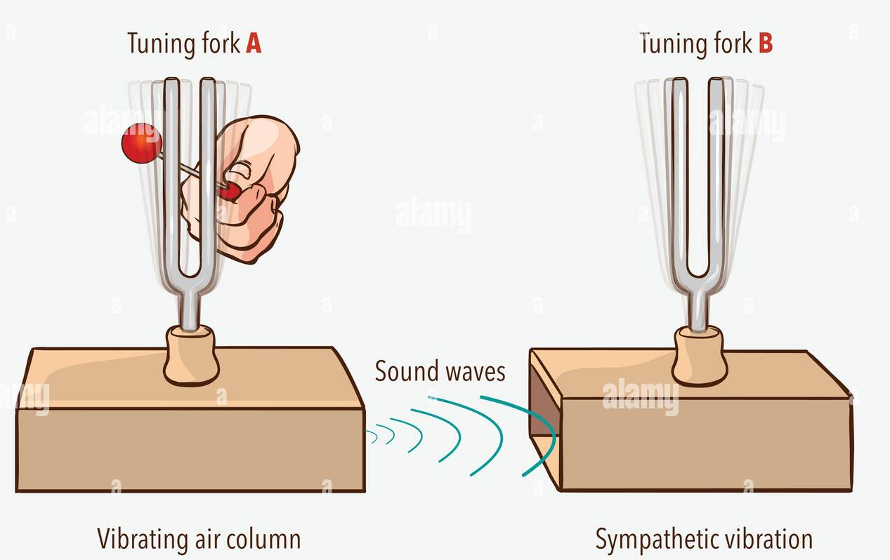
Resonance
Resonance occurs if the frequency of a periodic force applied to a body is the same or very near to its natural frequency that body will vibrate with a very large amplitude.
Link to activity idea!
Notes:
Resonance occurs if the frequency of a periodic force applied to a body is the same or very near to its natural frequency that body will vibrate with a very large amplitude. Resonance can be shown in a simple class demonstration. This can be done by striking a tuning fork causing it to vibrate. If this tuning fork is held close to but not touching another tuning fork of the same frequency it will cause the second to vibrate. This vibration can be heard by stopping the first tuning forks vibration. If this is repeated with tuning forks of different frequencies there will be no vibration.
On this slide there is a link to a pendulum activity that shows another example of resonance.

Slide 14
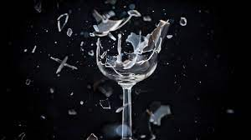
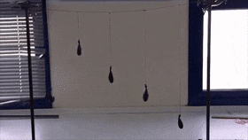
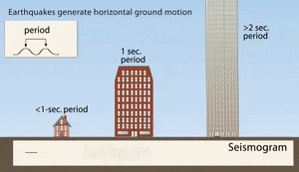
Resonance
Other examples of resonance
Bartons pendulum
Drinking glasses and opera singers
Buildings in an earthquake
Notes:
There are multiple examples of resonance. Another example is known as Bartons pendulum. This pendulum is set up by setting up a number of pendulums. As pendulum 1 is set vibrating then it will be seen that all of the pendulums gain some vibrational energy. The pendulum that is the same length as the pendulum 1 will starts to swing at the same pace as pendulum 1. This is because this pendulum has the same natural frequency as pendulum 1.
Some drinking glasses have the same natural frequency as some high pitched notes. Therefore when an opera singer sings high pitched notes they have been known to shatter glass due to resonance.
Buildings during an earthquake are another example of resonance.

Slide 15
Threshold of Hearing
The threshold of hearing is the minimum sound intensity detectable by the average human at a frequency of 1kHz, its value is x10⁻¹² Wm⁻²
Notes:
The more sound energy which enters your ear the louder the sound will appear. There is a minimum amount of sound energy that must enter you ear per second in order to hear, This minimum amount of sound is called the threshold of hearing.
The definition for the threshold of hearing is the minimum sound intensity detectable by the average human at a frequency of 1kHz, its value is x10⁻¹² Wm⁻²

Slide 16
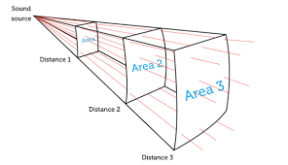
Intensity of sound
The rate at which sound energy is passing through unit area at right angles to the direction in which the sound is travelling at that point.
Sound intensity = $\frac{Power}{Area }$
I = $\frac{P}{A}$ Unit: W m⁻²
Notes:
Sound moves as a mechanical wave. This wave transfers energy from one place to another. The source emits sound in all directions. The further you move away from the source the less sound energy that passes per second through an area of 1m² placed at right angles to the direction at which the sound is travelling.
The definition for sound intensity is The rate at which sound energy is passing through unit area at right angles to the direction in which the sound is travelling at that point. Sound intensity can be found by dividing the power of the sound wave by the area.
The unit for sound intensity is W m⁻² (watt per square meter)

Slide 17
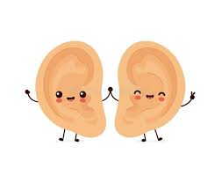
The ears frequency response
The ear is most sensitive to frequencies between 2000Hz and 4000Hz.
Notes:
The ear is most sensitive to frequencies between 2000Hz and 4000Hz. This means that is two sound carrying the same amount of energy per second into our ear at different frequencies wont be heard with equal loudness. This is because our ears are more sensitive to some frequencies than others. Sounds with frequencies between 2000Hz and 4000Hz can resonate in the ear canal.

Slide 18
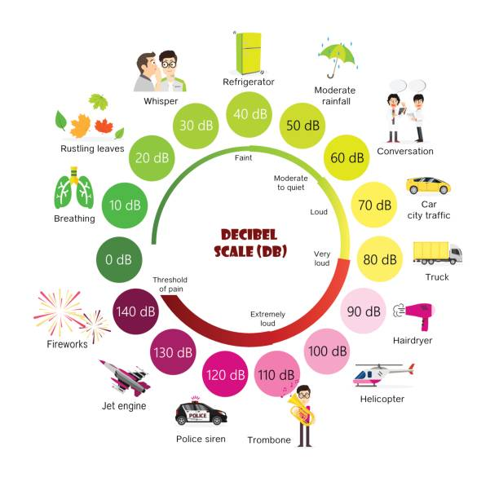
Sound intensity level.
Measured in decibels (dB)
85dB safe threshold
Notes:
The amount of energy that moves per second into the ear varies from small amounts to large amounts. A scale was adapted to measure the varying levels. The reading which are taken from this scale are called sound intensity level. This level is measure in decibels. On the slide the scale is shown. The scales move from faint to the threshold of pain. On this scale a large number of intensities can be represented by a small range of numbers. When sound intensity (W m⁻²) doubles the sound intensity levels increases by 3 dB.

Slide 19
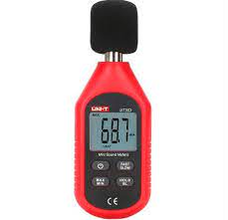
Sound level meter
A sound level meter measures sound intensity level in decibels.
Its scale is called dBA scale.
Notes:
A sound level meter measures the sound intensity in decibels. This meter uses a dBA scale, which is a decibel adapted scale. The Dba scale takes into account the variation in the human ears response to sounds of different frequencies. The meter supresses or ignores frequencies which the human ear is not sensitive to or does not hear. The meter is sensitive to sound which have frequencies between 2 kHz and 4 kHz. The sound meter is comprised of a microphone, amplifier and output meter.

Slide 20
Noise pollution.
Very loud sounds can cause damage to hearing.
Prolonged exposure to not so loud sounds can also cause damage
This source of deafness is incurable.
Prevention of hearing damage is essential!!
Notes:
Noise pollution is the propagation of noise with the ranging impacts on the activity of human or animal life. Very loud sounds can cause damage to hearing. Noise pollution is not just caused by loud sounds. Prolonged exposure to not so loud sounds can also cause damage. Deafness caused by this source is incurable. This is why it is essential to prevent hearing damage.

Slide 21
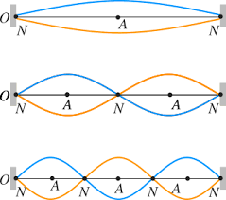
Vibrations on a stretched string.
Familiar terms:
Node
Antinode
New terms:
Mode
Fundamental frequency.
Notes:
When we look at vibrations on a string there are terms that we have already come across with regards to waves. These terms are nodes and antinodes. Now with a stretched string there are new terms mode and fundamental frequency.

Slide 22
Fundamental frequency
A string vibrating with an antinode at its centre and a node at each end (with no other nodes or antinodes)
Fundamental frequency of a string is inversely proportional to its length.
f $∝$ $\frac{1}{l}$
Notes:
A string vibrating with an antinode at its centre and a node at each end (with no other nodes or antinodes) is vibrating at its fundamental frequency.
Fundamental frequency of a string is inversely proportional to its length. The frequency is proportional to 1/l. This means that if we double the length the frequency is halved. If we half the length the frequency is doubles.

Slide 23
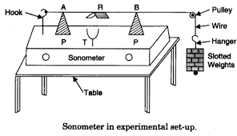
Experiment: To investigate the variation of the fundamental frequency of a stretched string with length.
Equipment needed:
Tuning forks of known frequency.
A sonometer.
A metre stick.
Students must be able to display their results in an appropriate manner.
Frequency f (Hz) | Length l (m) | $$\frac{1}{l}$$ | f x l
Notes:
Start the experiment with the wire as long as possible. Start with the tuning fork with the lowest frequency and strike it on a wooden block. Place the stem of the fork on one of the bridges. Adjust the tension until the wore resonates with the tuning fork. (small paper rider jumps off)
This tension remain constant for the rest of the experiment.
Using a metre stick measure the length (l) of the wire between the tops of the two bridges. Make note of this value and the frequency of the tuning fork.
Using the tuning fork of highest frequency move the bridges closer together until resonance occurs. Measure the length between the bridges, make note of the value and the frequency of the tuning fork.
The step is repeated for all available tuning forks.
Students will have to display their results in an appropriate manner. (A graph should be drawn where f is on the y axis and 1/l is on the x axis.) This graph should yield a straight line proving that f is proportional to 1/l

Slide 24
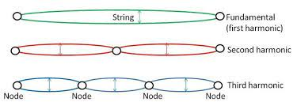
Harmonics on a string
Harmonics are frequencies which are multiples of a certain frequency (f).
The fundamental frequency f is the first harmonic.
2f is the second harmonic.
3f is the third harmonic
Etc……
Notes:
Harmonics are the frequencies which are multiples of a certain frequency. The fundamental frequency is denoted by an italicised f. The fundamental frequency is the first harmonic. f is the first harmonic, 2f is the second harmonic, 3f is the third harmonic etc.

Slide 25
Factors determining fundamental frequency.
Greater the length (l), the lower the fundamental frequency.
Higher the tension (T), the higher the fundamental frequency.
Greater mass per unit length (µ), the lower the fundamental frequency.
Another way to say this is:
f $∝$ $\frac{1}{l}$ T and µ fixed
f$∝\sqrt{T }$ l and µ fixed
f $∝$ $\frac{1}{√\text{µ}}$ T and l fixed
Notes:
There are factors which effect the determination of the fundamental frequency.
Greater the length (l), the lower the fundamental frequency.
Higher the tension (T), the higher the fundamental frequency.
Greater mass per unit length (µ), the lower the fundamental frequency.
We can use formulae to denote this, therefore if:
f $∝$ $\frac{1}{l}$ T and µ fixed
f$∝\sqrt{T }$ l and µ fixed
f $∝$ $\frac{1}{√\text{µ}}$ T and l fixed

Slide 26
Fundamental frequency of a stretched string
f = $\frac{1}{2l}\sqrt{\frac{T}{µ}}$
Quantity | Symbol | Unit
Length | l | Metre (m)
Tension | T | Newton (N)
Mass per unit length | µ | Kilogram per metre (kg m ⁻¹)
Notes:
The fundamental frequency of a stretched string is found by f = $\frac{1}{2l}\sqrt{\frac{T}{µ}}$.
The quantities involve in this are length, tension and mass per unit length. The units for these quantities are metre, newton and kilogram per metre.

Slide 27
Experiment: To investigate the variation of the fundamental frequency of a stretched string with length.
Equipment needed:
Tuning forks of known frequency.
A sonometer.
A metre stick.
Students must be able to display their results in an appropriate manner.
Frequency f (Hz) | Tension T (N) | $$\sqrt{T }$$ | f / $\sqrt{T }$
Notes:
Start the experiment with the wire approximately one third of its maximum length. Start with the tuning fork with the lowest frequency and strike it on a wooden block. Place the stem of the fork on one of the bridges. Adjust the tension until the wire resonates with the tuning fork. (small paper rider jumps off)
This length of wire must remain constant for the rest of the experiment.
Make note of the tension of the wire and the frequency of the tuning fork. If you are using weights the tension is equal to the weight.
This step is repeated for all available tuning forks.
Students will have to display their results in an appropriate manner. (A graph should be drawn where f is on the y axis and $\sqrt{T }$ is on the x axis.) This graph should yield a straight line proving that f is proportional to $\sqrt{T }$.

Slide 28
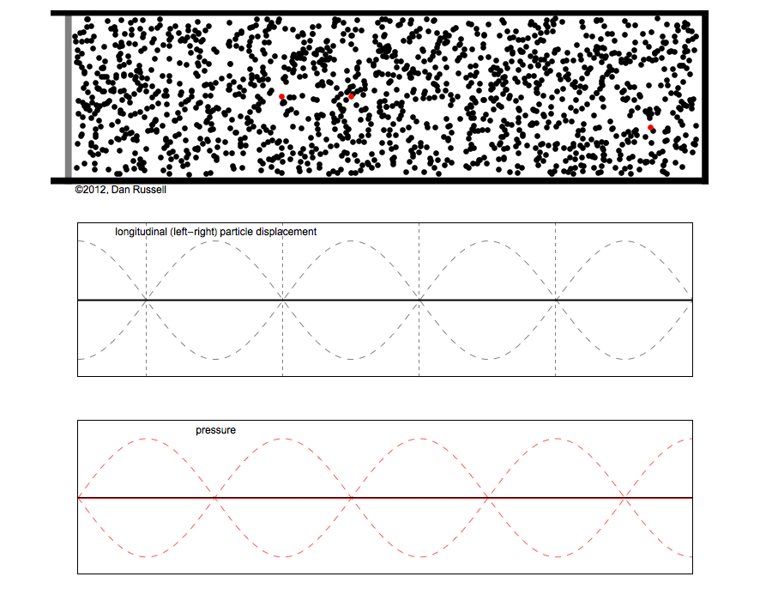
Stationary waves in a pipe closed at one end.
A closed pipe is one which is closed at one end and open at the other.
At certain lengths resonance occurs and a longitudinal stationary wave is set up.
A node occurs at the bottom of the pipe.
An antinode occurs at the top pipe.
This antinode creates a loud sound.
In a stationary wave the distance between a node and an antinode is $\frac{λ}{4}$.
This makes the length of the pipe $\frac{λ}{4}$.
Notes:
A stationary wave will occur in a pipe which is closed at one end. In this type of pipe resonance occurs and a longitudinal stationary wave is set up. In this stationary wave a node occurs at the bottom of the pipe and an antinode occurs at the top of the pipe. It is the antinode that creates the loud sound. In a stationary wave the distance between a node and an antinode is $\frac{λ}{4}$. Therefore, the length of the pipe is the wavelength over 4 ($\frac{λ}{4})$.

Slide 29
Harmonics in a pipe closed at one end.
f₁ = $\frac{c}{λ}$ = $\frac{c}{4l}$
f₁ = $\frac{c}{4l}$
f₂ = $\frac{c}{λ}$ $l=\frac{3λ}{4}$
Thus, f₂ = $\frac{c}{4l/3}$ = $3\left(\frac{c}{4l}\right)$
f₂ = 3 f₁
f₃ = 5 f₁
Notes:
First harmonic f1
Second harmonic f2
It can therefore be noted that in a closed pipe only odd numbered harmonics may be present.

Slide 30
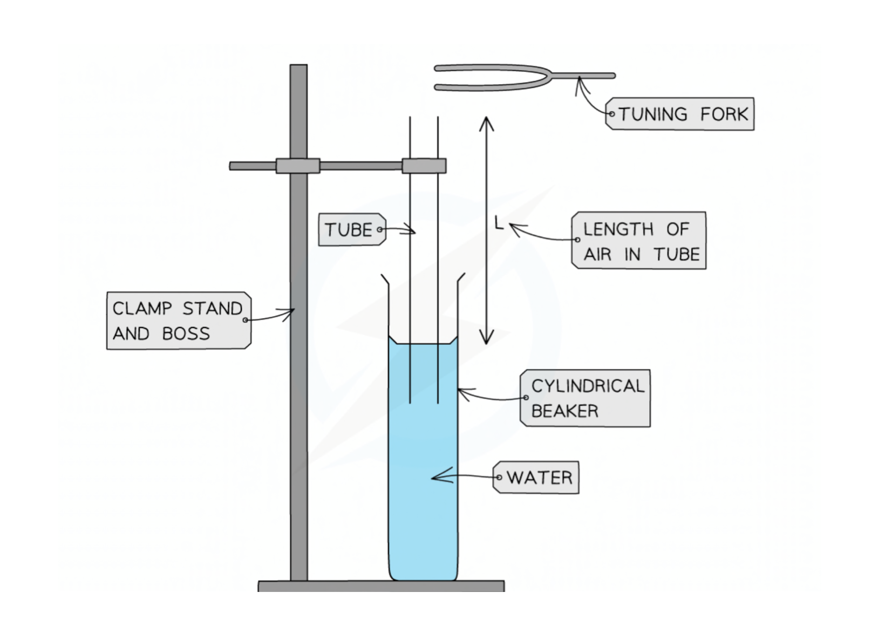
Experiment: To measure the speed of sound in air using a resonance tube
Equipment needed:
Large graduated cylinder
Resonance tubes
Retort stand and clamp
A set of tuning forks.
A metre stick.
Frequency f (Hz) | Resonance length l (m) | c / m s⁻¹ c= 4f (l + 0.3d)
Notes:
Set up apparatus as shown on the slide.
Strike a tuning fork of known frequency and hold it just above the resonance tube. Adjust the length of the tube until the sound is at its loudest.
With the meter stick measure the length l of the air column, this is the distance between the top of the water and the top of the tube. Record the value for l and the frequency of the tuning fork.
With a Vernier calipers measure the internal diameter d of the tube.
The wavelength is calculated as λ = 4(l+0.3d)

Slide 31
Stationary waves in a pipe open at both ends.
All harmonics may be present.
There is an antinode at each end.
Examples:
Flute
Tin whistle
Recorder
Notes:
Stationary waves that occur in a pipe which is open at both ends can contain all types of harmonics. In these wave types there are antinodes present at each end of the pipe. Examples of these waves are in musical instruments like the flute, tin whistle and the recorder.
The first harmonic is the fundamental frequency f and the wavelength is two times the length of the pipe.
The 2nd harmonic is twice the fundamental frequency and the wavelength is the length of the pipe.
The 3rd harmonic is three times the fundamental frequency and the wavelength is the two thirds the length of the pipe.
This pattern continues for all the harmonics present.

Slide 32
Useful links
Simulations of sound experiments.
Simulation for sonometer
Simulation showing standing waves on a string.
Tuning fork showing sound waves.
Sound - The physics classroom
Notes:
This slide contains numerous links to helps websites and simulations.

Slide 33
Bibliography
Vibrating objects http://wegrowthinkers.weebly.com/sound-energy.html
Interference of sound http://cikgufazilah.blogspot.com/2018/03/see-sound-2-interference-of-sound.html
Bell Jar https://byjus.com/physics/sound-waves-need-medium-propagation/
Overtones https://study.com/academy/lesson/overtone-definition-lesson-quiz.html
Frequency of audibility http://www.cochlea.org/en/hear/human-auditory-range
Bartons pendulum https://gfycat.com/gifs/search/pendulum+clock
Opera singer shattering glass https://www.youtube.com/watch?v=0_-TA1epGXU
Threshold of hearing https://www.istockphoto.com/illustrations/cartoon-of-a-whispering-in-ear
Happy ear https://www.dreamstime.com/cute-smiling-happy-human-ear-couple-cute-smiling-happy-human-ear-couple-vector-flat-cartoon-character-illustration-isolated-image165560614
Sound intensity level. https://www.istockphoto.com/photos/low-frequency-sound
Sound level meter https://bcscalibration.ie/product/sound-level-meter/
Hearing symbol https://www.vecteezy.com/vector-art/8352645-symbol-wear-hearing-protection-isolate-on-white-background-vector-illustration-eps-10
Nodes/Antinodes https://www.physicskey.com/39/standing-waves-and-normal-modes
Sonometer https://www.learncbse.in/to-find-the-frequency-of-the-ac-mains-with-a-sonometer/
Harmonics https://flypaper.soundfly.com/features/the-weird-and-creepy-world-of-string-harmonics/
Stationary sound wave https://hvysci.weebly.com/closed-pipes.html

Slide 34
Contact Details
Register for on-line CPD resources: https://epistem.ie
EPI•STEM project: Resources
Contact: Helen Fitzgerald, Senior Executive Administrator
Email: helen.fitzgerald@ul.ie
This on-line CPD project [HEA funded] is an initiative with EPI•STEM for science and mathematics secondary teachers in Ireland. The research-led development team include:
Geraldine Mooney Simmie, Niamh O’Meara, Merrilyn Goos, Stephen Comiskey, Ciara Lane, Tracey O’Connell, Vo Van De, Tara Ryan, Martina Scully, Jack Nealon, Daniel Casey, Keith Kennedy, Annette Forster, Céren O’Connell, Martha Cosgrave, Veronica Ryan, Gemma Henstock

