Slide 1
Waves & Sound Suitable for Junior Cycle Science
NARRATOR: Martha Cosgrave, Tara Ryan
EPI•STEM, University of Limerick
THIS IS A HEA FUNDED CPD PROJECT WITH EPI•STEM:

Slide 2
Learning Outcomes

Slide 3
Learning Outcomes

Slide 4
Learning Outcomes

Slide 5
What is Sound?
Sound is a form of kinetic energy produced when objects vibrate.
Sound is transferred in waves.
https://www.youtube.com/watch?v=px3oVGXr4mo&feature=youtu.be&app=desktop
Notes:
Firstly what is sound? Sound is a form of Kinetic energy (moving energy) produced when objects vibrate. Sound is transferred in waves. Sound needs a medium to travel through. The video clip can played from 2 minutes as it shows the different sound waves associated with the everyday sounds students hear. This helps students to visualise sound as the waves associated with it.

Slide 6
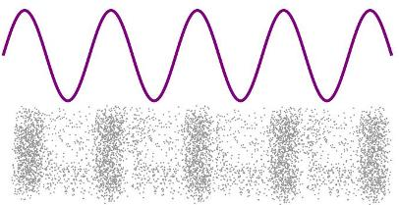
What is a wave?
A wave is a means of transferring energy from one place to another.
Notes:
A wave is a means of transferring energy from one place to another. Sound needs a medium to travel through. If the medium was absent there would be nothing to pass on the sounds waves.

Slide 7
Parts of a wave.
Notes:
There are different parts to a wave and these part influence the characteristic of that wave:
The highest point of a wave is a crest and the lowest is a trough.
The height of the wave is the vertical distance between the crest and the trough.
The amplitude is the vertical distance from the center line to either the crest or the trough.
The wavelength is the distance over which the wave's shape repeats (e.g. crest to crest/ trough to trough).
These are all measured in meters.

Slide 8
Waves
Frequency – How fast the sound is moving. The faster the sound the higher the pitch. Unit Hertz.
Amplitude – determines how loud a sound is. The higher the amplitude the louder the sound.
Notes:
All waves including sound waves have a frequency and amplitude. The frequency is how fast the sound wave is moving. The faster the sound waves are moving the higher the pitch. The amplitude of the wave determines how loud a sound is. The higher the amplitude the louder the sound.

Slide 9
PhET simulation
Notes:
The Phet simulation on the slide can be used with students to show sound waves and how the amplitude and frequency being adjusted changes the wave and therefore changes what we hear.

Slide 10
Inquiry activity
Explaining how sound is produced by vibrations.
Equipment:
Glass/Cup
Cling Film
Elastic band
Dry rice
Musical instrument
Notes:
This is an opportunity for students to strengthen skills in inquiry and critical thinking. The students can be given the equipment needed for the activity and encouraged to think about how they can show that sound is produced by vibrations. The scientific principle behind the activity is that the grains of rice vibrate on the cling film. Sound is created by vibrations. The vibrations travel through the air as a sound wave.
The steps that students should follow are:
Wrap the cling film over the top of the glass.
Secure the cling film with elastic band (tightly).
Put some grains of rice on the cling film.
Play the instrument close to the glass.

Slide 11
How do we hear?
Notes:
When sound is produced it caused vibrations in the air molecules that are surrounding the object. The vibrations produce a sound wave. The sound wave passes through the air until it reaches the eardrum. Once it hits the eardrum it causes the eardrum to vibrate. The human ear is very sensitive and can hear noises that range from being very loud to noises that are very quiet. Sound levels are measured in decibels.

Slide 12
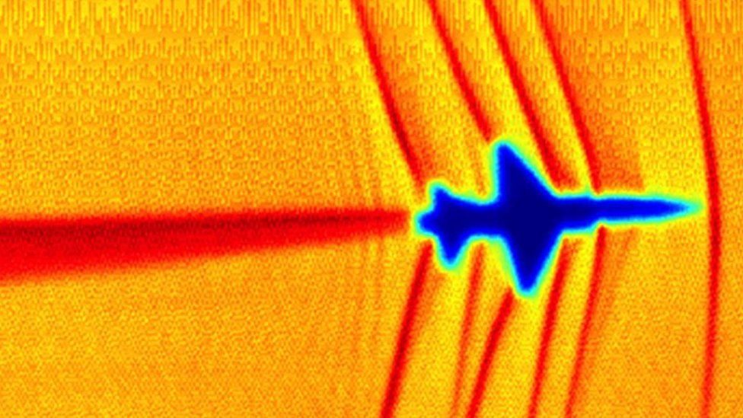
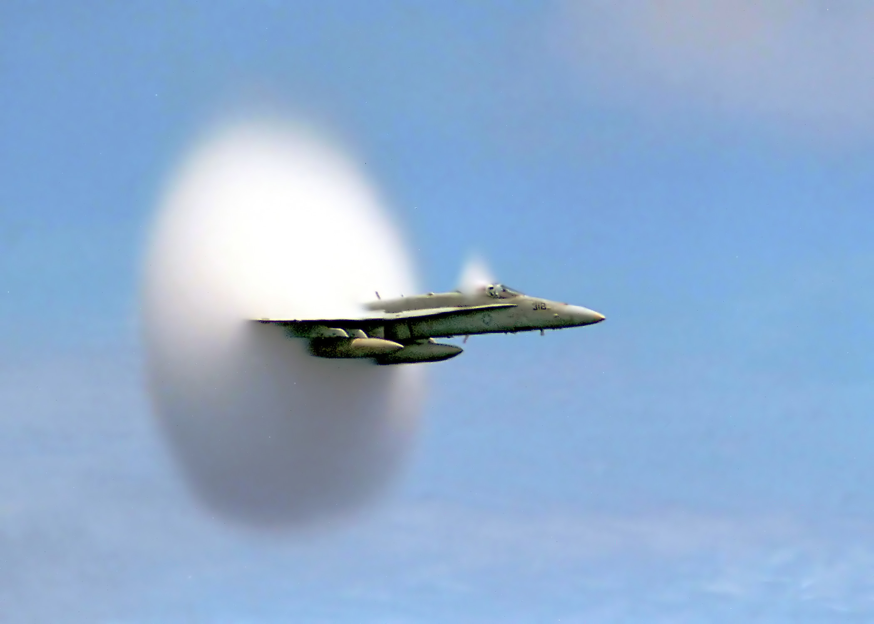
Speed of sound
The speed of sound is how fast vibration pass through a medium.
Speed of sound in air 340m/s
When an object travels faster than the speed of sound in air it breaks the sound barrier and an explosive noise is made this noise is a sonic boom
Explanation of Sonic Boom
Notes:
The speed of sound is how fast the sound travels through a medium. The speed of the sound can change if the medium changes. For example the speed of sound in air is 340m/s while the speed of sound in water is 1,480 m/s.
With regards to air if the object travels faster than the speed of sound then it breaks the sound barrier. When an object breaks the sound barrier there is an explosive noise, this noise is called a sonic boom.

Slide 13
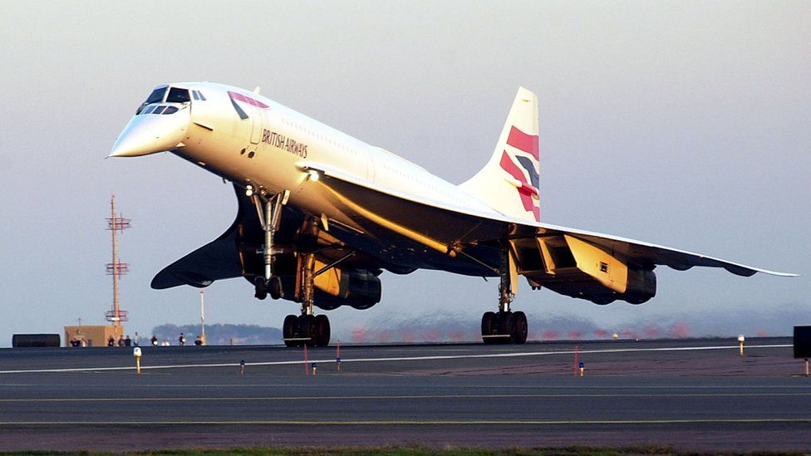
The Concorde
The first commercial journey of this plane was in 1976.
This plane flew from London to New York in 3hrs 30 mins
Usual flight time 7hrs 10 mins.
Travelled at 1,350 mph. This is twice the speed of sound.
The Concorde created a sonic boom as is broke the sound barrier.
The last flight was in 2003 as the planes were grounded due to operating costs.
Notes:
The Concorde was an aircraft that had its first commercial journey in 1976. The plane could fly from London to New York in 3hrs 30 mins, the usual flight time for this flight is 7hrs 10 mins.
The Concorde travelled at a speed of 1,350mph. This is twice the speed of sound. This resulted in the concorde breaking the sound barrier.
The Concorde made its last journey in 2003 and was grounded due to its operational costs.

Slide 14
Sound energy demonstration
Equipment needed:
Signal generator
Speaker
Table tennis ball
Retort stand
Clamp.
Notes:
In this demonstration the table tennis ball is hung from the clamp on the retort stand. As the speaker creates sound the ball on the string moves. The students should interpret this as meaning the kinetic energy of the moving ball on the clamp came from the sound energy. This can be linked back to the law of conservation that states energy cannot be created or destroyed.

Slide 15
Sankey diagrams
Notes:
Sankey diagrams can be used to model energy efficiency. The diagrams shows the energy which is useful but also the energy which has been dissipated. Energy efficiency can be calculated using formula useful output energy/total input energy x 100.

Slide 16
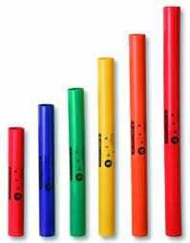
Boomwhackers
A boomwhacker is a musical instrument.
They are tuned to musical pitch by length.
Video Here!!
Notes:
25-40 euro
A boomwhacker is a musical instrument, these instruments are tuned to a musical pitch by their length.
Inquiry opportunity – How does length effect pitch? Can we predict if which tube has a low pitch or a high pitch? What would happen to the sound if the end of the tube was covered?

Slide 17
Class task.
Mammal | Lowest frequency (Hz) | Highest Frequency (Hz)
Elephant | 16 | 12,000
Human | 20 | 20,000
Dog | 40 | 60,000
Dolphin | 75 | 160,000
Bat | 15 | 120,000
Notes:
This is an example of a class task, students are asked to graph the results on the table for the highest frequency. This class task would encourage students to think about how to graphically represent their results. Students would have to think about the best way to show the information. On the slide is an example of how the results could be displayed.
Add on questions, which animal has the lowest frequency range? Which animal has the highest frequency?

Slide 18
Visualising waves.
https://www.youtube.com/watch?v=odJxJRAxdFU
https://www.youtube.com/watch?v=TsQL-sXZOLc
https://www.youtube.com/watch?v=uENITui5_jU&list=PLQlnTldJs0ZQRzLgW42JXOV_KjtG7TXck&index=9
Notes:
This video shows the 3-D acoustic manipulation. Sound waves shown throughout the video clip. Attention grabbing for students.

Slide 19
Bibliography
Useful links:
https://www.physicsclassroom.com/lab/sound/Slabs
Boomwhacker song sheet https://www.pinterest.ie/pin/686376799463008817/?mt=login
Image Sources.
Sound wave https://www.ducksters.com/science/physics/sound_wave_characteristics.php
Parts of the wave https://thescienceofwaves.weebly.com/parts-and-types-of-a-wave.html
https://scitechdaily.com/sound-science-great-headphones-blend-physics-anatomy-and-psychology/
Sonic boom https://en.wikipedia.org/wiki/Sound_barrier
Concorde https://www.bbc.com/news/business-44795639
Boomwhacker http://www.physikanten.de/experiments/boomwhackers

Slide 20
Contact Details
Register for on-line CPD resources: https://epistem.ie
EPI•STEM project: Resources
Contact: Helen Fitzgerald, Senior Executive Administrator
Email: helen.fitzgerald@ul.ie
This on-line CPD project [HEA funded] is an initiative with EPI•STEM for science and mathematics secondary teachers in Ireland. The research-led development team include:
Geraldine Mooney Simmie, Niamh O’Meara, Merrilyn Goos, Stephen Comiskey, Ciara Lane, Tracey O’Connell, Vo Van De, Tara Ryan, Martina Scully, Jack Nealon, Daniel Casey, Keith Kennedy, Annette Forster, Céren O’Connell, Martha Cosgrave, Veronica Ryan, Gemma Henstock

