Slide 1
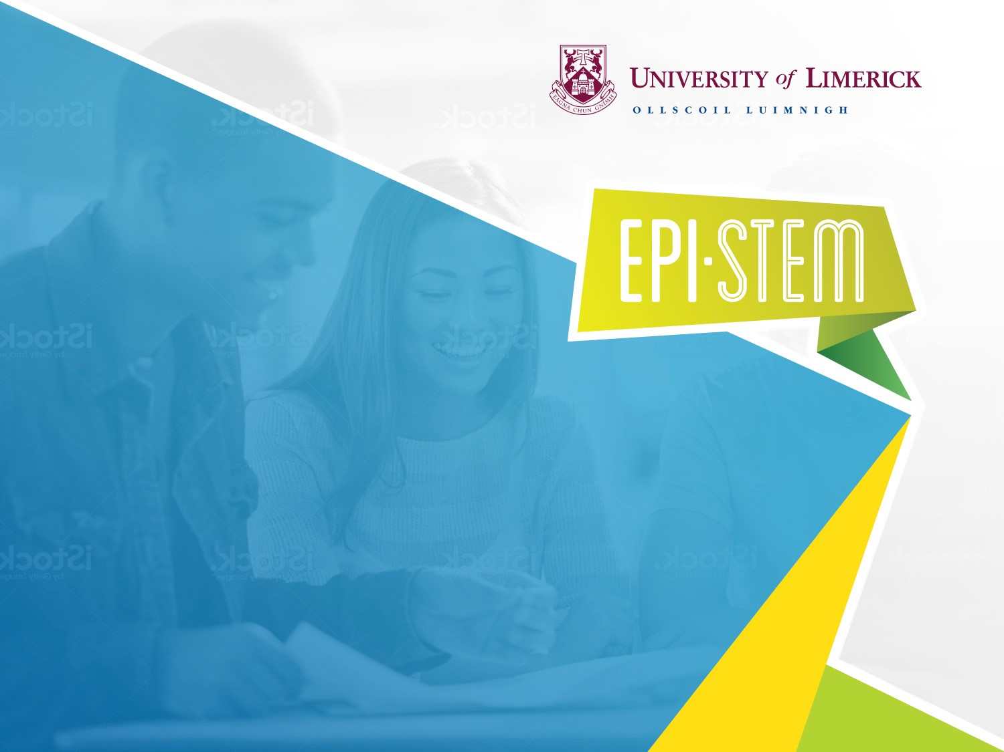


Electricity
Suitable for Transition Year Science
NARRATOR: Tara Ryan, EPI•STEM, University of Limerick
THIS IS A HEA FUNDED CPD PROJECT WITH EPI•STEM:

Slide 2









Overview of Topics
Electric Eels
Circuit Simulations
Student Workshops
Hair Straighteners
Formula 1
Piezoelectricity
Electricity
Transition Year

Slide 3

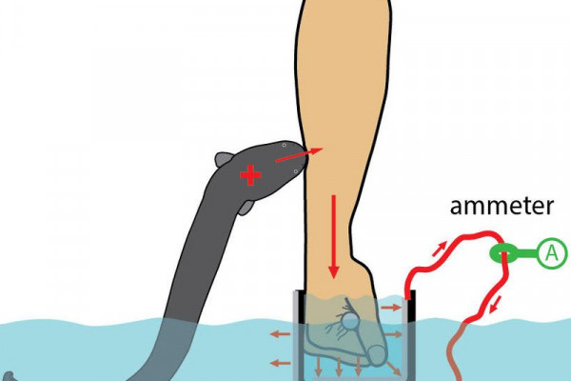
Electric Eels
Notes:
Electric eels breathe air. The main organ, Hunter's organ, and Sachs' organ are three pairs of electric organs that are positioned lengthwise. These organs enable electric eels to produce both low voltage and high voltage electric organ discharges. These organs are constructed of electrocytes that are stacked and lined up in such a way that a current of ions can pass through them. The main and Hunter's organs may discharge a maximum of at least 600 volts, making electric eels the most potent electric fish.
The brain of an electric eel delivers a message to the electrocytes when it spots a potential meal. This allows sodium to pass via open ion channels, momentarily reversing the polarity. Similar to a battery, which has stacked plates that each produce an electric potential difference of 0.15 volts, it generates an electric current by generating a quick change in electric potential. When utilized for electrolocation, Sachs' organ produces a discharge of almost 10 volts at a frequency of around 25 Hz.
The primary and Hunter's organs can generate signals at rates of several hundred hertz, and they are employed to stun prey or discourage predators. Curling up and making contact with the prey at two spots along the body allows electric eels to concentrate the discharge to stun prey more efficiently.
A recent study found that an electric eel can deliver a shocker ten times more powerful than a taser.

Slide 4
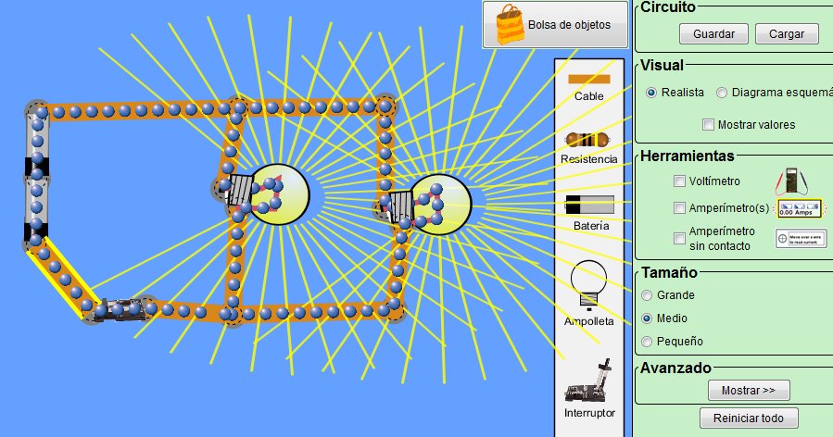
Circuit Simulations
PhET Simulation
Circuit Lab
Falstad
PartSim

Slide 5

Student Workshops
Sustainable Energy Authority of Ireland
Notes:
Environmental & Social Studies
Civic, Social, and Political Education
JC & LC Geography

Slide 6
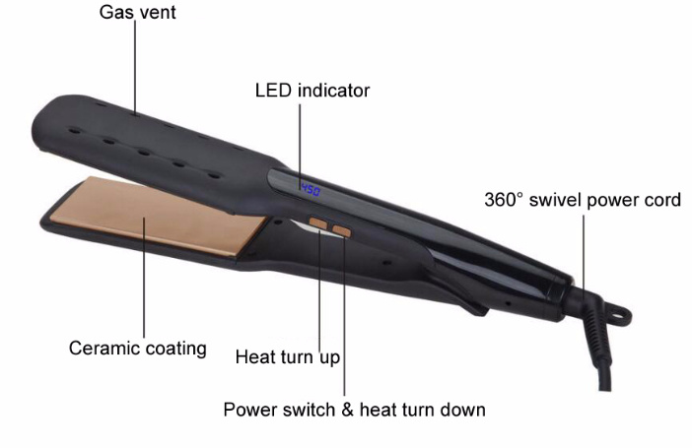
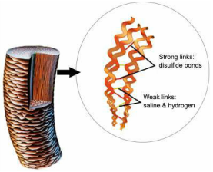
Hair Straighteners
Notes:
A hair iron or hair tong is a gadget that uses heat to alter the way that hair is styled. There are three main types: curling irons, which are used to make the hair curly; straightening irons, also known as straighteners or flat irons; and crimping irons, which are used to make the required size of crimps in the hair.
Flat irons, straighteners, and straightening irons function by breaking down the positive hydrogen bonds that cause hair to expand, bend, and become curly in the cortex. Although the hydrogen bonds can repair if exposed to moisture, hair is unable to maintain its original, natural form once they have been broken. The plates of straightening irons are often made of ceramic. High-end straighteners use numerous layers or even 100 percent ceramic material, while low-end straighteners just use a single layer of ceramic coating on the plates. To prevent fire incidents, certain straightening irons have an automated shut-off feature.
Early methods of straightening hair tended to use harsh chemicals that could harm hair. In order to straighten hair, the French hairdresser Marcel Grateau invented heated metal hair care tools like hot combs in the 1870s. The use of wider-toothed combs was made popular by Madame C.J. Walker along with her system of chemically based treatments for straightening and preparing the scalp. Annie Malone, who served as her instructor, is credited with patenting the heated comb. Heated metal tools glide through hair more smoothly, causing less damage and dryness. In the 1960s, women occasionally straightened their hair with garment irons.

Slide 7
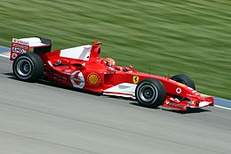
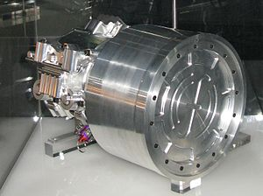
Formula 1
Notes:
Technology is used in F1 cars to make them faster, more resistant to drag, and safer.
Energy Recovery Systems are referred to as ERS. Mechanical and electrical ERS systems are the two primary forms, and both recover energy without consuming fuel or harming the environment. ERS functions by storing energy that would otherwise be lost during braking in a flywheel or battery (like the one shown in the picture) and allowing that energy to be used again during acceleration.
Because it prevents tire spin while understeering or oversteering, traction control is frequently utilized in corners. They simply refer to which end of the automobile loses traction first because tyres only have so much traction. Understeer causes the front axle and wheels to lose traction first, whereas oversteer causes the rear end to lose traction first. When this occurs, it feels similar to a handbrake skid. By modifying the wheel movement during these turns, traction control is the mechanism that attempts to maintain the vehicle's stability.
Drag Reduction System is referred to as DRS. It is a modification to the car's rear wing that was made for the 2011 Formula 1 season with the goal of promoting overtaking by lowering aerodynamic drag. When a driver is practically touching someone in front of him, he uses it. He will be able to open the back wing to make the vehicle more aerodynamic and sleek so he can pass his rival. As soon as he passes his rival, the device is turned off.

Slide 8
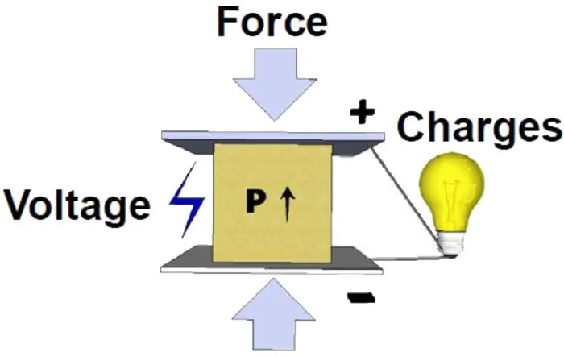
Piezoelectricity
Notes:
A crystal's ability to produce a voltage in response to mechanical stress is known as piezoelectricity. The word is a translation of the Greek verb piezein, which means to press or compress. Piezoelectric crystals can alter shape somewhat when an external voltage is applied; the effect is reversible. Although the effect is on the order of nanometres, it nonetheless has practical uses in the creation and detection of sound, the generation of high voltages, the creation of electronic frequencies, and the ultrafine focusing of optical components.
The positive and negative electrical charges in a piezoelectric crystal are separated but symmetrically distributed, making the crystal electrically neutral overall.
Piezoelectric materials also show the opposite effect, called converse piezoelectricity, where application of an electrical field creates mechanical stress (distortion) in the crystal. Because the charges inside the crystal are separated, the applied voltage affects different points within the crystal differently, resulting in the distortion.

Slide 9
Bibliography
https://www.thenakedscientists.com/articles/science-news/electric-eel-ten-times-power-taser
https://www.seai.ie/community-energy/schools/workshops-for-schools/student-workshops/
https://hairstraighteningexperiment.weebly.com/theory.html
https://m.made-in-china.com/product/Hair-Straightener-with-Wide-Plate-Adjustable-Heat-for-Different-Hair-Quality-769301252.html
piezoelectric effect for kids - Bing images
formula 1 - Bing images

Slide 10
Contact Details
Register for on-line CPD resources: https://epistem.ie
EPI•STEM project: Resources
Contact: Helen Fitzgerald, Senior Executive Administrator
Email: helen.fitzgerald@ul.ie
This on-line CPD project [HEA funded] is an initiative with EPI•STEM for science and mathematics secondary teachers in Ireland. The research-led development team include:
Geraldine Mooney Simmie, Niamh O’Meara, Merrilyn Goos, Stephen Comiskey, Ciara Lane, Tracey O’Connell, Vo Van De, Tara E. Ryan, Martina Scully, Jack Nealon, Daniel Casey, Keith Kennedy, Annette Forster, Céren O’Connell, Martha Cosgrave, Veronica Ryan, Gemma Henstock, Martina Ryan

