Slide 1
Electricity Part 3 Suitable for Junior Cycle Science
NARRATOR: Tara Ryan, EPI•STEM, University of Limerick
THIS IS A HEA FUNDED CPD PROJECT WITH EPI•STEM:

Slide 2
Junior Cycle Science Learning Outcomes

Slide 3
Junior Cycle Science Learning Outcomes

Slide 4
Junior Cycle Science Learning Outcomes

Slide 5
Overview of Topics
Sources of Electricity
Non-Renewable Energy
Renewable Energy
Energy Wastage
Ethics of Energy Sources
Part 3
Sources of Electricity

Slide 6
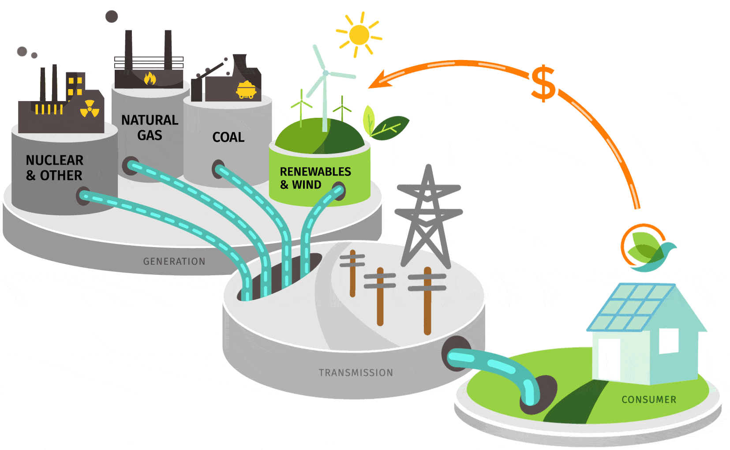
Sources of Energy
Notes:
We use electricity to power our homes and run our everyday lives, but have you ever stopped to consider where our electricity comes from and what the implications our choices lead to?

Slide 7
Sources of Energy
Non-Renewable
Renewable
Notes:
There are two types of energy sources we use to power our appliances.
Non-renewable energy is a natural resource that cannot be readily replaced by natural means at a pace quick enough to keep up with consumption. An example is carbon-based fossil fuels. The original organic matter, with the aid of heat and pressure, becomes a fuel such as oil or gas. In addition to being of limited supply, non-renewable energy, such as fossil fuels can be extremely damaging to both the environment and our health. When coal or turf is burned, it releases carbon dioxide, which causes respiratory problems and weakens the ozone layer, meaning more harmful UV rays are able to enter the atmosphere and increase the temperature of the planet.
Renewable energy is energy that is collected from renewable resources that are naturally replenished on a human timescale. It includes sources such as sunlight, wind, rain, tides, waves, and geothermal heat.

Slide 8
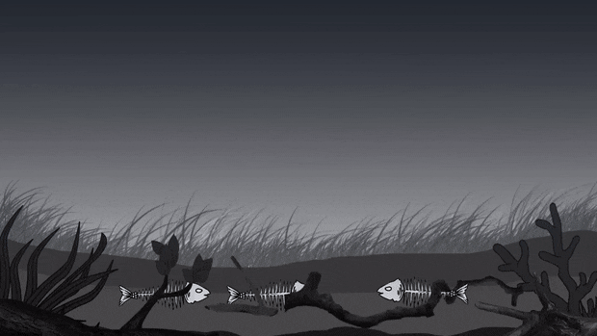
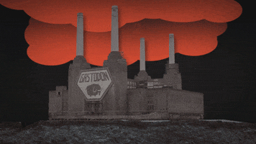
Non-Renewable Energy
Notes:
Fossil fuels are made from the remains of dead plants and animals compressed under high pressure and heat for millions of years. When we burn fossil fuels, harmful gases, such as carbon dioxide, are released into the atmosphere, which can cause severe damage, such as respiratory conditions.
Some examples of other types of non-renewable energy are
Petroleum/crude oil
Natural Gas
Earth Minerals
Coal
Groundwater
Land Surface/Soil
Plastic
Metal Ores

Slide 9
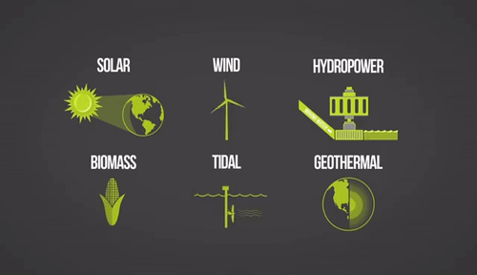
Renewable Energy
Notes:
Renewable energy is energy that is collected from renewable resources that are naturally replenished on a human timescale.
Some examples of renewable energy are:
Solar
Wind Energy
Hydroelectric
Ocean Energy
Geothermal Energy
Biomass
Hydrogen

Slide 10
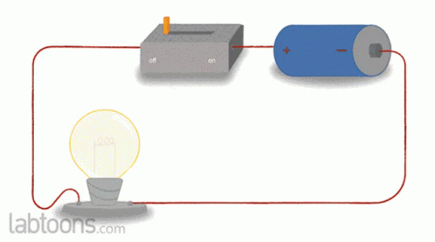
How can Energy be Wasted?
Notes:
We have previously established the law of conservation, which states that energy cannot be created nor destroyed, only converted into different forms. So, what does the expression ‘wasting energy’ mean? When we say this, we are referring to energy dissipation, which is the unintentional transformation of energy into a less useful form.
An example of this is when most energy from a bulb converted into heat energy, when only light energy is desired. Inventions like LED bulbs have been designed to overcome obstacles like these, in an effort to reduce electrical consumption and energy bills.

Slide 11
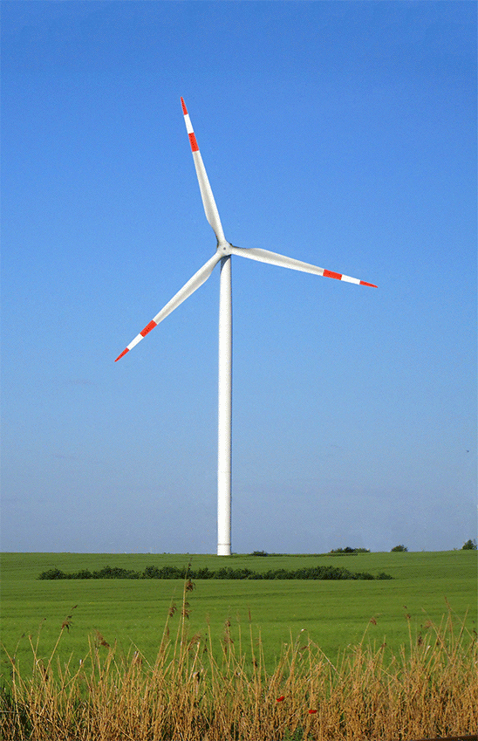
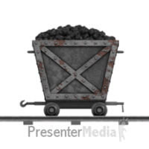
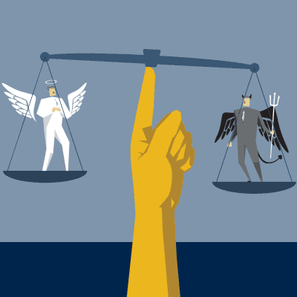
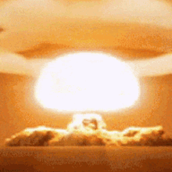
Ethics of Energy Consumption
Notes:
When discussing the ethics of energy consumption, it can often be overlooked as being a simple discission. Renewable energy sources should replace non-renewable ones. However, the matter is a lot more complicated than that.
For example, should law makers make a decision to close a coal mine? This would reduce the coal being extracted and burnt, leading to less pollution, but what about the people who will lose their jobs because of this? What are they supposed to do instead? Measures need to be put in place to prevent economic collapse, and changes need to be made gradual with replacements put in place.
Another ethical question are wind turbines a good source of energy? Wind energy is readily available, won’t be depleted, and causes no environmental harm, but what about the turbines themselves? Wind turbines take a substantial amount of impact from the high speeds and winds forced upon them, meaning that they must be made of extremely strong materials that won’t be damaged. Unfortunately, this means that these materials are typically non-biodegradable and usually end up in landfills when they’ve reached the end of their lifecycles, leading to a huge amount of waste.
What about nuclear energy? A huge amount of energy is generated from a relatively low input by colliding atoms, making it very sustainable and profitable. However, if not controlled properly, can be extremely dangerous. Is the risk worth harvesting it?

Slide 12
Sample Exam Question
JC Science 2019 Q13
Notes:
Here is a question taken from the 2019 junior cycle science exam to test your students’ understanding of the topic.

Slide 13
Bibliography
https://giphy.com/gifs/pbsdigitalstudios-no-stupid-52FwKQ3kGq7Gq5B8Er
https://gfycat.com/blandathleticdouglasfirbarkbeetle
https://rarebirdshq.com/2021/05/29/chile-deploys-blockchain-to-track-renewable-energy-usage/?lang=ar
https://gfycat.com/digitalgloomyemperorshrimp
https://gifer.com/en/7MvA
https://commons.wikimedia.org/wiki/File:Wind_turbine.gif
https://tenor.com/view/nuclear-catastrophic-disastrous-melt-down-gif-13918708
https://news.gatech.edu/archive/features/classroom-bob-kirkman.shtml

Slide 14
Contact Details
Register for on-line CPD resources: https://epistem.ie
EPI•STEM project: Resources
Contact: Helen Fitzgerald, Senior Executive Administrator
Email: helen.fitzgerald@ul.ie
This on-line CPD project [HEA funded] is an initiative with EPI•STEM for science and mathematics secondary teachers in Ireland. The research-led development team include:
Geraldine Mooney Simmie, Niamh O’Meara, Merrilyn Goos, Stephen Comiskey, Ciara Lane, Tracey O’Connell, Vo Van De, Tara E. Ryan, Martina Scully, Jack Nealon, Daniel Casey, Keith Kennedy, Annette Forster, Céren O’Connell, Martha Cosgrave, Veronica Ryan, Gemma Henstock, Martina Ryan

