Slide 1
Physics: Light and Colour Suggested Use: Transition Year
NARRATOR: Céren O’Connell
THIS IS A HEA FUNDED CPD PROJECT WITH EPI•STEM:

Slide 2
Overview of Topics
When Light Strikes an Object [absorption, reflection & transmission]
Where does the colour of objects come from? [addition/mixing, complementary, subtraction]
Art Application: PIGMENTS & Subtraction & Filters
Art Application: PRIMARY COLOURS OF PAINT
Art Application: STAGE LIGHTING

Slide 3
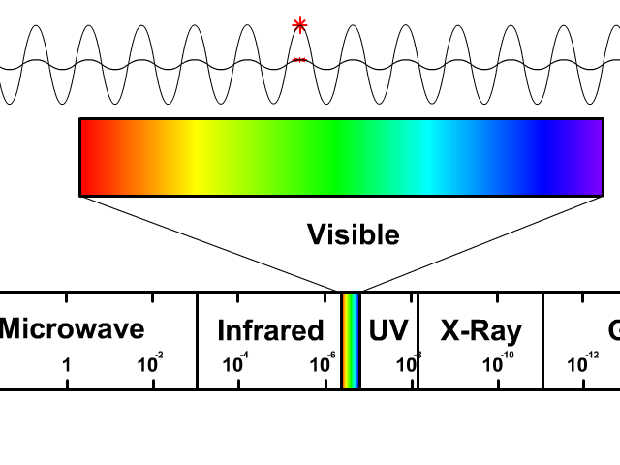
When Light Strikes An Object
We have previously learned that visible light waves consist of a continuous range of wavelengths or frequencies. When a light wave with a single frequency strikes an object, a number of things could happen. The light wave could be absorbed by the object, in which case its energy is converted to heat. The light wave could be reflected by the object. And the light wave could be transmitted by the object. Rarely however does just a single frequency of light strike an object. While it does happen, it is more usual that visible light of many frequencies or even all frequencies is incident towards the surface of objects. When this occurs, objects have a tendency to selectively absorb, reflect or transmit light at certain frequencies.
The manner in which visible light interacts with an object is dependent upon the frequency of the light and the nature of the atoms of the object.
Click here to see a video explaining the Electromagnetic Spectrum.
Click here for resources and quiz on the Electromagnetic Spectrum.

Slide 4
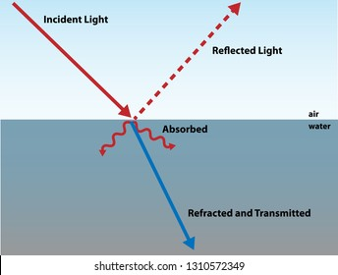
Visible Light Absorption
Atoms and molecules contain electrons. It is often useful to think of these electrons as being attached to the atoms by springs. The electrons and their attached springs have a tendency to vibrate at specific frequencies. Similar to a tuning fork or even a musical instrument, the electrons of atoms have a natural frequency at which they tend to vibrate. When a light wave with that same natural frequency impinges upon an atom, then the electrons of that atom will be set into vibrational motion. (This is merely another example of the resonance principle ).
If a light wave of a given frequency strikes a material with electrons having the same vibrational frequencies, then those electrons will absorb the energy of the light wave and transform it into vibrational motion. During its vibration, the electrons interact with neighbouring atoms in such a manner as to convert its vibrational energy into thermal energy. Subsequently, the light wave with that given frequency is absorbed by the object, never again to be released in the form of light. So the selective absorption of light by a particular material occurs because the selected frequency of the light wave matches the frequency at which electrons in the atoms of that material vibrate. Since different atoms and molecules have different natural frequencies of vibration, they will selectively absorb different frequencies of visible light.

Slide 5
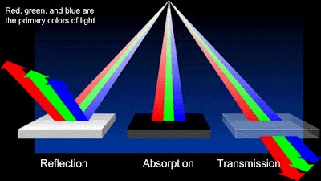
Visible Light Reflection and Transmission
Reflection and transmission of light waves occur because the frequencies of the light waves do not match the natural frequencies of vibration of the objects. When light waves of these frequencies strike an object, the electrons in the atoms of the object begin vibrating. But instead of vibrating in resonance at a large amplitude, the electrons vibrate for brief periods of time with small amplitudes of vibration; then the energy is reemitted as a light wave. If the object is transparent, then the vibrations of the electrons are passed on to neighbouring atoms through the bulk of the material and reemitted on the opposite side of the object. Such frequencies of light waves are said to be transmitted. If the object is opaque, then the vibrations of the electrons are not passed from atom to atom through the bulk of the material. Rather the electrons of atoms on the material's surface vibrate for short periods of time and then reemit the energy as a reflected light wave. Such frequencies of light are said to be reflected.
Reflection , Transmission
Absorption Video

Slide 6
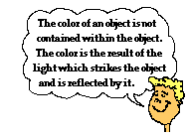
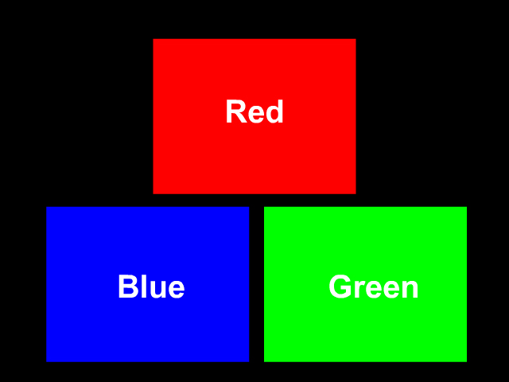
Where does the colour of objects come from?
The colour of the objects that we see is largely due to the way those objects interact with light and ultimately reflect or transmit it to our eyes.
The only role that the object plays is that it might contain atoms capable of selectively absorbing one or more frequencies of the visible light that shine upon it. So if an object absorbs all of the frequencies of visible light except for the frequency associated with green light, then the object will appear green in the presence of ROYGBIV.
The most common set of primary colours is red (R), green (G) and blue (B). When red, green and blue light are mixed or added together with the proper intensity, white (W) light is obtained. This is often represented by the equation below:
R + G + B = W
Notes:
Many people have used the mnemonic ROYGBIV. This was a great way to remember the light color spectrum until it was changed. Not the actual colors of light in a rainbow but what we name as the colors of light. Indigo in no longer included and cyan was added between green and blue. The new less catchy mnemonic is ROYGCBV. From largest wavelength to shortest the colors go Red, Orange, Yellow, Green, Cyan, Blue, and Violet.

Slide 7
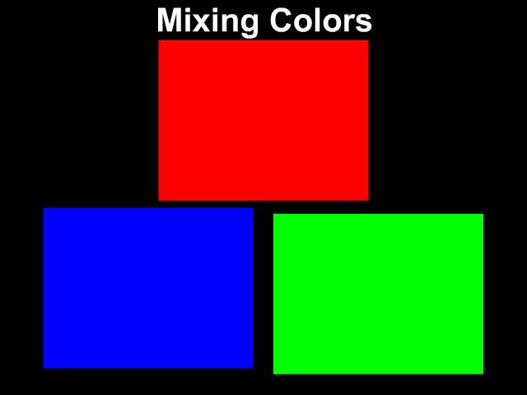
Colour Light Addition
The subject of colour perception can be simplified if we think in terms of primary colours of light. We have already learned that white light is not a colour at all, but rather the presence of all the frequencies of visible light.
But combining the range of frequencies in the visible light spectrum is not the only means of producing white light. White light can also be produced by combining only three distinct frequencies of light, provided that they are widely separated on the visible light spectrum. Any three colours (or frequencies) of light that produce white light when combined with the correct intensity are called primary colours of light.
The three primary colours of light are red, blue, and green. If you have heard otherwise it was likely a pigment. Colour refers to light. Pigments are use when painting or colouring. Pigments are chemicals capable of absorbing one or more of the colours of white light. Chemicals that are capable of selectively absorbing one or more frequency of white light are known as pigments. In the picture, the three primary colours are on a black background with the absence of any light. When all three colours are mixed in the correct intensity white light is obtained.
Click here for PhET simulator.
Click here to check understanding using interactive questions.

Slide 8
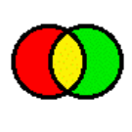
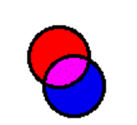
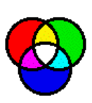
The mixing together (or addition) of two or three of these three primary colours of light with varying degrees of intensity can produce a wide range of other colours. For this reason, many television sets and computer monitors produce the range of colours on the monitor by the use of red, green and blue light-emitting phosphors.
The addition of the primary colours of light can be demonstrated using a light box. The light box illuminates a screen with the three primary colours - red (R), green (G) and blue (B). The lights are often the shape of circles. The result of adding two primary colours of light is easily seen by viewing the overlap of the two or more circles of primary light.
When you mix the primary colours of light they give you secondary colours.
All primary colours together = white light
Click here for colour interactive, worksheet and concept checker.
Red + Green = Yellow
Red + Blue = Magenta
Green + Blue = Cyan

Slide 9
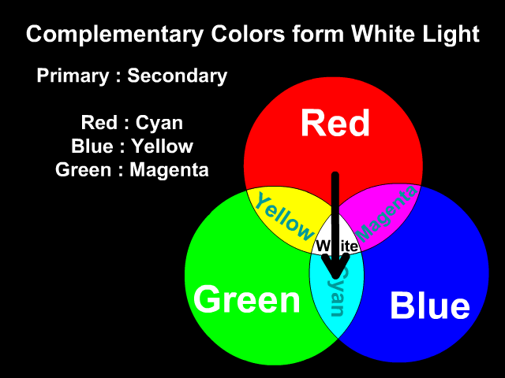
Complementary Colours of Light
Any two colours of light that when mixed together in equal intensities produce white light are said to be complementary colours of each other. The complementary colour of red light is cyan light. This is reasonable since cyan light is equivalent to a combination of blue and green light; and blue and green light when added to red light will produce white light. Thus, red light and cyan light (which is equivalent to blue + green light) represent a pair of complementary colours of light; they add together to produce white light. This is illustrated in the equation below:
R + C = R + (B + G) = White
What happens when you mix a primary colour with a non-complimentary secondary colour?
If you mixed the secondary colour yellow with red you get yellow. Yellow is already red and green combined. Having another red light would intensify the red light but you still have only red and green light which makes yellow.
Green + Red = Yellow
Green + Red + Red = Still Yellow!

Slide 10
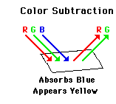
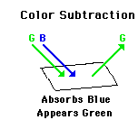
Colour Light Subtraction
To begin, consider white light to consist of the three primary colours of light - red, green and blue. If white light is shining on a shirt, then red, green and blue light is shining on the shirt. If the shirt absorbs blue light, then only red and green light will be reflected from the shirt. So while red, green and blue light shine upon the shirt, only red and green light will reflect from it. Red and green light striking your eye always gives the appearance of yellow; for this reason, the shirt will appear yellow. This illustrates the process of colour subtraction. In this process, the ultimate colour appearance of an object is determined by beginning with a single colour or mixture of colours and identifying which colour or colours of light are subtracted from the original set. The process is depicted in terms of an equation below.
W - B = (R + G + B) - B = R + G = Y
What happens when a cyan light is shining on the same shirt - (recall that cyan light consists of blue and green light) ?
C - B = (G + B) - B = G
Click here for interactive featuring M&M ’s with teacher notes and student activity sheet
Video available here
Notes:
From these two examples, we can conclude that a shirt that looks yellow when white light shines upon it will look green when cyan light shines upon it. This confuses many students many of whom believe that the colour of the shirt is in the shirt itself. This is where a misconception can occur. visible light interacts with matter to produce colour. In that part of Lesson 2, it was emphasized that the colour of an object does not reside in the object itself. Rather, the colour is in the light that shines upon the object and that ultimately becomes reflected or transmitted to our eyes. Extending this conception of colour to the above two scenarios, we would reason that the shirt appears yellow if there is some red and green light shining upon it. Yellow light is a combination of red and green light. A shirt appears yellow if it reflects red and green light to our eyes. In order to reflect red and green light, these two primary colours of light must be present in the incident light.

Slide 11
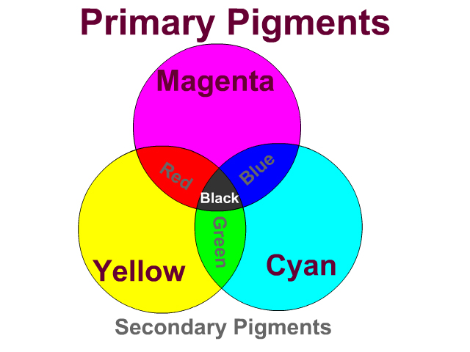
Primary Pigments
Pigments absorb light. Pure pigments absorb a single frequency or colour of light. The colour of light absorbed by a pigment is merely the complementary colour of that pigment. Pigments are what you are using while drawing or painting. Pigments subtract light. When you mix all the pigments together they subtract all colour and form black. Colours are additive and add light; while pigments are subtractive and take away light. The primary pigments are the secondary colours. The secondary pigments are the primary colours. Between the primary pigments in the pigment wheel diagram are the mixed secondary pigments. Primary Pigment + Primary Pigment = Secondary Pigment Magenta + Cyan = Blue Cyan + Yellow = Green Yellow + Magenta = Red All primary pigments mix to form black: Magenta + Cyan + Yellow = Black Primary Pigment + Secondary Pigment = Black
.
Click here for an interactive painting activity choosing colours for the school football team with teacher notes and worksheet

Slide 12
Primary Colours of Paint
A trip to the local newspaper or film developing company will reveal these same principles of colour subtraction at work. The three primary colours of paint used by an artist, colour printer or film developer are cyan (C), magenta (M), and yellow (Y). Artists, printers, and film developers do not deal directly with light; rather, they must apply paints or dyes to a white sheet of paper. These paints and dyes must be capable of absorbing the appropriate components of white light in order to produce the desired affect. Most artists start with a white canvas and apply paints. These paints have to subtract colours so that you might see the desired image. An artist can create any colour by using varying amounts of these three primary colours of paint.
Each primary colour of paint absorbs one primary colour of light. The colour absorbed by a primary colour of paint is the complementary colour of that paint. The three colours that are primary to an artist (magenta, cyan, and yellow) subtract red, green, and blue individually from an otherwise white sheet of paper.
How could we paint this bird using white paper viewed under white light?
Magenta paints absorb green light.
Cyan paints absorb red light.
Yellow paints absorb blue light.
Yellow paints absorb blue light
.

Slide 13
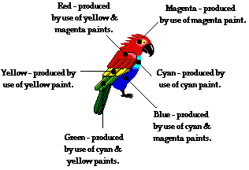
Predicting the colour appearance
This information is summarized in the graphic.
The process of colour subtraction is a useful means of predicting the ultimate colour appearance of an object if the colour of the incident light and the pigments are known. By using the complementary colour scheme, the colours of light that will be absorbed by a given material can be determined. These colours are subtracted from the incident light colours (if present) and the colours of reflected light (or transmitted light) can be determined. Then the colour appearance of the object can be predicted.
Click here for a detailed explanation

Slide 14
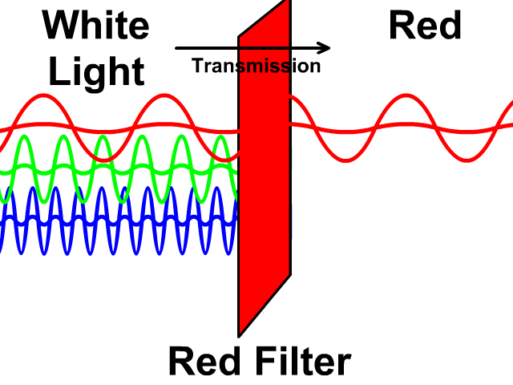
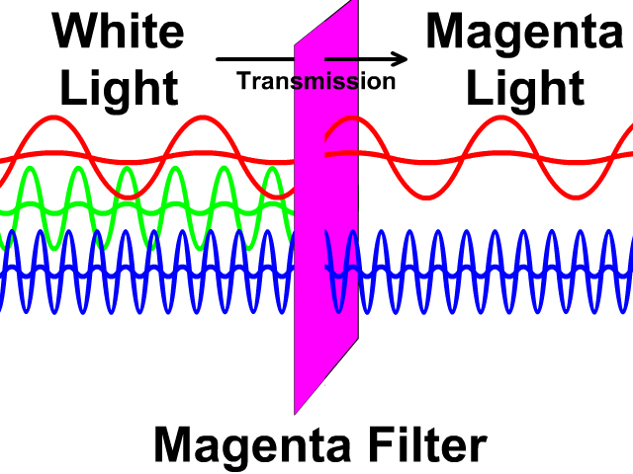
Colour subtraction using filters
What does a colour filter do?
How can one predict the colour appearance of an object when viewed through a colour filter?
Click here to watch a video to answer these question.
Primary Colour Filter
A light filter can be used to absorb some light while allowing others through. If a primary colour filter (red, blue, or green), only light of that primary colour will be transmitted.
If you are looking through a red filter, light will appear red or black if that colour of light is not present.
Secondary Colour Filter
With a secondary colour filter (yellow, magenta, or cyan), the secondary colour or either primary colours consisted of can be transmitted.
Click here for a colour filter interactive, teacher notes and concept checker. Additional interactive using coloured filters Click here and video here.

Slide 15
Viewed in Another Light
Turn on the white light and look at the colour of five M&Ms. This is their colour in white light. But what if you can change the light? Will a red M&M always look red? This simulation will allow you to investigate the colour appearance of five M&Ms when viewed under various colours of light.
Click here for the interactive to begin.
Click here for a work sheet and here for teacher notes suggestions and ideas

Slide 16
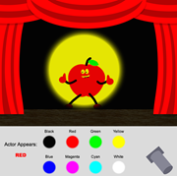
Stage Lighting Interactive
The curtains open, the theatre lights dim, the actors enter the stage, and you begin enjoying the school play. And then all of sudden, the stage lights change colours and the actors appear ... different. The yellow shirt of your favourite actor turns green, leaving you wondering exactly what is going on. Of course, you've just witnessed The Physics of Light in Action! And now its time to let all that wondering about coloured spotlights and the appearance of actors on the stage turn to understanding. So open this Stage Lighting Interactive and start finding some answers. For an accompanying work sheet click here and a concept checker here and teacher notes.
Click here for all work sheets on colour and light topics.

Slide 17
Bibliography
Images.
http://stickmanphysics.com/stickman-physics-home/electromagnetic-waves/waves-of-the-electromagnetic-spectrum/
https://sites.google.com/a/wyckoffschools.org/urban-heat-island/how-it-works/behavior-of-light/absorption-reflection-transmission?tmpl=%2Fsystem%2Fapp%2Ftemplates%2Fprint%2F&showPrintDialog=1
https://stickmanphysics.com/stickman-physics-home/electromagnetic-waves/color-of-light/
https://www.physicsclassroom.com/class/light/Lesson-2/Color-Addition

Slide 18
Contact Details
Register for on-line CPD resources: https://epistem.ie
EPI•STEM project: Resources
Contact: Helen Fitzgerald, Senior Executive Administrator
Email: helen.fitzgerald@ul.ie
This on-line CPD project [HEA funded] is an initiative with EPI•STEM for science and mathematics secondary teachers in Ireland. The research-led development team include:
Geraldine Mooney Simmie, Niamh O’Meara, Merrilyn Goos, Stephen Comiskey, Ciara Lane, Tracey O’Connell, Vo Van De, Tara Ryan, Martina Scully, Jack Nealon, Daniel Casey, Keith Kennedy, Annette Forster, Céren O’Connell, Martha Cosgrave, Veronica Ryan, Gemma Henstock, Martina Ryan

