Slide 1
Physics of Light Revision: try some Exam Questions Suitable for Senior Cycle Physics
NARRATOR: Tara Ryan, EPI•STEM, University of Limerick
THIS IS A HEA FUNDED CPD PROJECT WITH EPI•STEM:

Slide 2
List of Exam Questions
Higher Level
2022 | 2021 | 2020 | 2019 | 2018 | 2017 | 2016 | 2015 | 2014 | 2013 | 2012
3, 13 | 2, 8, 14d | 2 | 2, 10, 12c | 2, 3 | 12c | 3, 11 | 3, 12b | 2, 12b | 3 | 2
Ordinary Level
2022 | 2021 | 2020 | 2019 | 2018 | 2017 | 2016 | 2015 | 2014 | 2013 | 2012
2, 9, 14b | 3, 8, 10 | 2, 7 | 3, 11 | none | 3, 7 | 2, 7 | 3, 12b | 8 | 3, 12b | 3, 12b
Notes:
Provided here are lists of exam questions from 2012-2022 for both higher and ordinary levels.
Excluded from this list was:
Q5s, as they were considered too short
Qs focusing on waves and sound. This resource pack focuses solely on light.

Slide 3
Overview of Topics
Higher Level
Ordinary Level
Experiment Question
Theory Question
Experiment Question
Theory Question

Slide 4
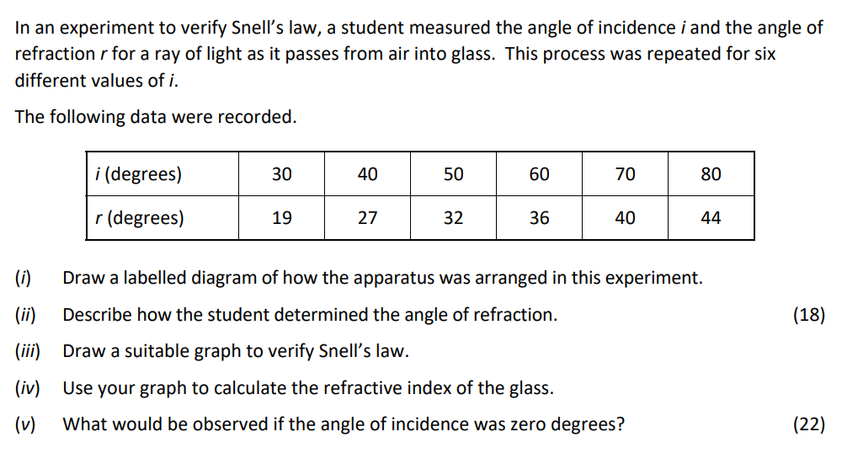
2022 Q3 HL

Slide 5
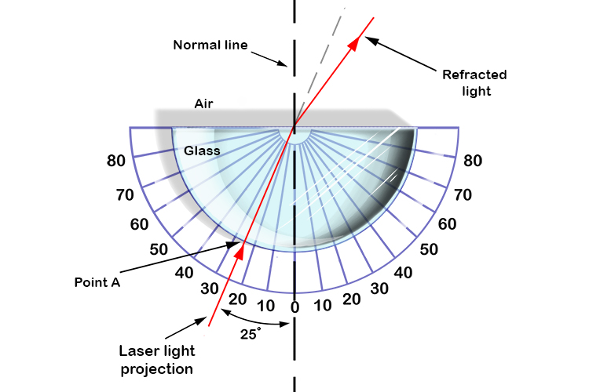
(i) Labelled Diagram
9 marks in total.
Must include:
A transparent block (3 marks).
A ray box, lasers, or pins (3 marks).
A detail such as paper, a ruler, or protractor (3 marks).
Notes:
For three marks each, students must include:
A transparent block
A ray box, lasers, or pins
And a detail such as paper, a ruler, or protractor.
The diagram should show a ray of light from a source entering a transparent block and exiting it as if it appears to have been bent. A normal line and protractor can indicate the difference in angles of the incidence and refraction.
As always, each component in the diagram should be labelled clearly. If not, one mark will be taken away.

Slide 6
(ii) Determine the Angle of Refraction
9 marks in total.
Include any 3 points:
Incident ray (3 marks).
Refracted ray (3 marks).
Normal line at point of incidence (3 marks).
Measure angle with protractor (3 marks).
Notes:
To determine the angle of refraction, a student would draw the incident beam projected on the sheet of paper, draw the refracted ray, and draw the normal line at the point of incidence.
The student would then measure the angle of refraction using a protractor.

Slide 7
(iii) Graph to verify Snell's Law
Given | Calculate
i (°) | r (°) | Sin(i) (°) | Sin(r) (°)
30 | 19 | 0.5 | 0.33
40 | 27 | 0.64 | 0.45
50 | 32 | 0.77 | 0.53
60 | 36 | 0.87 | 0.59
70 | 40 | 0.94 | 0.64
80 | 44 | 0.98 | 0.69
Notes:
In the exam question, the angles of incidence (i) and the angles of refraction (r) are given. However, in order to correctly plot a graph that verifies Snell’s law, students must first calculate the values for Sin(i) and Sin(r), as shown here.
Additionally, when drawing tables of data, the units being used (which are degrees in this case), must be clearly displayed alongside the label of the data column, rather than being repeated after each individual piece of data

Slide 8
(iii) Graph to verify Snell's Law
9 marks in total.
Must include:
Labelled axes (3 marks).
Correct points plotted (3 marks).
Line of best fit (3 marks).
Notes:
When plotting a graph, the independent variable will be placed on the x-axis. This is the set of parameters that the person carrying out the experiment sets. In this case, the independent variable is Sin(i).
Therefore, the dependent variable is Sin(r) and is placed on the y-axis. This set of data is entirely dependent on the outcome of the experiment.
As always, the chart title, and both axes must be labelled, including units.
One mark will be lost for incorrect scales.
When plotting a graph, it is important to be precise and accurate when plotting the points.
These points are then connected by a ‘line of best fit’ as shown in light blue, spanning the entirety of the graph. A line of best fit, approximately has the same number of points both above and below it.

Slide 9
(iv) Calculate Refractive Index
Refractive index $=Slope of line of best fit$
(x2, y2)
$$m= \frac{y2 −y1}{x2 −x1} (3 marks)$$
$$m= \frac{1 −0.19}{0.7 −0.1}$$
$$m= \frac{0.81}{0.6}$$
$m=1.35$ $(3 marks)$
(x1, y1)
Formula Shown | Excel Calculation | Marking Scheme
1.35 | 1.3981 | 1.4
Notes:
To determine the refractive index, the slope of the line of best fit must be calculated.
To do this, pick two points on the line of best fit. The further apart they are, the less error there will be.
Once these two points are determined, used the formula shown here to calculate the slope of the line.
When calculating the slope of the line, we used both the formula shown here, and an excel calculator. Comparing these values to the marking scheme, it is obvious that the values are not exactly the same. Due to hand drawn graphs not being as precise as digital ones, the examiner will allow slight variations in answers, provided that it is only a minor difference that can be approximated as being equal using rounding.

Slide 10
(v) What if Angle of Incidence = 0 degrees?
4 marks in total.
No refraction.
Ray travels straight through.
Incident ray
Transparent block
Normal line
Notes:
If the angle of incidence is zero degrees, then there would be no refraction, and the light beam would travel straight through the transparent block.

Slide 11
Overview of Topics
Higher Level
Ordinary Level
Experiment Question
Theory Question
Experiment Question
Theory Question

Slide 12
2019 Q12c HL
Notes:
You’ll notice that in earlier exam papers, the questions are either poorly labelled, or not labelled at all. To avoid confusion, we recommend that your students assign their own labels to each part of the question, as shown on the next slide.

Slide 13
2019 Q12c HL
(i)
(ii)
(iii)
Notes:
This is an example of a labelling system that we would recommend.
A good guide for students to use is to look to the right of the question at the numbers in brackets. The numbers indicate the start of a new part of a question and they tell students the maximum number of marks awarded for it.

Slide 14
(i) Definitions
Term | Definition | Marks Awarded
Critical Angle | The angle of incidence corresponds to the angle of refraction of 90°. | 2x3
Total Internal Reflection | The angle of incidence is less than the critical angle, resulting in all light being reflected. | 3

Slide 15
(ii) Calculate Area of Disc of Light
Step 1 Critical Angle | Step 2 Disc Radius | Step 3 Area of Disc | Step 4 Final Answer
$$n= \frac{1}{Sin(C)}$$ $$1.33= \frac{1}{Sin(C)}$$ $$C= {Sin}^{−1}(\frac{1}{1.33})$$ $C=48.8$° | $$Tan\left(\text{θ}\right)= \frac{r}{d}$$ $$Tan\left(\text{48.8}\right)= \frac{r}{12}$$ (12)$Tan\left(\text{48.8}\right)=r$ $r$ = 13.7m | $$A=\text{π}r^{2}$$ $$A=\text{π}{(13.7)}^{2}$$ | $$A=590m^{2}$$
Notes:
These are the following steps to answer the question. Each completed step is worth 3 marks.
First the student must calculate the critical angle, then the disc radius, before finally determining the area of the disc. Omission of correct units, will result in the loss of 1 mark.

Slide 16
(iii) Real Vs Apparent Depth
Observer
Medium 1 = Air
Medium 2 = Water
Apparent light ray
Apparent position of diver
Refracted light ray
12m
Actual position of diver
Notes:
As shown in the diagram, the observer’s eyes wrongly interprets the position of the diver to less deep than they actually are. This is because our brains do not account for refraction. The light ray bends because it is travelling through a second medium of different density.
This question is worth 7 marks. To get the first 4, the refracted ray needs to be drawn, and to get the remaining 3 marks, the apparent ray or position of image needs to be drawn.

Slide 17
Overview of Topics
Higher Level
Ordinary Level
Experiment Question
Theory Question
Experiment Question
Theory Question

Slide 18
2021 Q3 OL

Slide 19
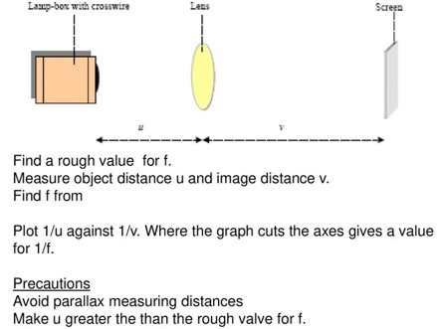
(i) & (ii) Labelled Diagram
(i) 12 marks in total.
Must include:
Crosswire, ray box (3 marks).
(Converging) lens (3 marks).
Screen (3 marks).
Detail e.g., correct arrangement, optical bench, meter stick, etc. (3 marks).
(ii) 6 marks in total.
Must include:
Correct position of u and v (6 marks).
Notes:
Part 1 and 2 of this question asks the student to draw a labelled diagram.
For a total of 18 marks, students must include:
A crosswire or ray box
A lens
A screen
An additional detail, such as the correct arrangement, an optical bench, or meter stick
And the correct positions of u and v distances.

Slide 20
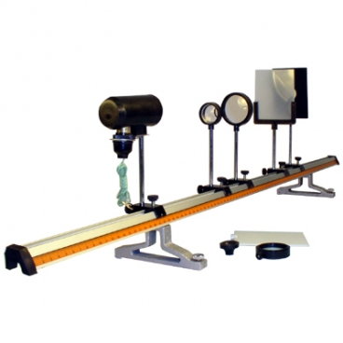
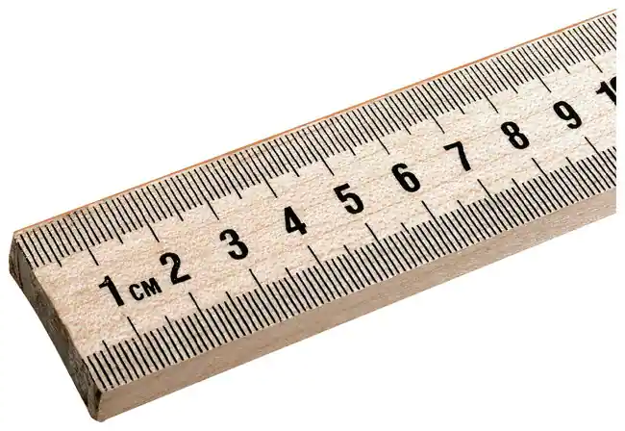
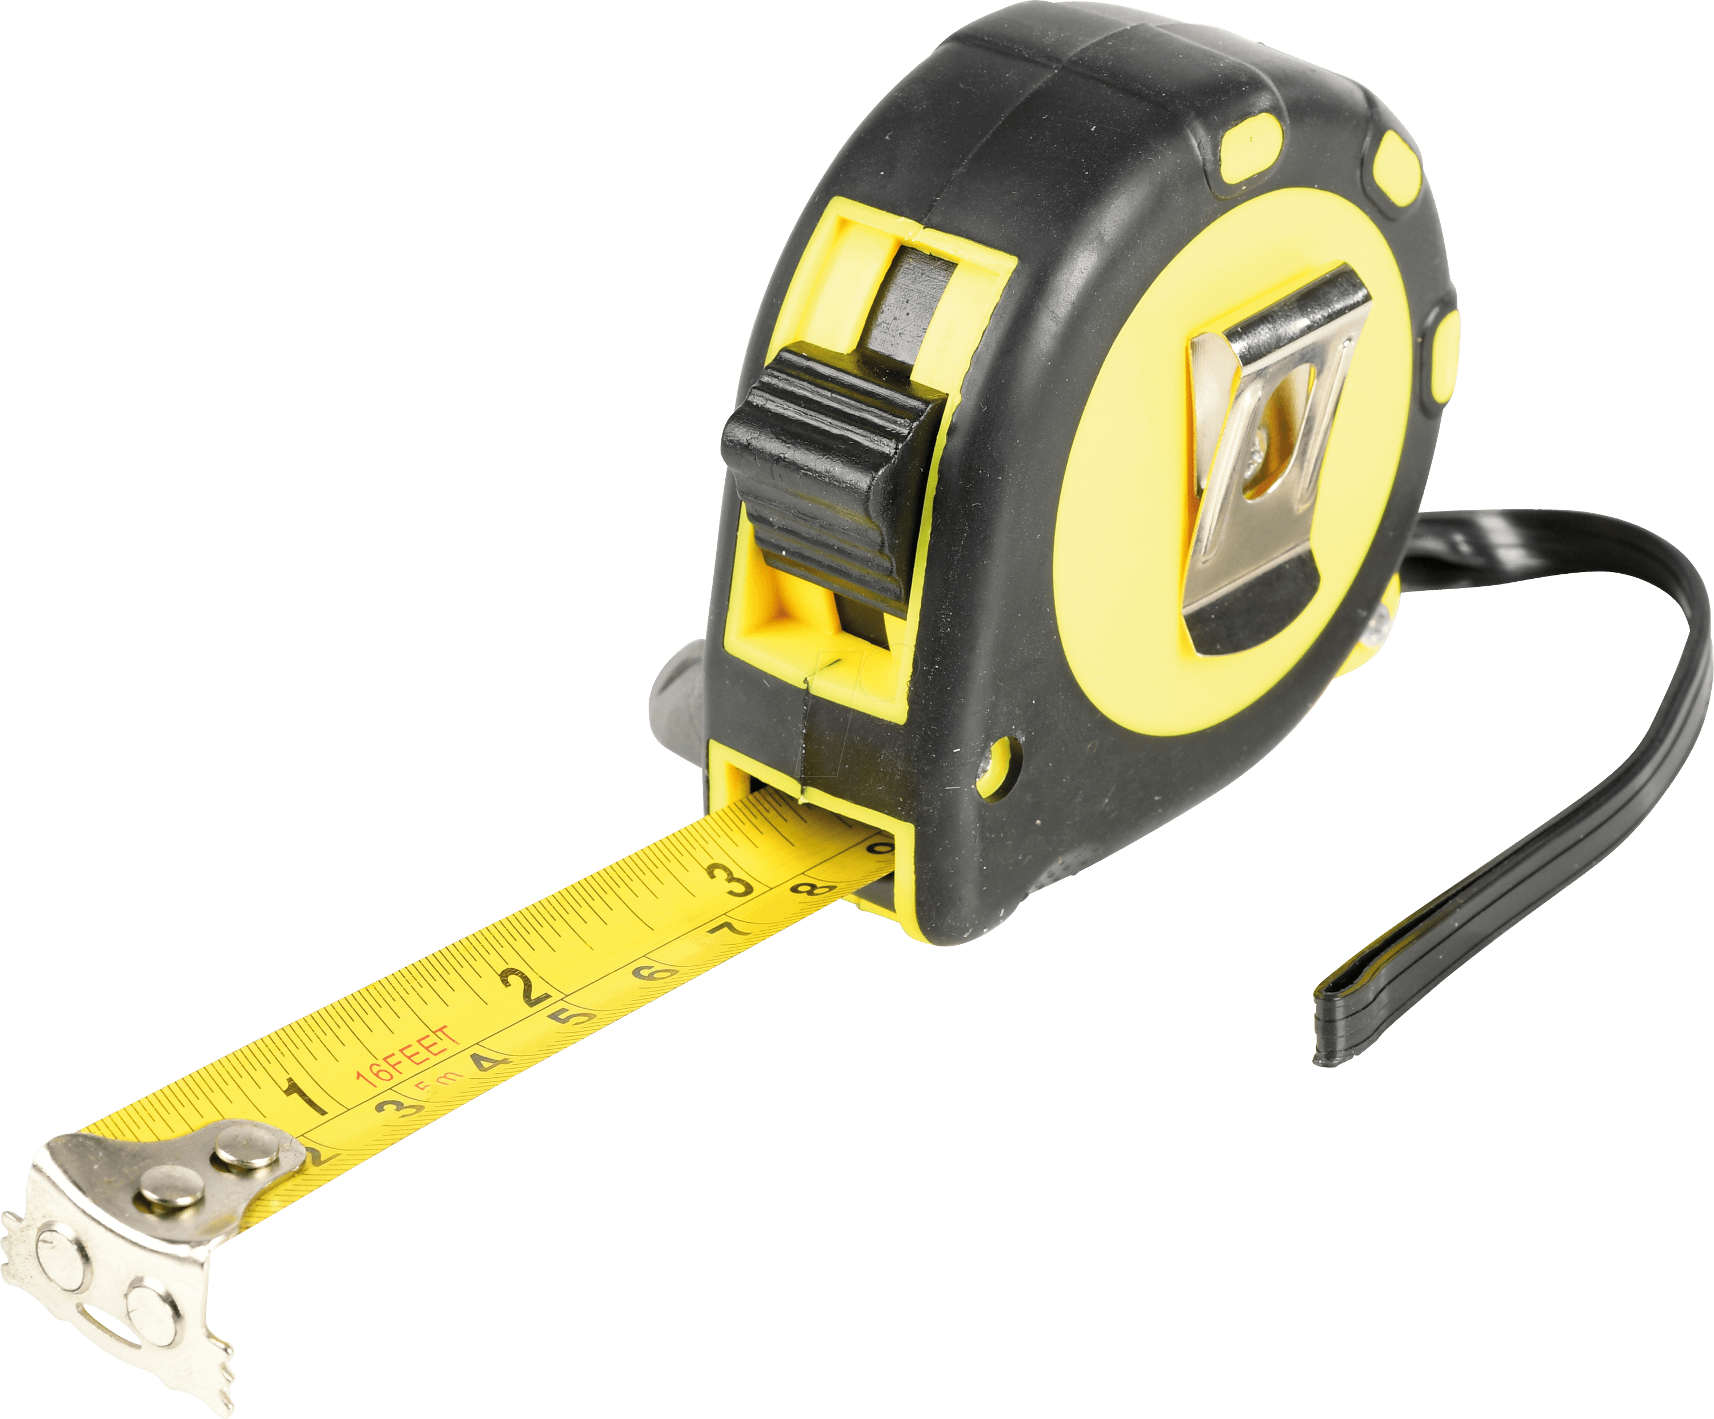
(iii) Instrument to Measure Distance
(3 marks)
Notes:
The next part of the question asks students to name any suitable instrument that could be uses to measure the object and image distance in this experiment.
For 3 marks, students could have said a meter stick, measuring tape, optical bench with scale, or ruler.

Slide 21
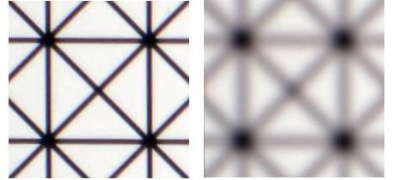
(iv) Determine when Correct Image Formed
Image in sharp focus (3 marks).
Notes:
The question then asks the student how they would know when the correct image distance had been found.
For three marks, students had to state that the image formed was in sharp focus.

Slide 22
(v) Formula to Calculate Focal Length
$$\frac{1}{f}= \frac{1}{u}+ \frac{1}{v}$$
$$\frac{1}{focal length}= \frac{1}{object distance}+ \frac{1}{image distance}$$
(6 marks)
Notes:
Part 5 of the question asks students to state the formula used to calculate the focal length. For 6 marks, they needed to answer 1/f = 1/u + 1/v

Slide 23
(vi) Calculate Focal Length
$$\frac{1}{f}= \frac{1}{u}+ \frac{1}{v}$$
$$\frac{1}{f}= \frac{1}{16}+ \frac{1}{48}$$
$$\frac{1}{f}= \frac{1}{12}$$
$$f=12cm$$
(6 marks)
Notes:
The student is then asked to use this formula to calculate the focal length, when the object and image distances are given. This calculation is worth 6 marks.

Slide 24
(vii) Why Experiment Fails when u is Small
u < f
Virtual Image
Cannot form on screen
(4 marks)
Notes:
Finally, the student is asked to explain why the experiment won’t work if the object is placed too close to the lens.
In order to get 4 marks, they need to explain that a virtual image is formed when u is less than f, and we cannot form this image on the screen.

Slide 25
Overview of Topics
Higher Level
Ordinary Level
Experiment Question
Theory Question
Experiment Question
Theory Question

Slide 26
2019 Q11 OL
Notes:
The next ordinary level exam paper question is taken from the 2019 exam, Q11.
Before the questions is a short passage. We recommend students take the time to read these during the exam, as in this case more than 60% of the answers could be found within this short paragraph.

Slide 27
2019 Q11 OL
Notes:
Each part of this question is worth 7 marks.

Slide 28
(a) Name Part of Eye that Forms Image
Notes:
Firstly, students are asked to name the part of the eye that the image is formed at. For 7 marks, students just had to name the retina, or if they just said the back of the eye, then they would have been awarded 4 marks,

Slide 29
(b) Function of Pupil
Notes:
Next students needed to answer that the function of the pupil was to allow light to enter the eye.

Slide 30
(c) Explain how Eye Focuses
Notes:
Students were told that the eye can focus light from both nearby and faraway objects and were asked to explain how it was able to do this.
Students needed to explain that the lens has different powers or it is able to change shape in order to be awarded 7 marks.
They would have achieved 4 marks if they said that the lens, the ciliary muscles and the cornea work together to focus the image onto the retina

Slide 31
(d) Name 2 Common Eye Defects
Notes:
The next part of the question asked for the name of 2 of the most common eye defects.
Myopia is short sightedness and
Hyperopia is long sightedness.

Slide 32
(e) Lens to Correct Short Sightedness
Notes:
The student is then asked to name and draw a diverging or concave lens as the appropriate lens used to correct short sightedness.

Slide 33
(f) Diagram to Form a Real Image
Notes:
Part f of the question asks students to copy the diagram and fill in the ray lines that form a real image. The dotted red lines are the light rays and the blue arrow shows the real image formed as a result.

Slide 34
(g) Calculations
Power of Lens | Focal Length of Lens
$$P=38 − 32$$ $$P=6m^{−1}$$ | $$f= \frac{1}{P}$$ $$f= \frac{1}{6}$$ $$f=16.7cm$$
Notes:
Part g of the question asks the student to calculate the power of the lens needed to correct the defect of a person’s eye to allow them to see a sharp image and to calculate the focal length of this lens.
This can be done by using these formulae.

Slide 35
(h) Define Refraction
Term | Definition | Marks Awarded
Refraction | The bending of light when it travels from one medium to another. | 7
Notes:
Finally, the student is asked to define refraction as the bending of light when it travels from one medium to another.

Slide 36
Overview of Topics
Higher Level
Ordinary Level
Experiment Question
Theory Question
Experiment Question
Theory Question

Slide 37
Bibliography
https://www.examinations.ie/exammaterialarchive/
https://mammothmemory.net/physics/refraction/how-to-find-the-critical-angle-in-an-experiment/how-to-find-the-critical-angle-in-an-experiment.html
https://www.fishersci.com/shop/products/solid-hard-maple-meter-sticks-2/p-2379873
https://www.reichelt.com/de/en/measuring-tape-5-m-massband-5m-p270050.html
https://shop.sciencefirst.com/optical-bench/2746-optical-bench-1m-deluxe.html
http://www.bobatkins.com/photography/technical/bokeh.html
https://in.pinterest.com/pin/842102830315003045/

Slide 38
Contact Details
Register for on-line CPD resources: https://epistem.ie
EPI•STEM project: Resources
Contact: Helen Fitzgerald, Senior Executive Administrator
Email: helen.fitzgerald@ul.ie
This on-line CPD project [HEA funded] is an initiative with EPI•STEM for science and mathematics secondary teachers in Ireland. The research-led development team include:
Geraldine Mooney Simmie, Niamh O’Meara, Merrilyn Goos, Stephen Comiskey, Ciara Lane, Tracey O’Connell, Vo Van De, Tara Ryan, Martina Scully, Jack Nealon, Daniel Casey, Keith Kennedy, Annette Forster, Céren O’Connell, Martha Cosgrave, Veronica Ryan, Gemma Henstock, Martina Ryan

