Slide 1
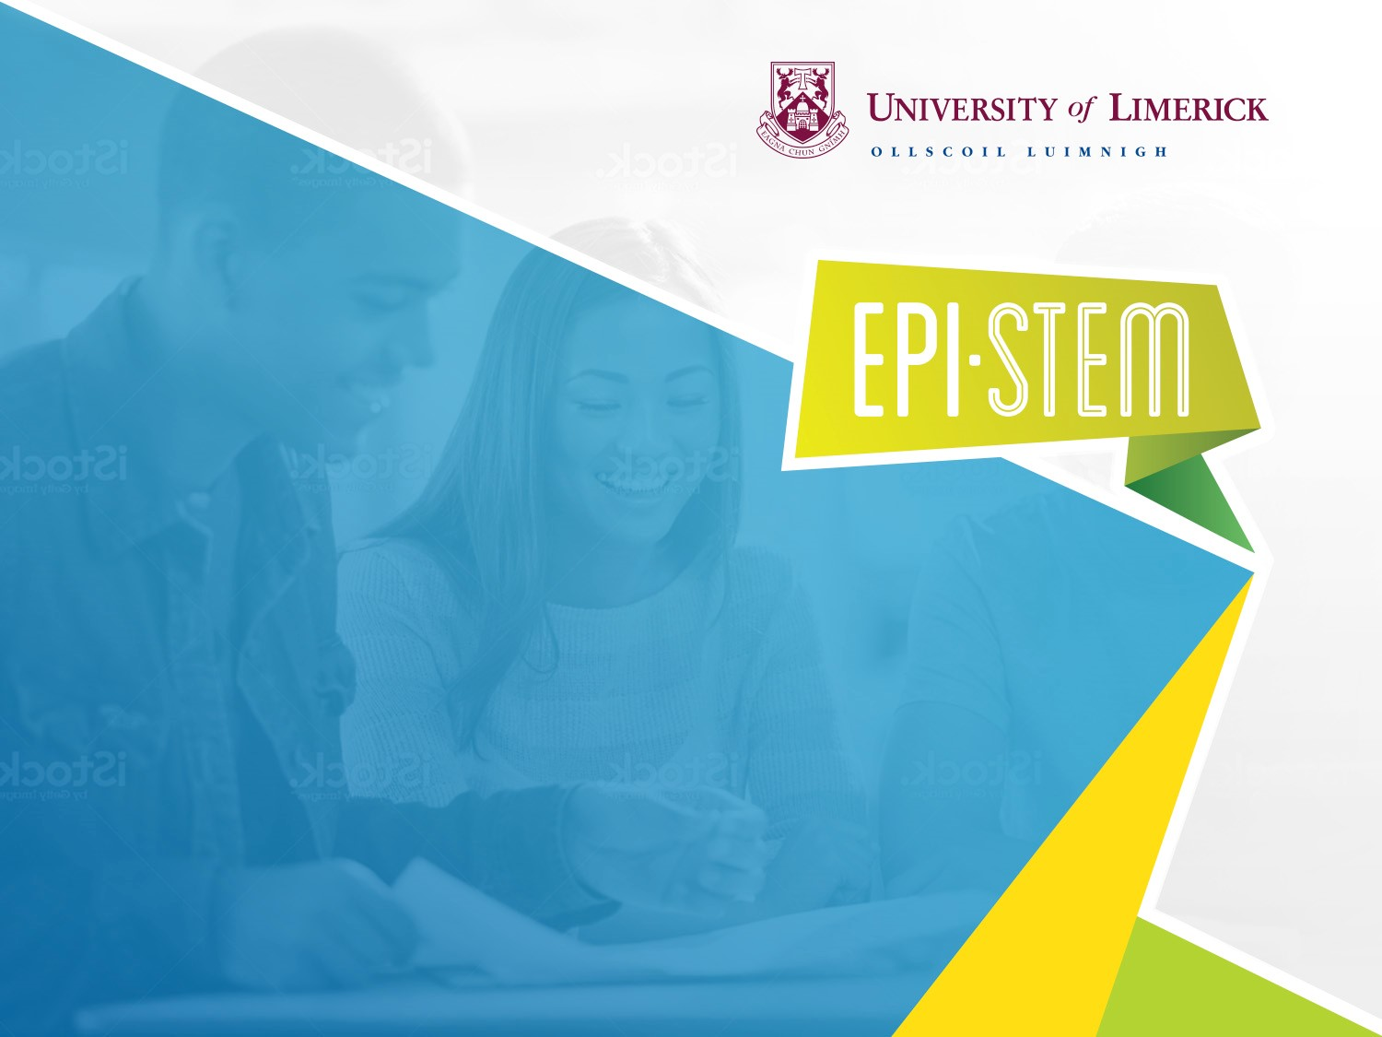
Interactive Simulations for Inquiry-Based Learning in THE PHYSICAL WORLD AND PHYSICS Suitable for Junior Cycle and Senior Cycle
NARRATOR: Geraldine Mooney Simmie & Vo Van De
EPI•STEM, University of Limerick
THIS IS A HEA FUNDED CPD PROJECT WITH EPI•STEM:

Slide 2
CPD Resource: The Physical World & Physics
1. Inquiry-based Pedagogical Approaches
2. Advantage of Interactive Simulations
3. Interactive Simulations in The Physical World
- Measuring speed and acceleration
(Suitable for Junior Cycle)
- Force and Spring
(Suitable for Junior Cycle)
- Electromagnetic induction - Faraday’s law
(Suitable for Senior Cycle)

Slide 3
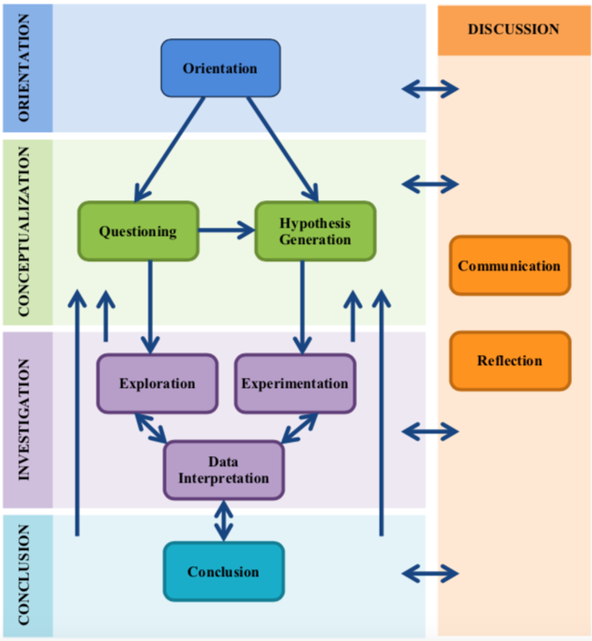
Inquiry-based Approaches: Science Teaching & Learning
General inquiry-based learning framework (Pedaste et al., 2015)
Improving your Pedagogical Repertoire
Active and Engaged Learning
Reflective Practices

Slide 4
Advantage of Interactive Simulations [SMART classroom: ICT-enhanced learning]
A simulation can include a physical system (pictures, graphs, words, diagrams, data tables)
Students observe and make visual connections between the representations and can see how one variable affects another, to gain a deeper understanding of ideas/concepts.
Science Teachers can save time and financial resources for preparing (safe) experimental lessons
Students’ hands-on experience both virtually and physically can help to support young people’s understanding of science concepts and scientific reasoning (Hake, 1998)

Slide 5
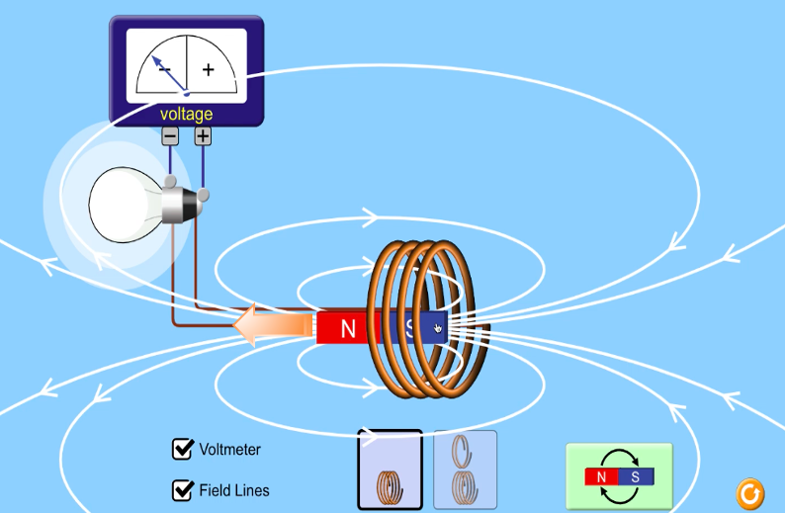
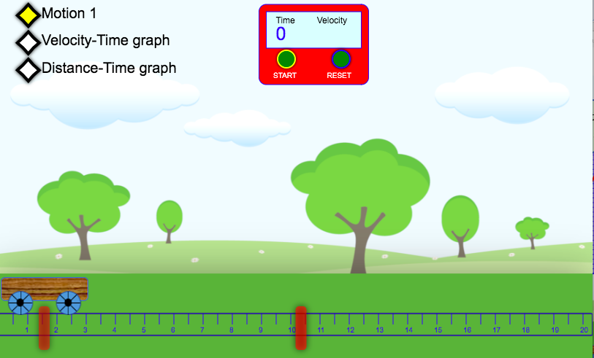
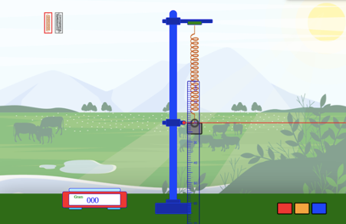
Interactive Simulations: Science Teaching & Learning
Force and Spring
(Suitable for Junior Cycle)
Electromagnetic induction - Faraday’s law
(Suitable for Senior Cycle)
Measuring speed and acceleration
(Suitable for Junior Cycle)

Slide 6
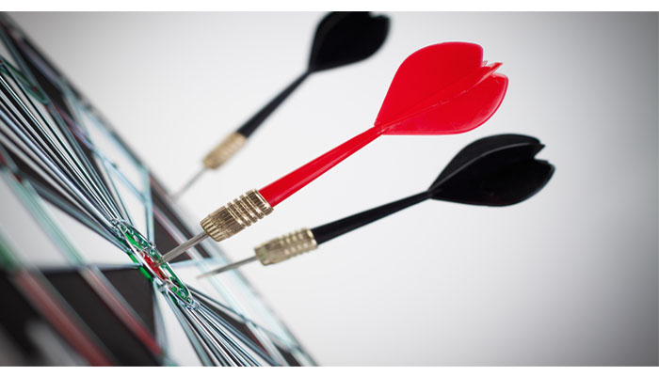
Measuring speed, velocity and acceleration
- Understand the concept of speed and acceleration
- Identify and measure/calculate distance, time, speed and acceleration.
- Investigate patterns and relationships between distance-time, velocity-time.
- Produce and select data, critically analyse data to identify patterns and relationships and interpretation.
Learning goals
This Photo by Unknown Author is licensed under CC BY

Slide 7
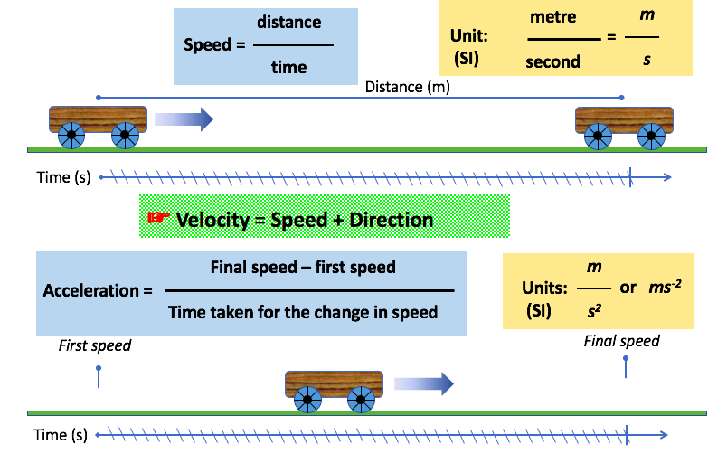
Summary of the content knowledge

Slide 8
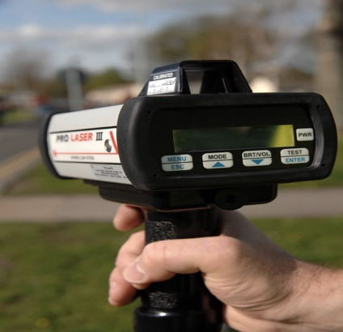
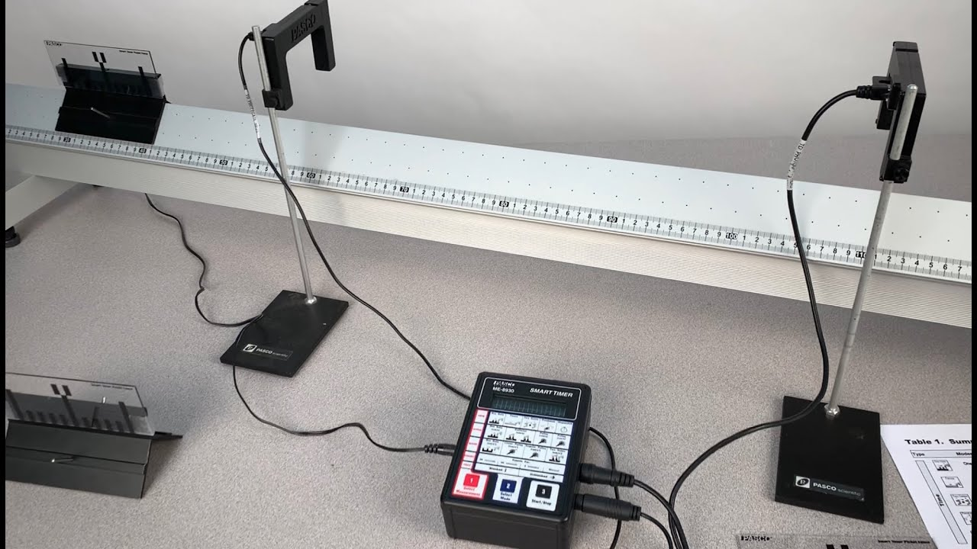
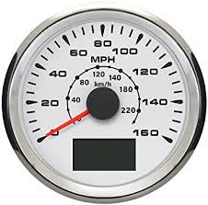
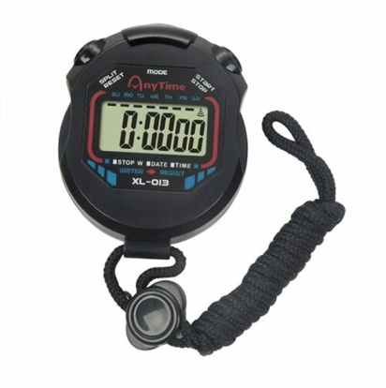
Summary of the relevant content knowledge
Tools for measuring speed
Speed gun
Speedometer
Stopwatch with light gates
Stopwatch

Slide 9
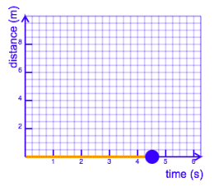
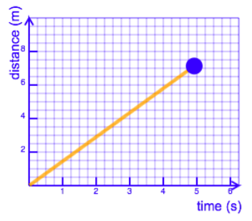
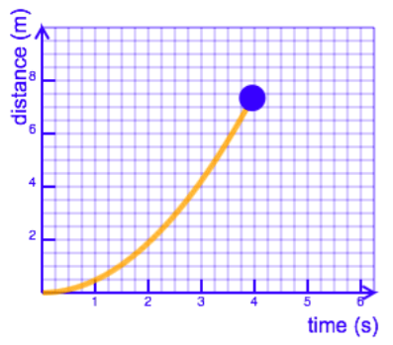
Summary of relevant content knowledge
Graphs of a motion - visual representations of a movement
The object did not move over the time observed
The object moving steadily away
The object moving acceleratively
A distance – time graph: how far away an object has moved from the observer at any given time

Slide 10
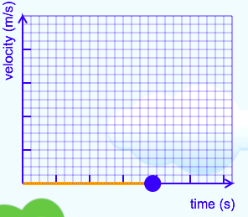
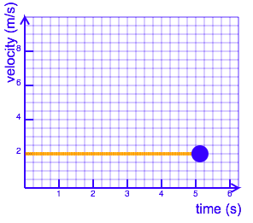
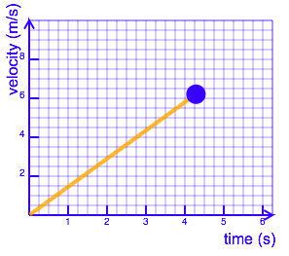
Summary of the relevant content knowledge
Graphs of a motion - visual representations of a movement
The object did not move over the time observed
The object travelling with
a constant velocity
The object travelling with
a steadily increasing velocity
A velocity – time graphs : how speed of an object has changed over time during the time an observation started

Slide 11
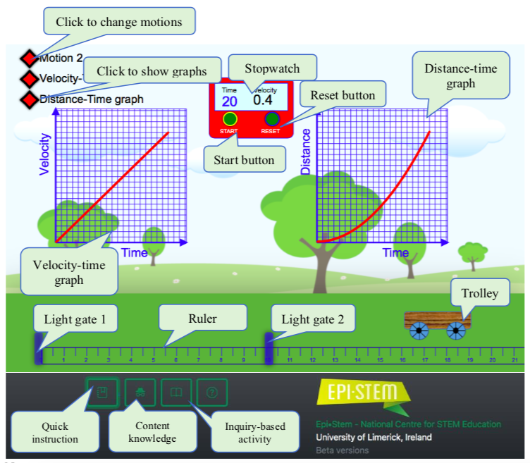
Measuring speed and acceleration with Motion Package (Suitable for Junior Cycle)
To access online version (click link or scan QR code)
Notes:
Live demonstration then

Slide 12
Interactive Simulations: Science Teaching & Learning
Force and Spring
(Suitable for Junior Cycle)
Read
CPD Physics Booklet for full instructions
Electromagnetic induction - Faraday’s law
(Suitable for Senior Cycle)

Slide 13
Bibliography
Hake, R. R. (1998). Interactive-engagement versus traditional methods: A six-thousand-student survey of mechanics test data for introductory physics courses. American Journal of Physics, 66(1), 64–74. https://doi.org/10.1119/1.18809
https://sciencenotes.org/
https://www.toppr.com/guides/physics/magnetic-effects-of-electric-current/
Interactive Simulations for Science and Math. https://phet.colorado.edu/
National Council for Curriculum and Assessment (NCCA) (2015). Junior cycle science: Curriculum specification. NCCA. https://curriculumonline.ie/getmedia/f668d804-6283-4d4a-84ab-c71e5b37d198/Specification-for-Junior-Cycle-Science.pdf.
National Council for Curriculum and Assessment (NCCA) (2018). Junior cycle science guidelines for the classroom-based assessments and assessment task: For use with CBAs from October 2018. NCCA https://www.curriculumonline.ie/getmedia/5f3e9d74-50e4-4795-bef7-9a21bd7a2e53/Assessment-guidelines_Science_March_2018_For-Principles.pdf.
O’Callanghan, M., Doyle, P., Molamphy, O., Reilly, G. (2016). Exploring Science for the New Junior Cycle. The Educational Company of Ireland.
Pedaste, M., Mäeots, M., Siiman, L. A., de Jong, T., van Riesen, S. A. N., Kamp, Manoli, C. C., Zacharia, Z. C., & Tsourlidaki, E. (2015). Phases of inquiry-based learning: Definitions and the inquiry cycle. Educational Research Review, 14, 47–61. https://doi.org/10.1016/j.edurev.2015.02.003
Van Vo, D., & Csapó, B. (2021a). Development of scientific reasoning test measuring control of variables strategy in physics for high school students: evidence of validity and latent predictors of item difficulty. International Journal of Science Education, 1–21. https://doi.org/10.1080/09500693.2021.1957515
Radi, H.A., Rasmussen, J.O. (2013). Principles of Physics for Scientists and Engineers. Springer.

Slide 14
Contact Details
Register for on-line CPD resources: https://epistem.ie
EPI•STEM project: Resources
Contact: Helen Fitzgerald, Senior Executive Administrator
Email: helen.fitzgerald@ul.ie
This on-line CPD project [HEA funded] is an initiative with EPI•STEM for science and mathematics secondary teachers in Ireland. The research-led development team includes:
Geraldine Mooney Simmie, Niamh O’Meara, Merrilyn Goos, Stephen Comiskey, Ciara Lane, Tracey O’Connell, Vo Van De, Tara E. Ryan, Martina Scully, Jack Nealon, Daniel Casey, Keith Kennedy, Annette Forster, Céren O’Connell, Martha Cosgrave, Martina Ryan, Veronica Ryan, Gemma Henstock

