Slide 1
Leaving Certificate Analysis
In the chief examiner report of 2015, financial maths was highlighted as the second highest scoring question for candidates with a mean score of 73%.
On inspection of the examination paper however, the question posed to candidates was procedural and akin to sample questions distributed by the SEC in prior years which learners and teachers would have prepared in advance.

Slide 4
Leaving Certificate Analysis
Fast forward to 2017 and the water becomes muddy. The ASTI mathematics representative describes the financial maths question as "very challenging, even for the most able students".
The format of the question had now changed and required conceptual understanding and an ability to adapt ones` knowledge of the topic. While the skills required were "reasonably standard” students “found it difficult to know where they were going with it”.

Slide 5
Misconceptions

Slide 6
Misconceptions
Can you think of any errors students may make when approaching this question?
Would students use the amortization formula? The compound interest formula?
How would you explain this question to a student?

Slide 7
Misconceptions
The mathematics required to complete this problem are taught at primary school. Yet this problem was worth ten marks in the Leaving Cert Higher Level paper! Four marks were awarded to students who wrote down any unknown of note to the question.
Many students attempt to use the compound interest formula or amortization formulas as they are given a percentage a financial value and there is mention of time and “A” in the problem. They do not understand what they are being asked to do so they revert to what they know.

Slide 8
Misconceptions

Slide 9
Misconceptions
Can you think of any errors students may make when approaching this question?
How would you explain this question to a student?
Would they have they seen a reducing balance problem like this before?
Do they understand how interest repayments work?
What patterns do we notice from the table? What remains constant, what increases, what decreases?

Slide 11
Misconceptions
The following problem can be used in conjunction with the Leaving Cert question as a teaching tool for understanding.
A graduate is setting up his own computer company. He borrows the €5000 for set-up costs for 6 months at a flat rate of 1% per month (compounded monthly). He wants to arrange to pay this off in equal monthly instalments.
(i) Calculate the monthly repayment amount.
(ii) Make a schedule showing the monthly payment, the monthly interest on the outstanding balance, the portion of the payment contributing toward reducing the debt, and the outstanding balance.

Slide 12
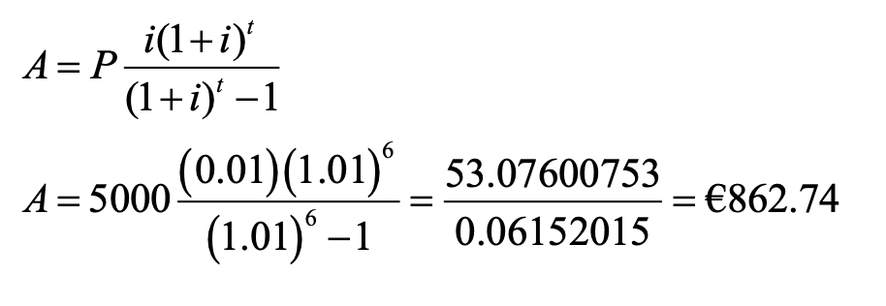
Solving for the value of the monthly repayment using the amortization formula.

Slide 13
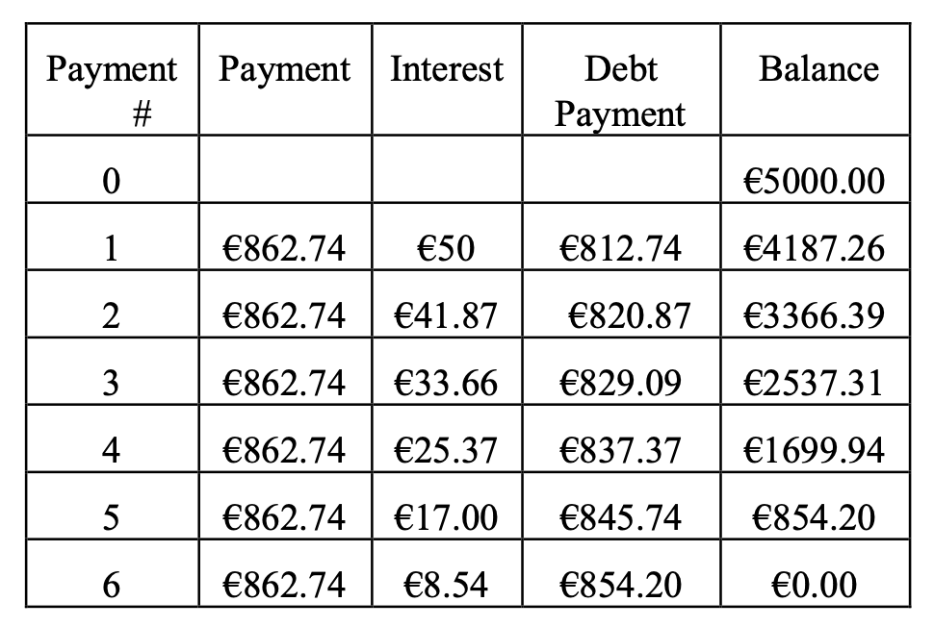
The table generated by the loan repayments.
Note how the interest amount decreases while the Debt payment increases throughout the lifetime of the loan period.

Slide 14
Contact Details
Register for on-line CPD resources: https://epistem.ie
EPI•STEM project: Resources
Contact: Helen Fitzgerald, Senior Executive Administrator
Email: helen.fitzgerald@ul.ie
This on-line CPD project [HEA funded] is an initiative with EPI•STEM for science and mathematics secondary teachers in Ireland. The research-led development team include:
Geraldine Mooney Simmie, Niamh O’Meara, Merrilyn Goos, Stephen Comiskey, Ciara Lane, Tracey O’Connell, Vo Van De, Tara Ryan, Martina Scully, Jack Nealon, Daniel Casey, Keith Kennedy, Annette Forster, Céren O’Connell, Martha Cosgrave, Veronica Ryan, Gemma Hemstock

