Slide 1
Financial Maths Leaving Certificate
Narrator: Keith Kennedy
THIS IS A HEA FUNDED CPD PROJECT WITH EPI•STEM:

Slide 2
Financial Maths
Financial maths has been highlighted as an area that maths teachers want further CPD in.
Mathematics as a subject has expanded from being the language of science to now being instrumental in the worlds of business, finance and health.
Financial maths opens doors for students and allows them to become financially literate; but do learners and teachers have the conceptual understanding and adaptive reasoning in this relatively new topic?

Slide 3
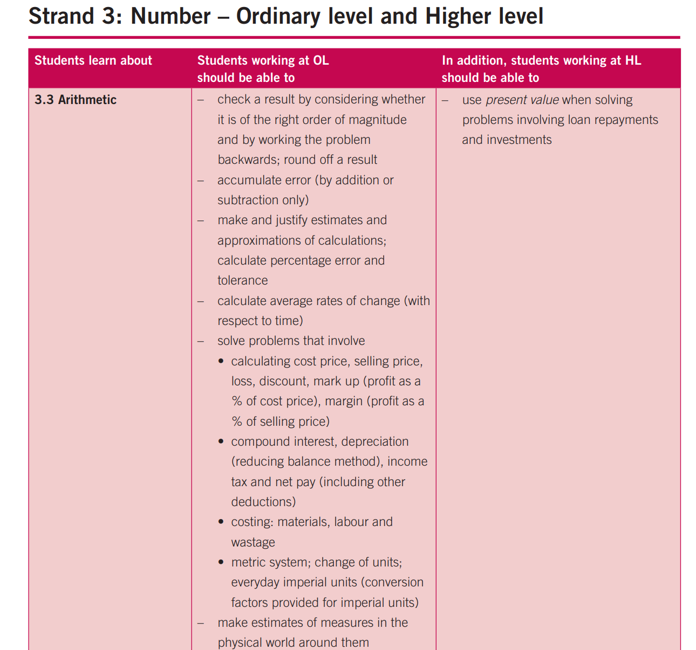
Financial Maths - Senior Cycle

Slide 4
Introduction
In general, financial mathematics is the application of mathematical methods to financial problems. It draws on tools from other mathematical strands including arithmetic, sequences and series, probability and statistics.
In the early days financial mathematics primarily consisted of the study of compound interest and Albert Einstein has been accredited with saying “Compound interest is the eighth wonder of the world. He who understands it, earns it; he who doesn't, pays it.” Compound interest has also been referred to as “the most powerful force in the universe”.
However, the area of financial mathematics has expanded and we now look at much more than compound interest including mortgage repayments, currency conversion, interest rates, savings, bonds etc. The field expands even further if one studies it at third level.

Slide 5
Introduction
When teaching financial mathematics there are many important formulae which we will undoubtedly introduce.
However, it is important that we understand where these formula came from and why they work in particular circumstances.
Some examples of formulae that might be useful when teaching this strand are:
Compound interest/Depreciation formula
Sum of geometric sequence
Amortisation formula
Reducing balance method of depreciation
Present value of money

Slide 6
Compound Interest - Definitions
Principal: “Principal” has many financial meanings. It usually refers to the original sum of money borrowed for a loan or put into a savings account or investment. (Investopedia)
Compound Interest: Compound interest is interest on savings, loans or depreciation calculated based on the initial principal and the accumulated interest from previous periods. Compound interest is sometimes called interest on the interest. (Investopedia)

Slide 7
Example
On the day Jack was born his Godfather put €1000 into a savings account for him and left it there until he was 18 years old. The bank offered an annual interest rate of 4% compounded annually.
That means at on the day Jack turns 1 there will be how much in his account?
How would you work this out?
Is there more than one way to work this out?

Slide 8
Revision: Decimals and Percentages
What is 4% as a decimal?
4 $÷$ 100 = 0.04
What is 100% as a decimal?
1 $÷$ 100 = 1.00
What about 104% as a decimal?
104 $÷$ 100 = 1.04

Slide 9
Revision: Decimals and Percentages
So, once we reach Jack’s first birthday what percentage of the original principal would he have in his account?
104% : this is because we have our original 100% plus the 4% interest our savings earned!
To calculate the new amount, we take the original principal amount and multiply it by 1.04 to find 104%.

Slide 10
Compound Interest: How does it work?
Say we win €1000 in the local GAA club lotto and want to save it. The credit union offers 4% compound interest on savings for four years if you do not withdraw any money.
So how much money would we save by the end of the four years?
The following table will help us to visualize our interest and savings over the course of the investment.

Slide 11
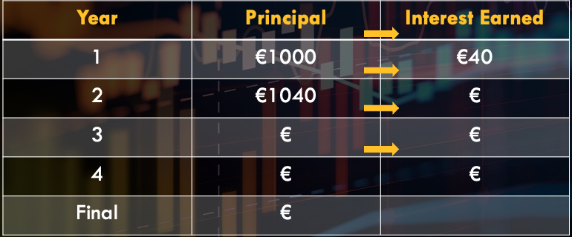
Compound Interest: How does it work?

Slide 13
Compound Interest
The table worked well in helping us to visualize how our investment grew over time.
It also allowed us to see that as we earned interest, we began to earn interest on our interest! This concept is believed to have begun in Italy in the 17th century.
Tables are time consuming however; if we were asked to work out our interest after 20 years, we could spend a long time using a table to work out our final value!
Is there a faster way?
Is there a formula we could use?

Slide 14
Compound Interest Formula: Derivation
Let’s say we want to save P Euros in the bank at an interest rate of i (as a decimal).
To calculate the the principal for year 2 we multiply P by (1 + i) to give us P(1 + i) for the start of year two.
Lets draw a table and see what we notice over the course of 4 years like in the previous lesson.
Do you notice a pattern?

Slide 15
Compound Interest Formula
Year | Principal | Principal + Interest Earned
1 | P | P x (1 + i)
2 | P(1 + i) | P(1 + i) x (1 + i)
3 | P(1 + i)² | P(1 + i)² x (1 + i)
4 | P(1 + i)³ | P(1 + i)³ x (1 + i)
Final | P(1 + i)⁴

Slide 16
Compound Interest/Future Value Formula
Did you notice a pattern?
The power of (1 + i) was equal to the time period.
The final amount F, for a principal of P, at an interest rate of i (as a decimal) for t years gives us the formula:
F = P(1 + i)^{t}

Slide 17
Futurama Example
https://www.youtube.com/watch?v=g9Z4d5EOjGs
https://www.youtube.com/watch?v=L7DvEV9kSeE

Slide 18
Bitcoin
Bitcoin is a cryptocurrency that has become famous in the last 5 years.
There are 21 million bitcoins in the world so most people buy fractions of bitcoins rather than a whole coin.

Slide 19
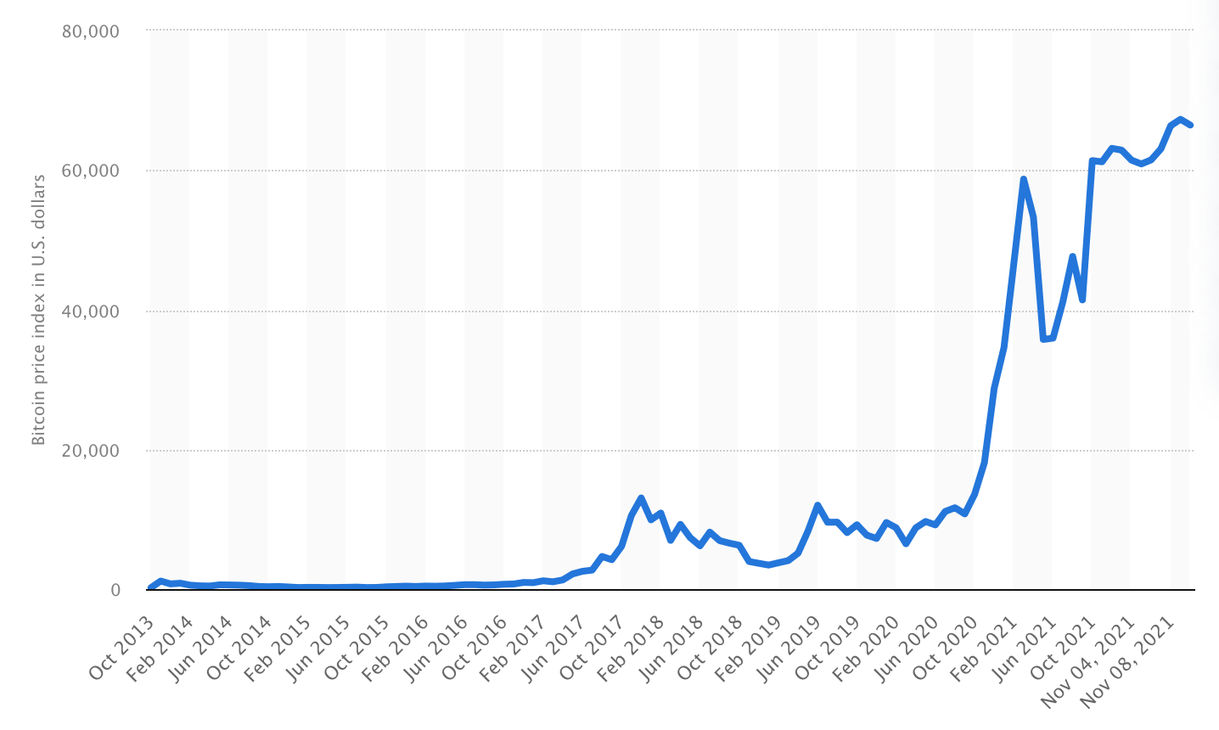
Bitcoin

Slide 20
Bitcoin
We can now earn interest on bitcoin and other cryptocurrencies much like we earn interest from banks and other financial institutions.
The average rate of interest for “crypto” is 8% compounded.
Bear in mind 2 to 3% growth is considered very desirable for normal investments and savings.

Slide 21
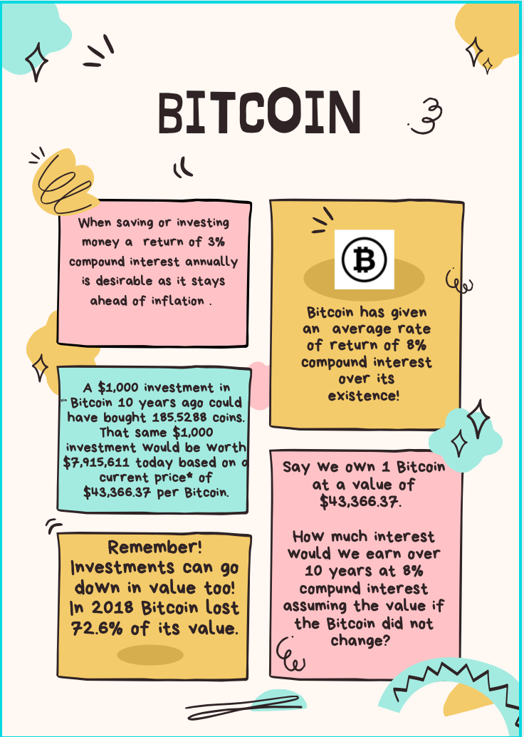
Bitcoin

Slide 22
Compound Interest Formula
Do investments and their value always have to increase?
What term do we use when an investment or asset loses value?
Where do we see this loss of value in the real world?
How could we represent a compounded loss of value by adjusting our derived formula?

Slide 23
Continuous Compound Interest and e Activity
What happens if we vary the number of compounding periods for an investment?
Let’s say you invest €1 for one year at an interest rate of 100% to be compounded n times that year.
What is the value of your investment if the interest is added:
1 year
Every 6 months
Every 3 months
Every month
Every week

Slide 24
Continuous Compound Interest and e Activity
Every day
Every hour
Every minute
Every second

Slide 25
Continuous Compound Interest and e Activity
How often interest is compounded | Final value
Yearly | F = 1(1 + 1)¹ = 2
Every 6 months | F = 1(1 + ½)² = 2.25
Every 3 months | F = 1(1 + ¼)⁴ =
Every month | F = 1(1 + $\frac{1}{12}$)¹² =
Every week | F = 1(1 + $\frac{1}{52}$)⁵² =
Every day | F = 1(1 + $\frac{1}{365}$)365 =
Every hour | F = 1(1 + $\frac{1}{8760}$)⁸⁷⁶⁰ =
Every minute | F = 1(1 + $\frac{1}{525600}$)⁵²⁵⁶⁰⁰ =
Every second | F = 1(1 + $\frac{1}{31536000}$)³¹⁵³⁶⁰⁰⁰ =

Slide 26
Continuous Compound Interest and e Activity
How often interest is compounded | Final value
Yearly | F = 1(1 + 1)¹ = 2
Every 6 months | F = 1(1 + ½)² = 2.25
Every 3 months | F = 1(1 + ¼)⁴ = 2.44140625
Every month | F = 1(1 + $\frac{1}{12}$)¹² = 2.61303529
Every week | F = 1(1 + $\frac{1}{52}$)⁵² = 2.69259695
Every day | F = 1(1 + $\frac{1}{365}$)365 = 2.71456748
Every hour | F = 1(1 + $\frac{1}{8760}$)⁸⁷⁶⁰ = 2.71812669
Every minute | F = 1(1 + $\frac{1}{525600}$)⁵²⁵⁶⁰⁰ = 2.71827923
Every second | F = 1(1 + $\frac{1}{31536000}$)³¹⁵³⁶⁰⁰⁰ = 2.71828162

Slide 27
Continuous Compound Interest and e Activity
Conclusion: As we compound the interest more frequently the rate of growth of our investment appears to slow down.
We can see that a limit exists at a value close to 2.7182. We can state with certainty that the value of the investment will never exceed 2.72. No matter how many times we compound the interest we cannot exceed this value.
As n, the number of compounding periods gets larger and larger, the “unrounded” amount is getting closer and closer to the number called e.

Slide 28
Continuous Compound Interest and e Activity
We can state that the $\lim_{n→∞}{{\left(1+\frac{1}{n}\right)}^{n}}$ = e represents the unrounded amount to which €1 would grow in a year if the nominal rate were 100% and the number n of compounding periods per year increased without limit; that is when the interest is compounded continuously.

Slide 29
Depreciation
Depreciation: a reduction in the value of an asset over time, due in particular, to wear and tear.
For the car owners: cars generally lose between 40% to 50% of their value in the first three years of ownership.

Slide 30
Depreciation Formula
Begin with the compound interest formula
F = P(1 + i)^{t}
Try to think of depreciation as negative interest.
How would we represent this in our formula?
F = P(1 - i)^{t}
We have now found a formula to represent compounded depreciation over time!

Slide 31
Depreciation: Example
Say we buy a second-hand Toyota Auris for 18950 euro.
We know that depreciation will be 15% per annum for the next 3 years.
What value will the car have at the end of this period to the nearest euro?

Slide 32
Depreciation Formula
F = P(1 - i)^{t}
P = 18950; i = 0.15 (convert to a decimal); t = 3
F = 18950(1 – 0.15)³
F = 18950(0.85)³
F = 11638

Slide 33
Reflective Practice
How did I teach this topic before?
How will I teach it now?
Will I change something here?
Will I stay the same in some areas?

