Slide 1
Ecology – Leaving Certificate Human Impact on Ecosystems.
Narrator – Martha Cosgrave
THIS IS A HEA FUNDED PROJECT WITH EPI-STEM

Slide 2
Learning outcomes

Slide 3
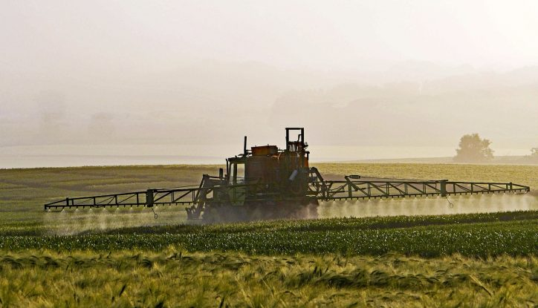
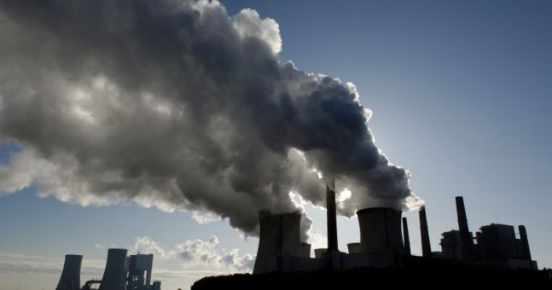
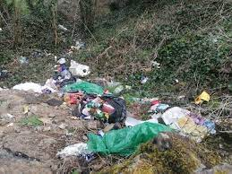
Pollution
Domestic
Agricultural
Industrial

Slide 4
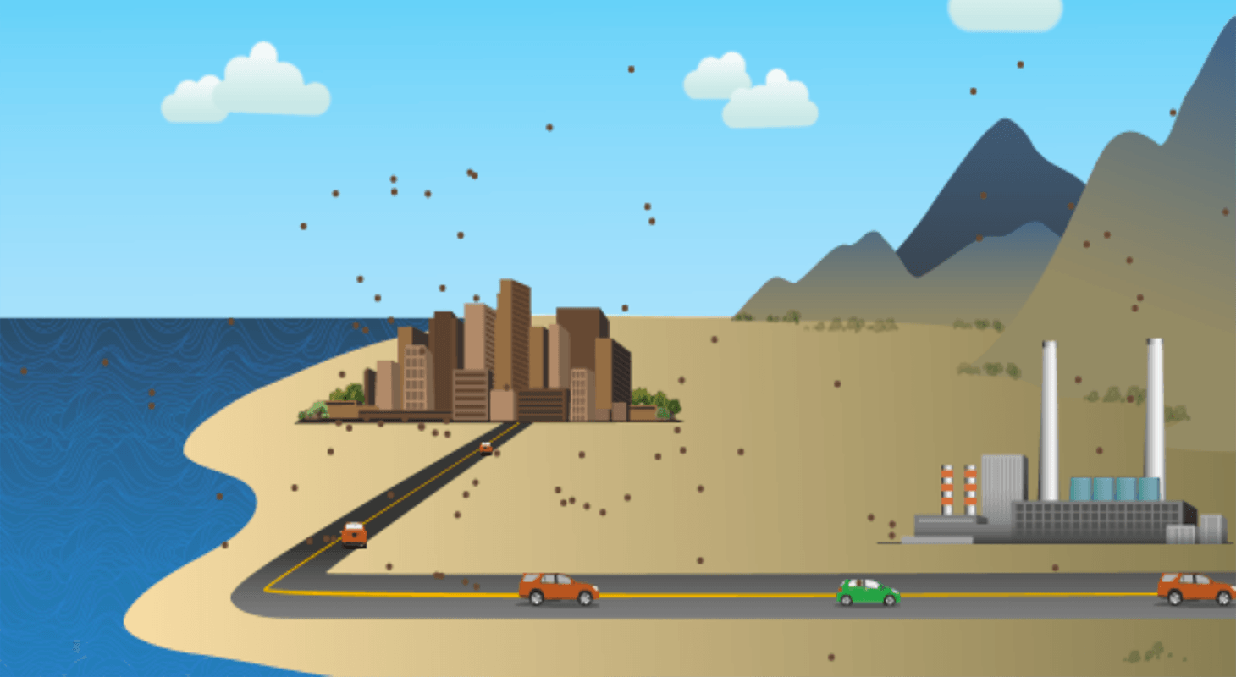
Air Pollution
Air Pollution Simulation click here

Slide 5
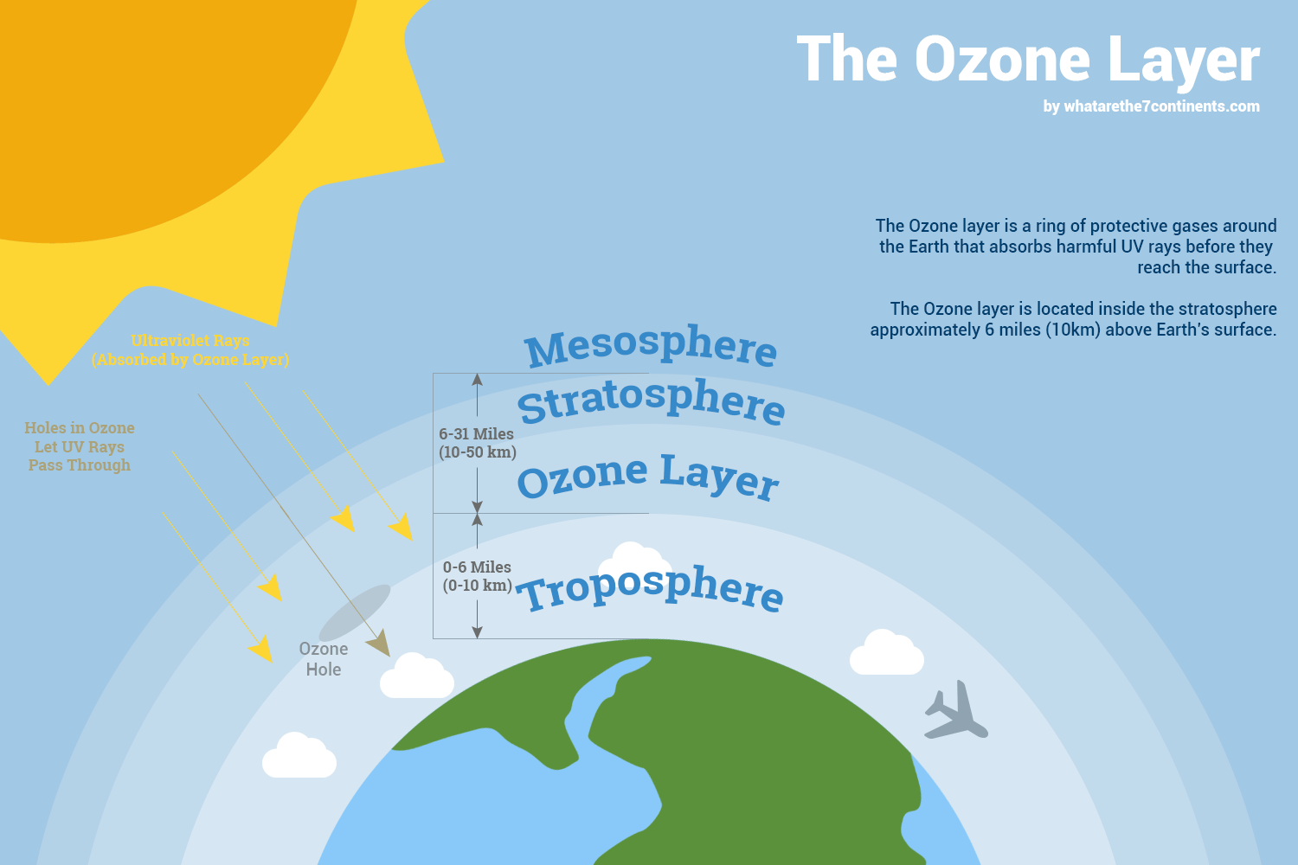
Student Inquiry activity.
Give the Students an opportunity to complete their own research on Ozone Layer Depletion.
Group students into teams of 3 or 4.
Students research the depletion and find the:
Cause
Effects
Control
Students make a presentation to the class using the information which they have found and suggesting ethical solutions.
Notes:
This activity brings back skills which students have previous experiences of from the junior cycle. Student have to critically think about the information they obtain and the source of this information.
Having students research information encourages students to become more hands-on. As students complete their research the teacher can circulate the room providing students with prompts and formative feedback.
As each group is presenting the other groups must come up with a question to ask the group presenting, this encourages all students to engage and actively listen.
Link to some information:
https://www.teachengineering.org/content/cub_/lessons/cub_air/cub_air_lesson08_ozone.pdf

Slide 6
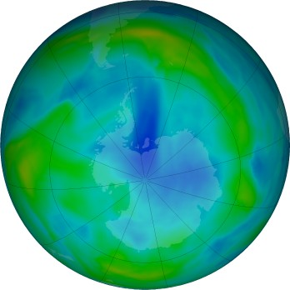
Ozone depletion
This link to the NASA website provides a real life image of the Ozone layer over the course of the year and previous years.
NASA Ozone Watch
Ozone layer 24th June 2022

Slide 7
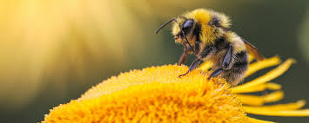
Conservation
The wise management of existing natural resources in an ecosystem.
Notes:
Ask students if they have heard of any conservation efforts.
Students make be familiar with bee conservation from wild flower gardens.
Conservation of Honeybee in Ireland https://www.youtube.com/watch?v=JMhvcd0KbEI

Slide 8
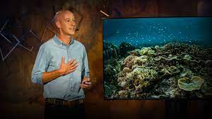
Ted Talk
Video shows how fishing villages are tackling overfishing.
Video Here
Notes:
Encourages students to think about conservation and the different that small changes can make to conservation. Brings in critical thinking and encourages students to think about ethical issues.

Slide 9
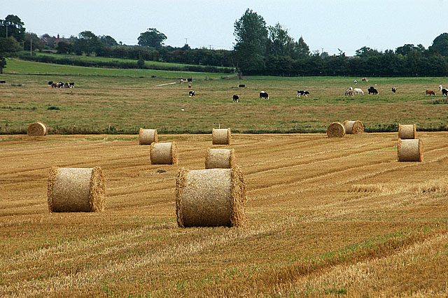
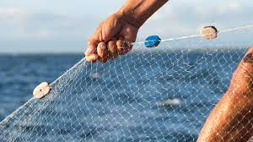
Conservation Practices.
Area | Conservation Practices
Agriculture | Mixed farming, crop rotation, Biological controls, Gene Banks.
Fisheries | Appropriate fishing net size, Quotas, Re-stocking.
Forestry | Re-planting, using a broadleaf/conifer mix.

Slide 10
Waste Management
Agriculture
Slurry
Plastic
Causes:
Eutrophication
Pollution
Solution:
Storing and recycling slurry appropriately.
Disposing of material appropriately
Fisheries
Fish offal
Plastic netting
Causes:
Pollution
Solution:
Composting fish waste, creating fertiliser.
Disposing of plastic material appropriately.
Forestry
Tree tops, branches.
Sawdust.
Causes:
No negative effect
Solution:
Waste products are allowed to slowly decay naturally and release nutrients back to forest floor.
Sawdust recycled to make MDF.

Slide 11
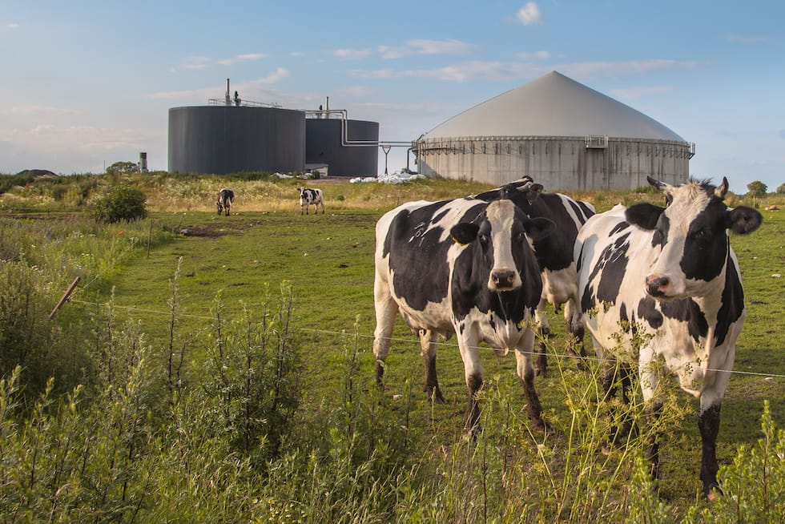
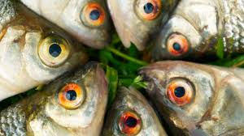
Does it have to be waste??
Waste products can be turned around and used for good purposes.
Anaerobic Digestion - uses microorganism to convert feedstocks to electricity and the “waste” product can be used as a fertiliser.
Fish waste is converted to pig and chicken feed in Killybegs Co. Donegal.
Fish waste is also being used as a fertiliser in agriculture.
Notes:
Information regarding anaerobic digestion. https://www.teagasc.ie/media/website/rural-economy/rural-developent/diversification/Energy-2-Anaerobic-Digestion.pdf

Slide 12
Waste disposal problems
Give the students the floor!!
Group students into groups of 3/4.
Gives each group a topic
Allow students time to research the topic.
Each group presents the information found.
Notes:
Topic ideas:
Disease
Toxic chemicals
Nutrient release
Sea pollution
Landfills
Incinerators

Slide 13
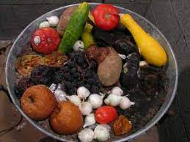
Role of micro-organisms – Organic matter.
Clip showing fruit and vegetables decomposing Click Here.
Notes:
This video clip shows biodegradation in slow motion.

Slide 14
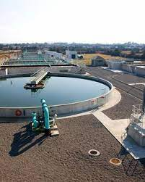
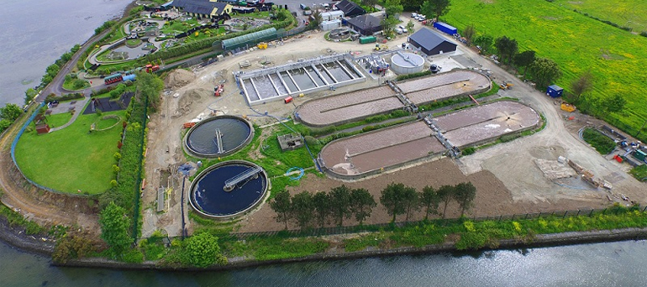
Role of microorganisms – Sewage
Primary treatment – Physical
Secondary treatment – Biological
Bacteria and Fungi breaks down organic waste.
Tertiary treatment – Removes minerals
Video Here
Notes:
Sewage is composed of waste from toilets, bathrooms or industry and rainwater from drains.
Primary treatment involves the physically filtering and screening waste and allowing it to settle. Large objects and solids are removed.
Secondary treatment is a biological process. This uses bacteria and fungi to break down organic matter. The liquid waste is aerated to allow the breakdown,
Tertiary treatment removes mineral nutrients such as phosphates and nitrates.
On this slide there is a link to a national geographic video which goes through the process of waste water treatment.

Slide 15
Controlling Waste Production
Notes:
Reduce – reuse - recycle is a way to control waste production.
Reduce – this can be done by reducing our need for goods and looking at the packaging being used unnecessarily.
Reuse – reuse objects that would be usually discarded. Example is reusing glass jars and glass bottles. Donating our clothing and getting any new clothes from second hand outlets.
Recycling – materials are nowadays collected, treated and reformed into new products. Paper and plastics are examples. Organic matter can be broken down by oxygen requiring bacteria into compost and used in soils to improve the growth of plants.

Slide 16
References
Domestic Pollution https://www.independent.ie/regionals/sligochampion/news/disgust-as-household-rubbish-dumped-near-collooney-railway-station-41517105.html
Agricultural pollution https://verde.ie/blog-post/rising-ammonia-emissions-key-contributor-to-air-pollution-in-ireland/
Industrial pollution https://www.joe.ie/news/four-people-die-in-ireland-every-day-from-air-pollutionaccording-to-the-climate-minister-567403
Air Pollution https://learn.concord.org/resources/855/air-pollution-model-cross-section
Ozone layer: https://www.teachengineering.org/lessons/view/cub_air_lesson08
Bee image http://www.cec.org/strengthening-regional-pollinator-conservation-to-secure-local-benefits-1/
Ted talk https://www.ted.com/talks/alasdair_harris_how_a_handful_of_fishing_villages_sparked_a_marine_conservation_revolution?language=en
Fish waste https://www.foodnavigator.com/Article/2015/10/12/Conversion-of-fish-waste-to-flavours-could-be-commercially-viable-say-researchers
Anaerobic digestion : https://www.rubicon.com/blog/anaerobic-digestion-food-waste/
Mixed Farming https://commons.wikimedia.org/wiki/File:Mixed_farming_-_geograph.org.uk_-_2056108.jpg
Fishing net https://www.zsl.org/conservation/regions/asia/net-works
Forestry https://ecoplan.ie/native-woodland-conservation-ecoplan-forestry-ltd/
Presentation https://www.vecteezy.com/vector-art/6834216-workers-doing-presentation
Waste water treatment https://www.dutchwatersector.com/news/first-of-three-nereda-wastewater-treatment-plants-in-ireland-took-flow
Waste water 2: https://www.murphygroup.com/ie/what-we-do/our-sectors/water/wastewater-treatment
Reduce reuse recycle https://medium.com/evolve-you/10-ways-to-reduce-reuse-recycle-83dd37a088aa

Slide 17
Contact details
Register for on-line CPD resources: https://epistem.ie
EPI•STEM project: Resources
Contact: Helen Fitzgerald, Senior Executive Administrator
Email: helen.fitzgerald@ul.ie
This on-line CPD project [HEA funded] is an initiative with EPI•STEM for science and mathematics secondary teachers in Ireland. The research-led development team include:
Geraldine Mooney Simmie, Niamh O’Meara, Merrilyn Goos, Stephen Comiskey, Ciara Lane, Tracey O’Connell, Vo Van De, Tara E. Ryan, Martina Scully, Jack Nealon, Daniel Casey, Keith Kennedy, Martina Ryan, Annette Forster, Céren O’Connell, Martha Cosgrave, Veronica Ryan, Gemma Henstock

