Slide 1
Ecology – Leaving Certificate Energy flow through the ecosystem.
Narrator – Martha Cosgrave
THIS IS A HEA FUNDED PROJECT WITH EPI-STEM

Slide 2
Learning Outcomes

Slide 3
What students already know.
Notes:
From the junior cert curriculum students have an understanding of energy flow in an ecosystem.
They have a basic understanding of food webs and food chains and how energy and matter differ.
Key Words:
Producer
Consumer
Decomposer
Primary, secondary and tertiary consumer.

Slide 4
Primary Source of energy
Notes:
An ecosystem needs a constant input of energy from an external source.
Our students must be comfortable with the understanding that the primary source of our energy for our planet is the sun.

Slide 5
Sun – producer – primary consumer – secondary consumer.
Notes:
Trophic levels
Sun provides energy in the form of food for the producer.
The producer provide energy for the primary consumer. Etc.

Slide 6
Food Chain
Notes:
A food chain is a sequence of organisms in which one is eaten by the next member in the chain.
In this food chain the sun is the producer. The plant uses energy of the sun to create food in the form of glucose. The grasshopper is the primary consumer as it eats the plant. The rat is the secondary consumer and the snake is the tertiary consumer. In this case the snake is the top consumer.
As 90% of the energy is lost where does this energy go?
Why are food chains short? How do you think populations are affected as we move up through the pyramid?

Slide 7
Food chain length.
Notes:
As we already know only approximately 10% of the energy is passed from one trophic level to the next. The other 90% of the energy is used by the organism or is lost as heat or waste.
Therefore the amount of energy passed along the chain decreases. This is why the length of the chain is short. The fox has to use lots of energy to get its prey (blackbird). So if something was to hunt the fox it would use too much energy hunting. This is why the chain ends with the fox.

Slide 8
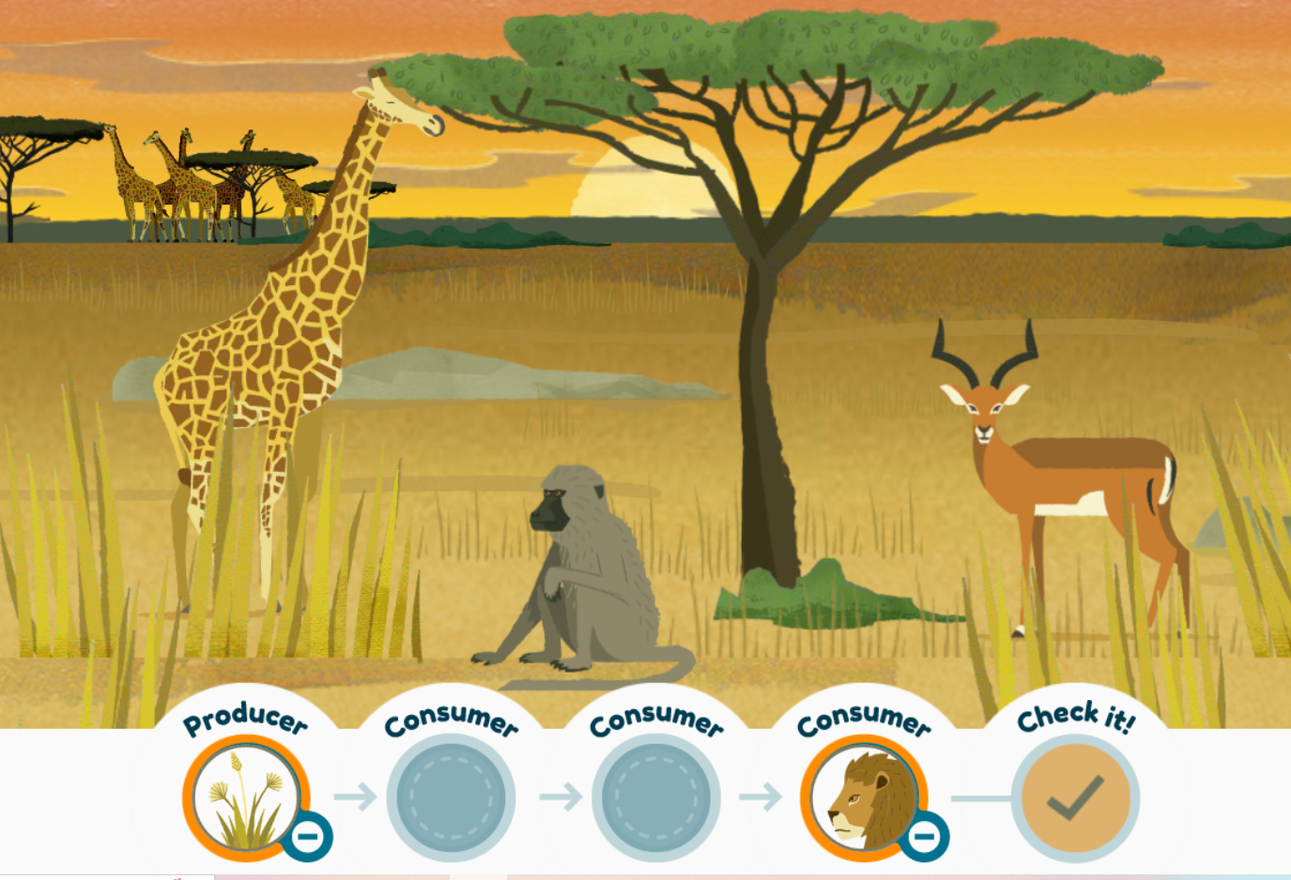
Food chain games
Food chain game for students
Build a food chain game
Multiple food chain activities
Notes:
This may see like a simple exercise however, giving students time in the classroom to interact with food chains can be very useful for students as they are engaging directly with the content.
These activities can prove very useful as the students are building their own food chain and in turn are learning by doing.

Slide 9
Food Webs
Notes:
A food web consists of two or more interlinked food chains. These webs show the feeding inter-relationships in an ecosystem. They model flow of energy through an ecosystem.
This shows an example of a food web found in a grassland habitat. Visual aids are extremely important for students and practicing drawing and labelling food webs can help students to gain confidence constructing these webs.
Speaking to students about the importance of links in the food web is important. Links higher up in the food web rely on the lower links. Even though Badgers don't eat dock leaves, they wouldn't last long if there wasn't any dock leaves because then the slugs wouldn't have anything to eat.

Slide 10
Food Web activities.
Food web activity
Simple Worksheet
Using Dominoes to highlight energy flow.
Notes:
Food web tag. Activities that takes place outside the classroom and encourages active learning.
Worksheet has extension opportunity for students to make their own food web.
Energy flow though the eco system is important for students to understand and has previously been covered in the junior cert curriculum. Therefore this should just be reinforced for students.

Slide 11
Trophic level pyramid

Slide 12
Pyramid of numbers
Notes:
A pyramid of numbers represents the numbers of organisms at each trophic level in the food chain. The number of organisms usually decreases as we move up through the food chain.
This is due to the high energy loss at each trophic level. This means there is less energy available for the organisms as we move up along the chain.
The organism size also increases as we move along the chain.
The example given on this slide is the food chain Grass → Field Mouse → Badger. There is an abundance of grass to feed the mouse. There are fewer mice than grass, there are fewer badgers.

Slide 13
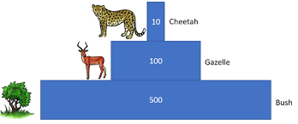
Steps to creating a pyramid of numbers
Identify and count the primary producer and place them on the base of the pyramid.
Count the different consumers and include them based in their status. Identify the primary and secondary consumer.
Place the top consumer (tertiary consumer) on the top of the pyramid
Construct the pyramid so that the area/volume of each level is proportional to the number of organisms found.

Slide 14
Sample Question
Sample question for students
Draw the following food chain
Rabbits(3) Dandelions (15) Fox (1)
Construct the pyramid of numbers for the chain.

Slide 15
Niche
The ecological niche of an organism is the functional role that it plays in the community.
Notes:
An organisms niche includes what it eats, what it is eaten by, how it interacts with other organisms and its abiotic environment.
Two species with identical niches cannot survive in the same habitat for long.
This would lead to competition between the two species.

Slide 16
References
Useful links:
https://www.earthreminder.com/how-does-energy-flow-through-an-ecosystem/
Image links:
Energy flow and food chain https://www.earthreminder.com/how-does-energy-flow-through-an-ecosystem/
Solar energy: http://www.thunderboltkids.co.za/Grade4/03-energy-and-change/chapter1.html
Pyramid of numbers https://keystagewiki.com/index.php/Pyramid_of_Numbers
Fox https://www.dreamstime.com/stock-illustration-sly-cartoon-fox-pondering-his-next-move-image70447328
Niche https://eco-intelligent.com/2016/09/28/habitat-and-niche/

Slide 17
Contact details
Register for on-line CPD resources: https://epistem.ie
EPI•STEM project: Resources
Contact: Helen Fitzgerald, Senior Executive Administrator
Email: helen.fitzgerald@ul.ie
This on-line CPD project [HEA funded] is an initiative with EPI•STEM for science and mathematics secondary teachers in Ireland. The research-led development team include:
Geraldine Mooney Simmie, Niamh O’Meara, Merrilyn Goos, Stephen Comiskey, Ciara Lane, Tracey O’Connell, Vo Van De, Tara E. Ryan, Martina Scully, Jack Nealon, Daniel Casey, Keith Kennedy, Martina Ryan, Annette Forster, Céren O’Connell, Martha Cosgrave, Veronica Ryan, Gemma Henstock

