Slide 1
Ecology – Leaving Certificate (Higher Level)
Narrator – Martha Cosgrave
THIS IS A HEA FUNDED PROJECT WITH EPI-STEM

Slide 2
Learning Outcomes

Slide 3
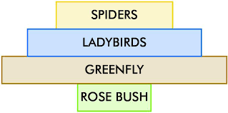
Pyramid of numbers – Limitations
Organism size is not always taken into account. This gives rise to an inverted pyramid.
A large number of greenfly feed on one rose bush.
Notes:
A pyramid of numbers represents the number of organisms at each trophic level in the food chain. The size of organisms is not taken into account, Looking at this pyramid there are a large number of greenfly which is represented by the largest rectangle. All of the greenfly live in the one rose bush. This can be represented using an inverted pyramid.

Slide 4
Pyramid of numbers – Limitations.
Parasitic food chains – a large number of mites can survive on one greenfly.
Can result in inverted pyramid or a partially inverted pyramid of numbers.
The number or organisms be so high that the pyramid cannot be drawn to scale.
Notes:
Another limitation of a pyramid of numbers is the representation of a parasitic food chain. When representing these food chains a partially inverted pyramid of numbers should be used. One oak tree can feed millions of greenfly. These greenfly can host a greater number of mites. The spiders then feed on the greenfly and therefore the mites that life on the greenfly.
The final limitation is the scale of the pyramid. Is it possible to represent the millions of mites compared to the one oak tree?

Slide 5
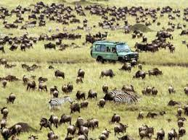
Population Control.
Factor that control population:
Competition
Predation
Parasitism
Symbiosis
Notes:
As we know the definition for population is all the members of a species living in an area.
There are factors that have an impact on population. These factors help to maintain a balance in the population numbers. This is the balance of nature.
This ensures that the population remains close to what the habitat can support.
The factors are:
Competition
Predation
Parasitism
Symbiosis

Slide 6
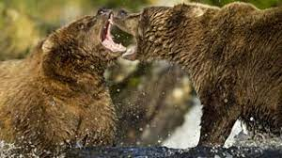
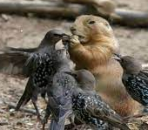
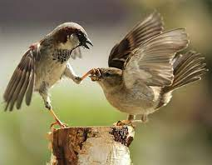
Competition
Occurs when organisms actively struggle for a resource that is in short supply.
Intra-specific competition: takes place between members of the same species.
Inter-specific competition: occurs between members of different species.
Simulation Here!!
Notes:
Competition: occurs when organisms actively struggle for a resource that is in short supply. Competition reduces the number of organisms. Intra-specific competition takes place between members of the same species. An example of this is two brown bears competing for territory for feeding. Inter-specific competition occurs between members of different species. An example is different bird species competing for food.
This slide provides a link for a simulation which shows competition.

Slide 7
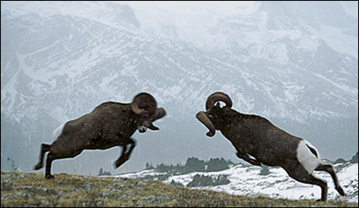
Types of competition
Contest competition: There is an active physical contest between two individual organisms.
Scramble competition: all of the competing individuals get some of the resources.
Notes:
There are two different types of competition. Contest competition and scramble competition. Contest competition is an active physical contest between two individual organisms, one individual gets all the resources. An example of contest competition is how birds or deer defend a territory. In scramble competition all of the competing individuals get some of the resources. This competition may mean that none of the individuals get enough resources to thrive. An example of scramble competition is the overcrowding of seedlings in a flowerbed.

Slide 8
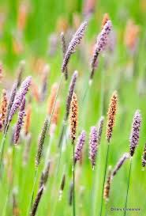
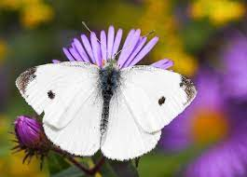
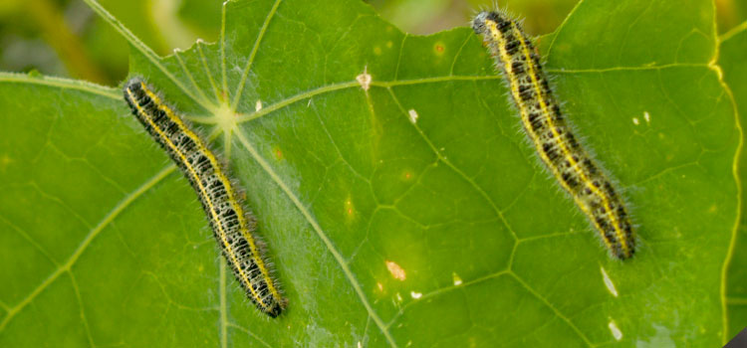
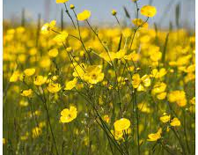
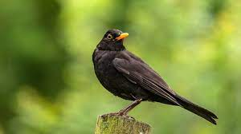
Avoiding Competition
Done by adapting to their environment.
Notes:
Species need to avoid competition if they are to survive. Species do this by adapting to their environment.
A grass plant produces large quantities of pollen increasing its chance of reproducing.
Blackbird ‘song’ to warn competitors to stay away.
Yellow petals of buttercups to attract insect pollinators.
Bacteria in soil secrete chemicals to inhibit their competitors.
The caterpillar of the cabbage white butterfly chews on cabbage leaves, while the adult butterfly drinks nectar from flowers

Slide 9
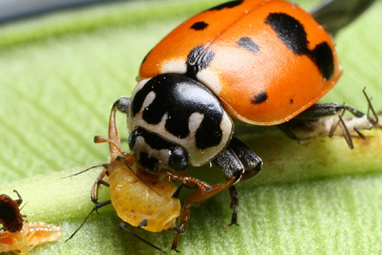
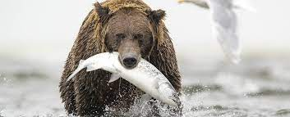
Predation
Predation is the catching, killing and eating of another organism.
Notes:
Predation is the catching, killing and eating of another organism. An example of predation is the brown bear catching and killing salmon. Another include a ladybird catching and killing aphids.

Slide 10
Self directed learning – Predators and Prey.
Research – Place students in groups of 3/4 and split the groups into predator or prey.
Give the students time to research a predator or prey.
Each group presents their research to the class.
Notes:
Self directed learning.
Give students opportunity of complete their own research on predators and prey.
Place students into groups of three or four this is a great opportunity for mixed ability grouping and peer teaching. Give the group a topic of predator or prey.
Students take a predator or prey and research their adaptations.
Once the students complete their research they present it to the class.

Slide 11
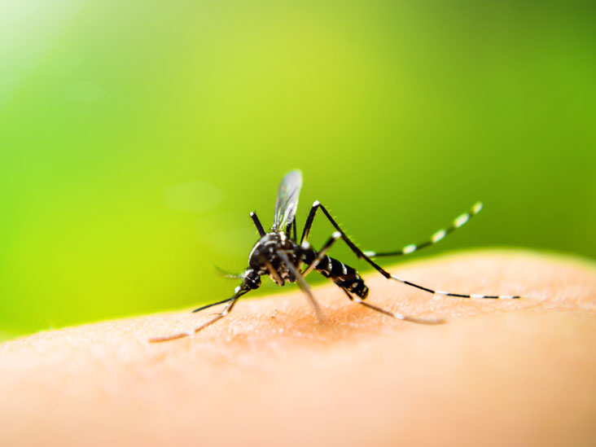
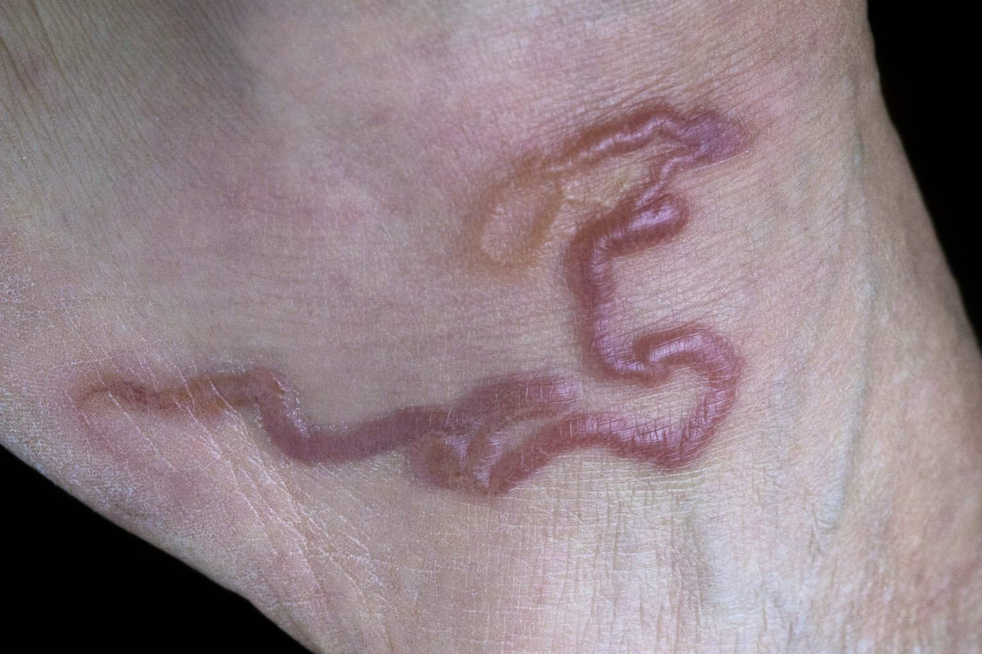
Parasitism
Occurs when two organisms of different species live in close association and one organism (the parasite) obtains its food from, and to the disadvantage of, the second organism (the host).
Exoparasites: live outside the host.
Endoparasites: live inside the host.
Build a parasite activity. Click here
Notes:
Parasites live in or on the body of the host.
Exoparasites live outside of the body of the host. Examples fleas on dogs, mosquitoes or leeches on humans skin.
Endoparasites live inside the host . Examples liver fluke in sheep and cattle. Potatoes blight, fungus in potatoes. Tapeworms or hookworms in the human body.
Weaken their host but do not kill.

Slide 12
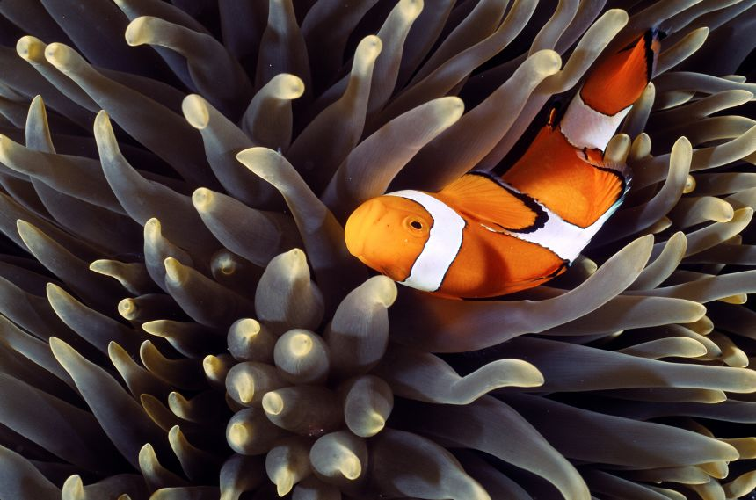
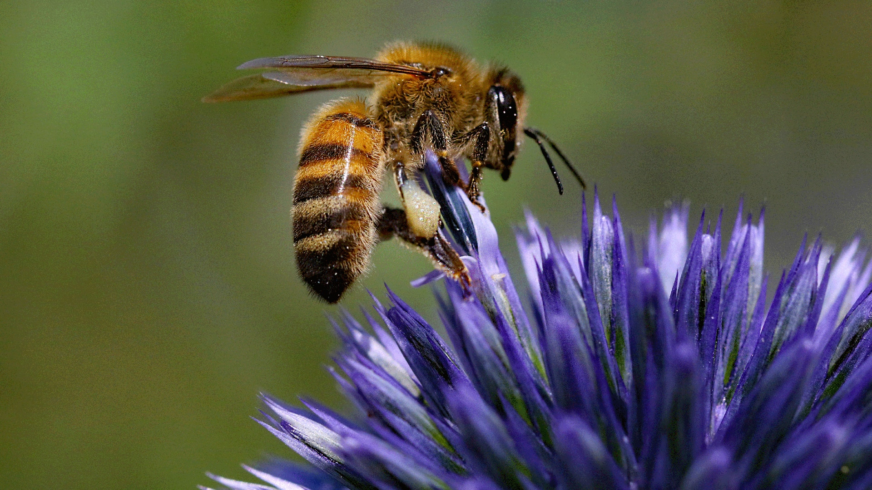
Symbiosis
Symbiosis occurs when two organisms of different species live (and have to live) in close association and at least one benefits.
Mutualism – when two organism of different species live in close association and both benefit.
Increases the numbers of both organisms involved.
Notes:
Parasitism is a form of symbiosis, the parasite gets the benefit and the host is harmed.
Mutualism is when both organisms benefit from the association.
The anemone provides the clownfish with protection and shelter, while the clownfish provides the anemone nutrients in the form of waste while also scaring off potential predator fish
Bee acts as a pollinator for the plant while the plant provides the bee with food.
Other examples of mutualism
Cellulose digesting bacteria in the mammalian intestine. The bacteria get food, shelter, warmth and moisture.
Bacteria in the large intestine of humans. The bacteria produce vitamins B and K while the bacteria get food and shelter.
Lichen which are composed of algae and fungus, algae get protection minerals and support and fungus get food.
Nitrogen fixing bacteria in the nodules of some plants (clover) bacteria get food, shelter and anaerobic conditions and clover gets nitrates.

Slide 13
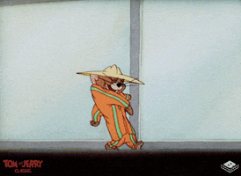
Population dynamics
Factors affecting predator-prey interactions
Availability of food
Concealment
Movement of predators.
Notes:
Population dynamics refers to the factors that cause a change in population numbers.
The numbers of predators and prey are interrelated. As the number of prey increase the numbers of predators increase and as the numbers of prey decrease the numbers of predator decrease.
The factors that affect predator prey interactions are:
Availability of food, concealment and movement of predators.

Slide 14
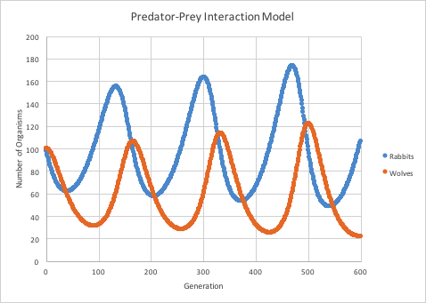
Population Dynamics
Notes:
Have students study the graph and interpret the information.
Students should recognise that as the numbers of rabbits increases the numbers of wolves increases. Therefore there is more rabbits being killed and the numbers start to decline.
This then results in fewer foxes which is why we note a decline in the population.
As the numbers of predators falls the number of prey increase and this continues in a cycle.

Slide 15
Human population growth
Notes:
The population has grown very rapidly since 1850. The worlds population is increasing by approximately 75 million people per year, Experts expect that the population will stabilise in 2100 at 10 billion. The increase in population is caused by reduced death rates, better medicine, improved sanitation and public health, better access to resources, diet and exercise. 1850 marks the start of the Industrial Revolution and more people coming to live and work in urban settings and receiving waged labour. While public health and access to leisure time was denied for many years to a majority of people, there were incremental improvements and finally a number of breakthroughs that supported improved public health services and better diets and access to education and the concept of a good life. The population of the planet went over the 7 billion mark for the first time in 2010. The world is divided in relation to these gains and there are many parts of the world today where people die from starvation, famine, diseases and where large populations of poor people and women fail to receive access to education and resources for a good and shared life.

Slide 16
Human-made Factors affecting human population numbers
War
Famine
Contraception
Disease
Notes:
There are a number of human-made factors that influence the growth of the human population.
Examples of these factors are war, famine, contraception and disease.
War - reduces population as a result of death rate. Temporary effect: a baby boom (increase in birth rate) follows.
Famine – reduces population numbers. The lack of food leads to malnutrition and death due to disease or starvation.
Contraception – use of contraception has decreased birth rate and rate of population growth, especially in developed countries.
Disease – improved disease control methods have reduced and death rate and caused an increase in human numbers.

Slide 17
Image Sources
Population control https://adventure.howstuffworks.com/outdoor-activities/hunting/game-handling/selective-culling.htm
Contest competition https://vetmed.illinois.edu/wildlifeencounters/grade9_12/lesson2/adapt_info/competition.html
Grass https://www.pinterest.ie/pin/547398529685571220/
Butterfly https://www.birdsandblooms.com/gardening/garden-bugs/cabbage-white-butterfly/
Blackbird https://www.wildlifetrusts.org/wildlife-explorer/birds/thrushes-chats-flycatchers-starling-dipper-and-wren/blackbird
Buttercup https://www.meadowmania.ie/meadow-buttercup-ranunculus-acris-seed-packet.htm
Bear https://www.sciencealert.com/animals-have-evolved-to-avoid-overexploiting-their-resources-can-humans-do-the-same
Ladybird https://news.cornell.edu/stories/2010/03/plants-influence-food-chain-bottom
Mosquito https://www.healthline.com/health/parasitic-infections
Hookworm https://www2.hse.ie/conditions/worms-in-humans/
Pollinator https://www.bbcearth.com/news/astonishing-plant-animal-alliances
Jerry giph https://giphy.com/explore/mouse-suit
Population https://www.statista.com/statistics/1006502/global-population-ten-thousand-bc-to-2050/

Slide 18
Contact details
Register for on-line CPD resources: https://epistem.ie
EPI•STEM project: Resources
Contact: Helen Fitzgerald, Senior Executive Administrator
Email: helen.fitzgerald@ul.ie
This on-line CPD project [HEA funded] is an initiative with EPI•STEM for science and mathematics secondary teachers in Ireland. The research-led development team include:
Geraldine Mooney Simmie, Niamh O’Meara, Merrilyn Goos, Stephen Comiskey, Ciara Lane, Tracey O’Connell, Vo Van De, Tara E. Ryan, Martina Scully, Jack Nealon, Daniel Casey, Keith Kennedy, Martina Ryan, Annette Forster, Céren O’Connell, Martha Cosgrave, Veronica Ryan, Gemma Henstock

