Slide 1
Trigonometry
Teacher CPD Overview

Slide 2
Trigonometry Lessons & Teacher CPD Overview
 | Lessons | Teacher CPD Focus
1 | Triangles & Right-Angled Triangles Exploration
2 | Pythagoras Theorem (Recap) | Pythagoras’ Theorem – Common Misconceptions/ Mistakes (Involving Proof & Calculations)
3 | Right Angled Triangle – Relationship between Sides & Angles (Toothpick/Ladder Activity) | Transforming Textbook Questions → Authentic Problems
4 | Introduction to Sin/Cos/Tas as a Function | Sin/Cos/Tan → Similar Triangles
5 | Sin/Cos/Tan → Ratio of Sides
6 | Solving Trigonometric Equations → To Find Side
7. | Inverse Trigonometric Functions ➔ To Find Angle | Inverse Functions → Other Types/ Link between Trig Functions & Inverse Trig Functions
8 | Learning Experience: Real-Life Problem (Exploration of a Problem – No definite answer) | Link to the Problem-Solving Cycle + Potential CBAs (Using Learning Experiences to build to a CBA)

Slide 3
Teacher CPD & Types of Knowledge
 | Common Content Knowledge | Specialised Content Knowledge | Knowledge of Content & Students | Knowledge of Content & Teaching | Knowledge of Curriculum
1.
2.
3.
4.
5.

Slide 4
Trigonometry
Teacher CPD #1: Pythagoras Theorem
Theorem & Common Misconceptions

Slide 5
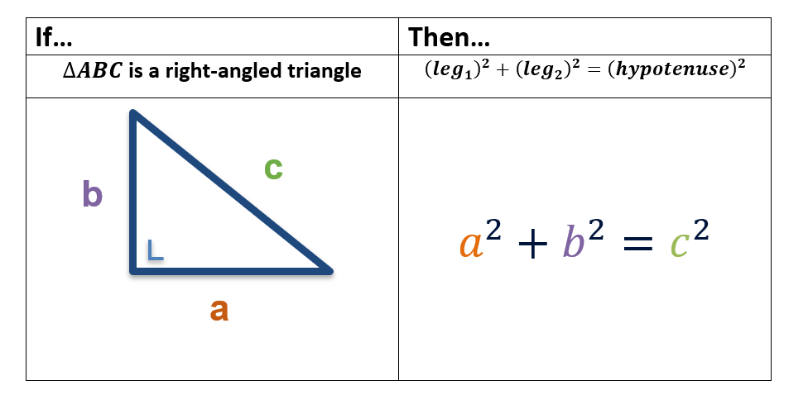
Pythagorean Theorem
If a triangle is a right angled triangle, then the sum of the squares of the lengths of the legs is equal to the sum of the square of the length of the hypotenuse.

Slide 6
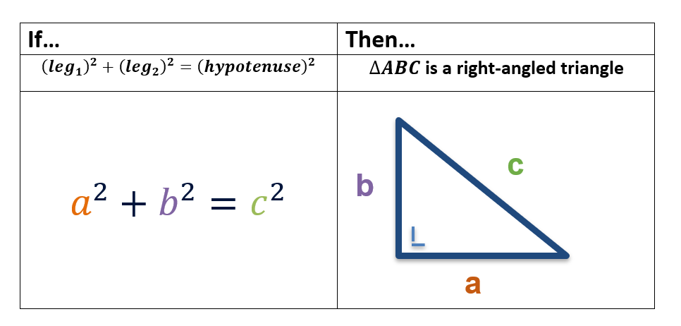
Converse of the Pythagorean Theorem
If the sum of the squares of the lengths of two sides of a triangle is equal to the square of the length of the third side (the hypotenuse), then the triangle is right angled.

Slide 7
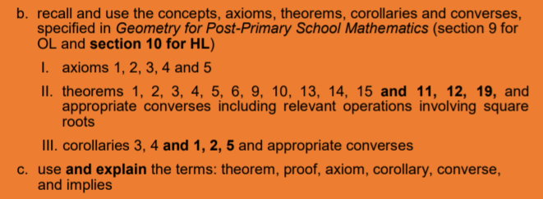
Link to Learning Outcomes

Slide 8
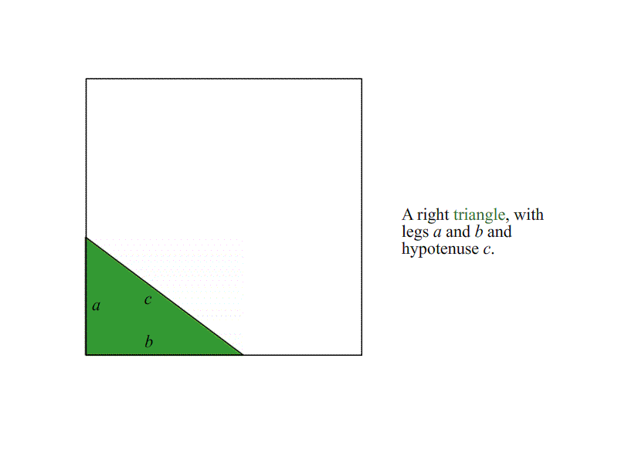
Proof – Pythagoras Theorem

Slide 9
Pythagorean Triple
A Pythagorean triple consists of three positive integers a, b and c, such that $a^{2}+b^{2}=c^{2}$
When a triangle’s sides are a Pythagorean Triple, it is a right angle triangle.
Pythagorean Triple
(3, 4, 5) | (5, 12, 13)
(7, 24, 25) | (8, 15, 17)
(9, 40, 41) | (11, 60, 61)
(15, 20, 25) | Infinite more…
c
b
a

Slide 10
Common Student Misconceptions/ Mistakes
Recognising right-angled triangles
Labelling the sides
Dividing by two
Finding a side other than the hypotenuse
Not seeing the connection between the theorem and its converse.

Slide 11
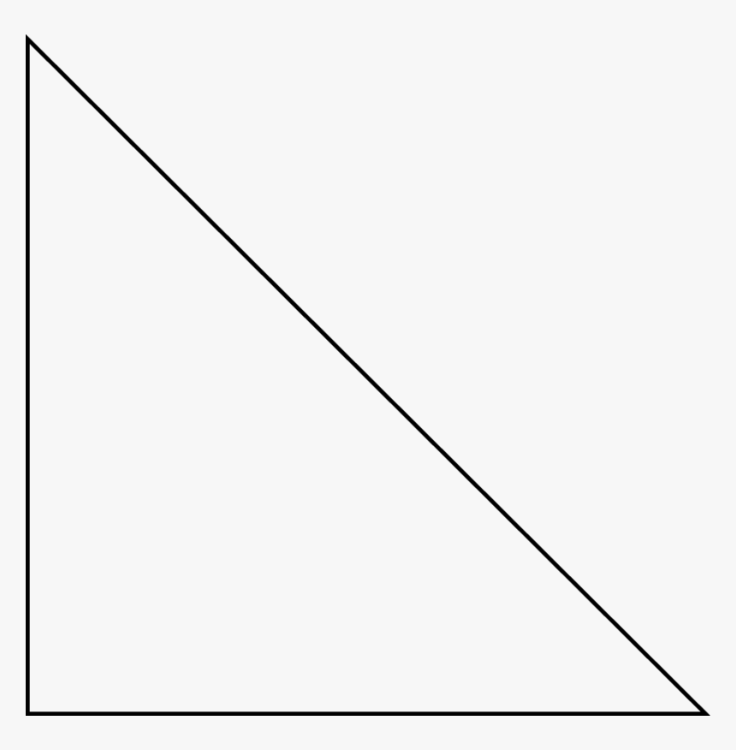
Students may not recognise a right-angle triangle
Students sometimes struggle to identify if a triangle is right angled or not.
This results in students using Pythagoras theorem incorrectly on non-right angled triangles.
Important that students are aware of the different ways that right angled triangles can be labelled.
90º

Slide 12
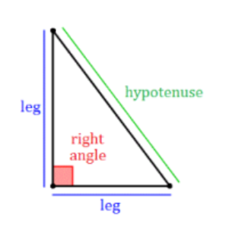
Labelling the triangle – Which side is which?
Students often struggle with the labelling of a right angled triangle.
Often what is perceived to be the longest side is labelled the hypotenuse. However, this might not actually be the longest side.
It is important that students know the hypotenuse is across from the right angle.
This can cause confusion when triangles are presented differently.
1
2

Slide 13
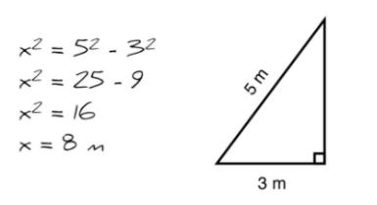
Dividing by 2 instead of finding the square root
${(hypotenuse)}^{2}={\left(leg_{1}\right)}^{2}+{\left(leg_{2}\right)}^{2}$
Students often have a misunderstanding surrounding the power of two and square root operations.
Students sometimes multiply by 2 instead of squaring.
Similarly, students divide by 2 instead of finding the square root.
Explaining these operations as inverse operations of each other should help increase understanding.

Slide 14
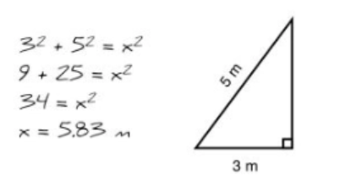
Finding a side other than the hypotenuse
Students sometimes assume that the unknown side is always the side that is isolated in the Pythagoras theorem formula.
${(hypotenuse)}^{2}={\left(leg_{1}\right)}^{2}+{\left(leg_{2}\right)}^{2}$
As a result, students sometimes automatically put in the unknown value for the hypotenuse, when in fact it is one of the legs of the triangle.
It needs to be reinforced that the hypotenuse is the longest side of the triangle and students need to be familiar with using the formula to find a hypotenuse and other sides of the triangles.

Slide 15
Converse of the Theorem
The converse of the theorem is equally as important in proving triangles are right-angled.
Often, students are able to use the theorem but struggle to see the connection between the theorem and its converse.
Encourage students to look at questions involving…
If ${(hypotenuse)}^{2}={\left(leg_{1}\right)}^{2}+{\left(leg_{2}\right)}^{2}$ then the triangle is right angled.
If the triangle is right angled, then ${(hypotenuse)}^{2}={\left(leg_{1}\right)}^{2}+{\left(leg_{2}\right)}^{2}$
This will help increase understanding of not only Pythagoras theorem in trigonometry but a wider knowledge of theorems and their converses in geometry.

Slide 16
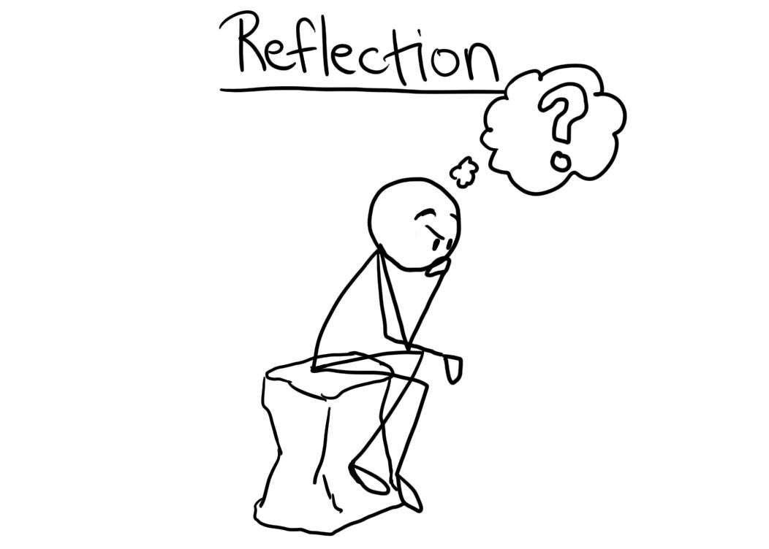
Reflection:
How did you approach teaching Pythagoras before?
How might your practice change as a result of this video?
Is there anything from this video that you would like to learn more about?

Slide 17
References:
https://www.jct.ie/maths/planning_resources
https://commons. File:Pythagorean_Theorem_Proof.gif
https://www.onlinemathlearning.com/pythagorean-triples.html

Slide 18
Contact details
Web Link: https://epistem.ie
Twitter handle
Email:

Slide 19
Trigonometry
Teacher CPD #2: Transforming Textbook Questions
Creating Authentic Questions

Slide 20
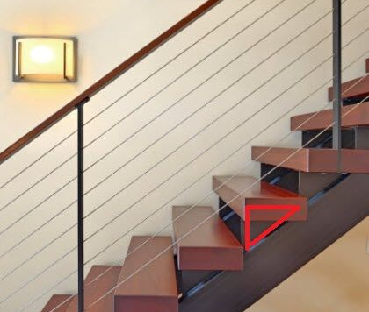
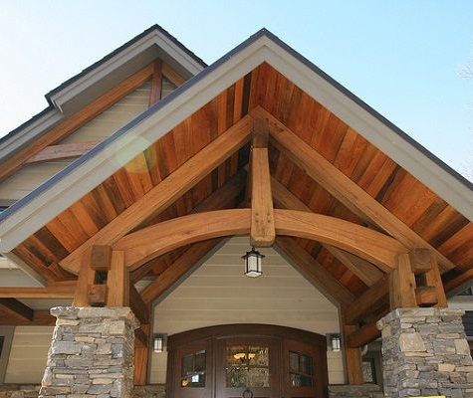
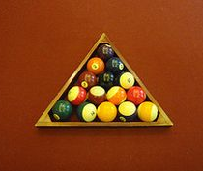
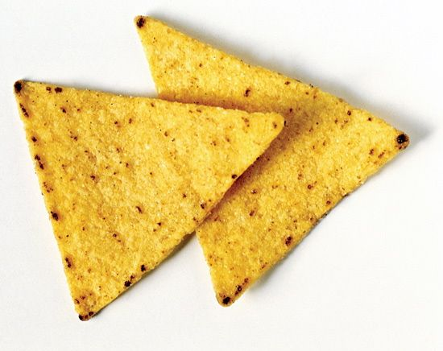
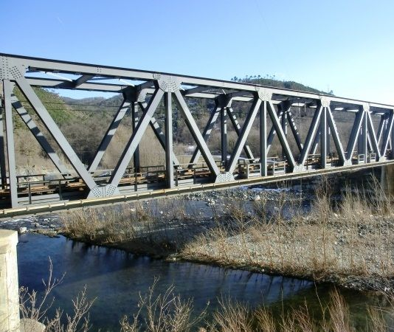
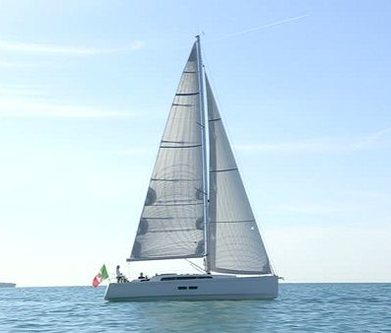

Slide 21
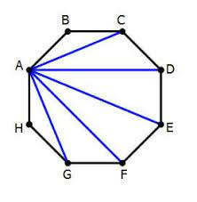
Finding Right Angled Triangles
Students often have difficulty seeing triangles within various shapes and real-life objects.
Actively asking the students to identify and create triangles and right-angled triangles is a useful skill that students could practice.

Slide 22
Real-Life Applications
Game Development
Heights of Buildings
Music Composing
Astronomy
Navigation
Rollercoaster Development

Slide 23
Creating Authentic Questions
It’s important for students to be able to see the real-life application of these questions from the beginning, and not necessarily something that is introduced at the end.
This can be done by using real-life examples, instead of just repeating right-angled triangles.

Slide 24
Creating Authentic Questions
To create authentic questions, textbook questions can be used and adapted into real-life contexts.
Terms such as angle of elevation and angle of depression should be introduced from the start and used throughout all real-life examples.
Also, using terms such as vertical/ horizontal give the students a real-life understanding of right angled triangles.

Slide 25
Angle of Depression & Elevation
A practical application of the trigonometric functions is to find the measure of lengths that you cannot measure. Very frequently, angles of depression and elevation are used in these types of problems.
Angle of Depression: The angle measured from the horizon or horizontal line, down.
Angle of Elevation: The angle measure from the horizon, or horizontal line, up.

Slide 26
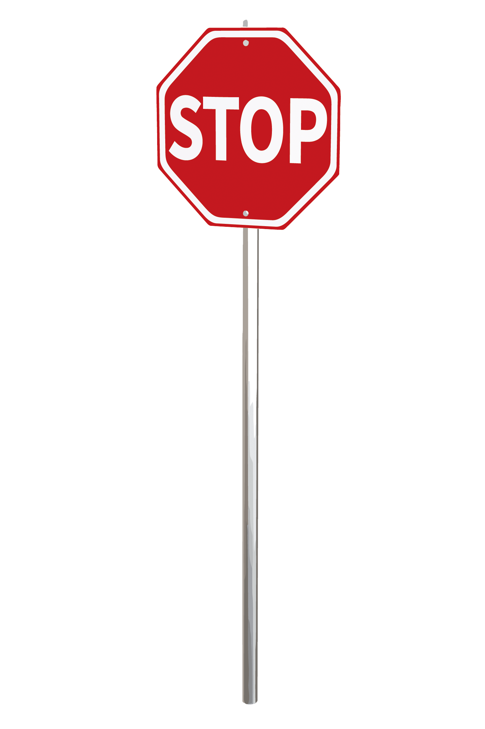
8
51°
x
An 8m metal wire is attached to a broken stop sign to secure it in a vertical position until repairs can be made. Attached to a stake in the ground, the wire makes an angle of 51º with the ground. How far from the foot of the stop sign is the stake?
Find x

Slide 27
What type of people would be solving problems like this?
What other information might have been helpful?
What tools do you think they might have needed to collect enough information to solve this problem?
An 8m metal wire is attached to a broken stop sign to secure it in a vertical position until repairs can be made. Attached to a stake in the ground, the wire makes an angle of 51º with the ground. How far from the foot of the stop sign is the stake?

Slide 28
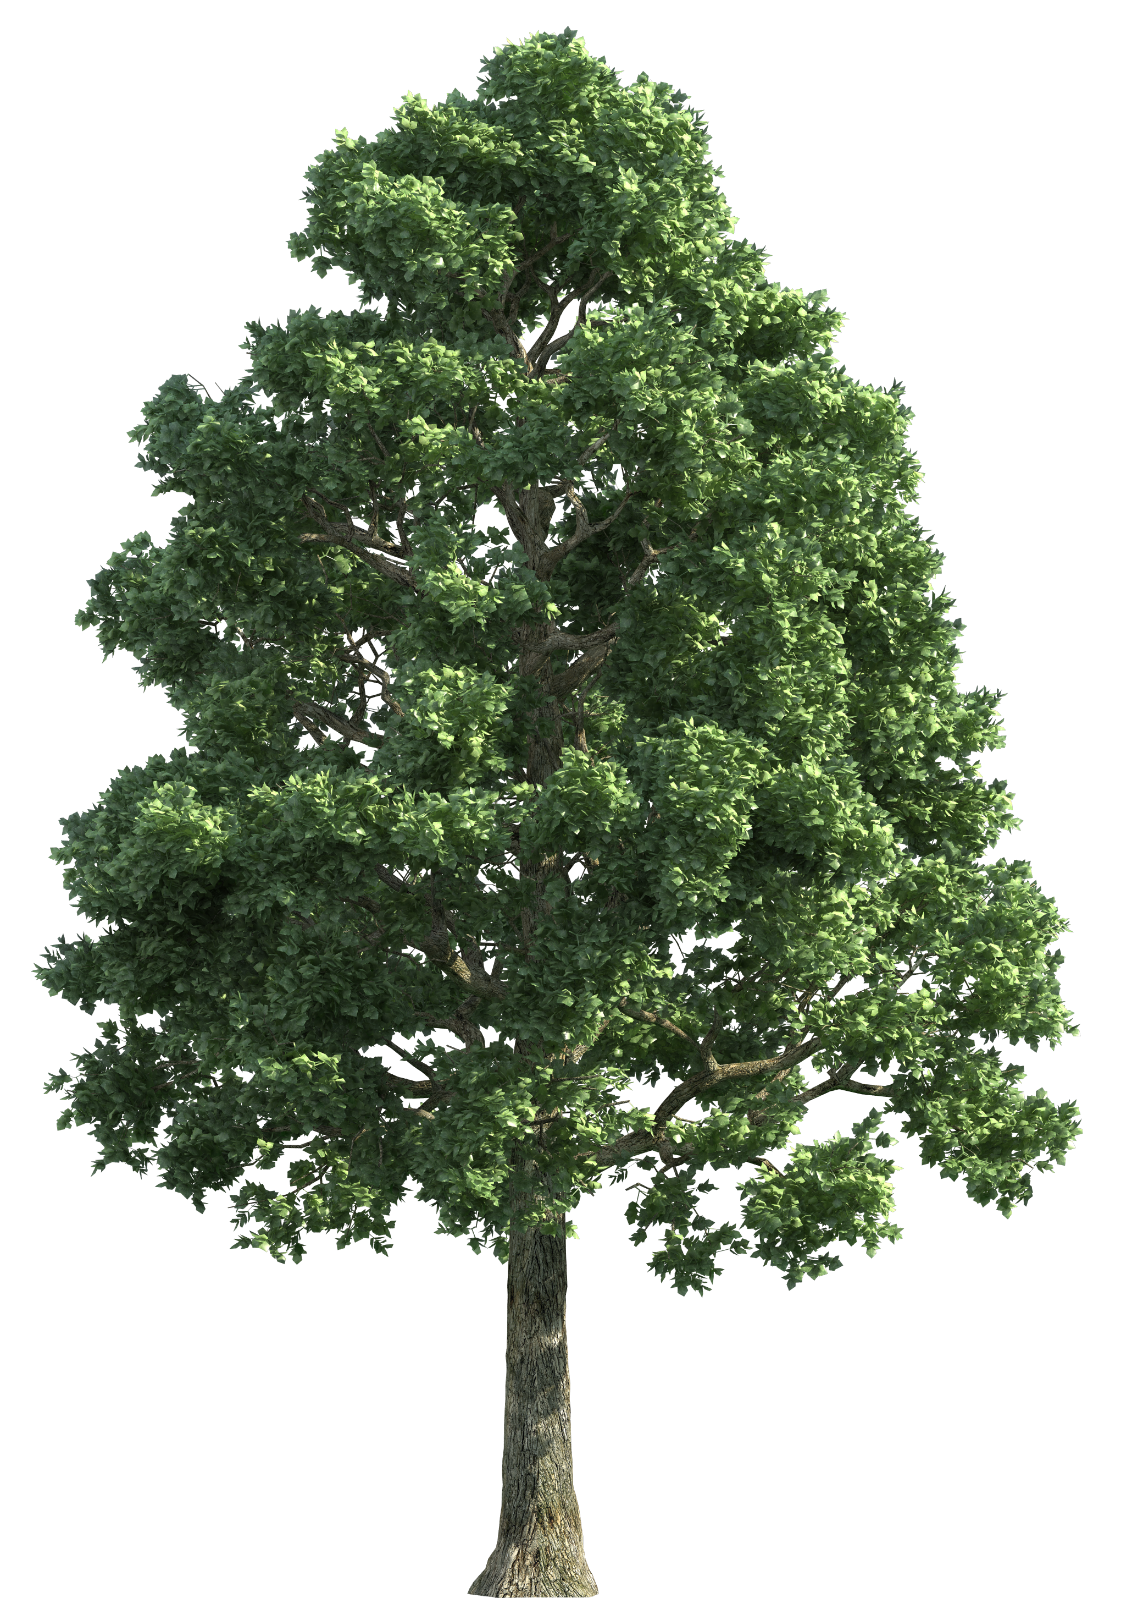
x
35°
45
Find x
From a point on the ground 45 metres from the foot of a tree, the angle of elevation of the top of the tree is 35º. Find the height of the tree to the nearest metre.

Slide 29
What type of people would be solving problems like this?
What other information might have been helpful?
What are the important trigonometric terms that we need to understand to solve this problem?
35°
From a point on the ground 45 metres from the foot of a tree, the angle of elevation of the top of the tree is 35º. Find the height of the tree to the nearest metre.

Slide 30
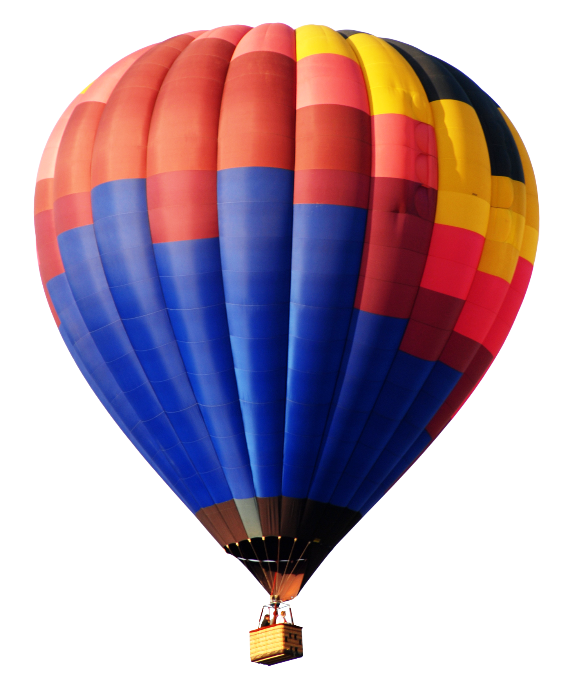
25°
x
90
On a windy day, a 90m rope tightly secures a hot air balloon to a stake in the ground. From the balloon, the angle of depression of the stake is 65º. Find the height of the balloon above the ground.
Find x

Slide 31
What type of people would be solving problems like this?
What other information might have been helpful?
Why might the angle of depression part of this question confuse some people?
25°
x
90
On a windy day, a 90m rope tightly secures a hot air balloon to a stake in the ground. From the balloon, the angle of depression of the stake is 65º. Find the height of the balloon above the ground.
Find x

Slide 32
Building Authentic Problems
Using authentic problems in your class will help students:
Develop problem solving and build fluency skills.
Help identify and recognise the real-life applications of trigonometry in the world around them.
Allows the students time to think, reason and build connections between topics and questions.
Helps students spot patterns, make conjectures and create generalisations.
Helps students become familiar with the mathematics registrar and the type of communication that is used when dealing with these problems.

Slide 33
Reflection:
How did you approach teaching real-life applications before? Did you embed them into your lessons from the start?
How might your practice change as a result of this video?
Is there anything from this video that you would like to learn more about?

Slide 34
Contact details
Web Link: https://epistem.ie
Twitter handle
Email:

Slide 35
Trigonometry
Teacher CPD #3: Sin/Cos/Tan Functions

Slide 36
Trigonometric Ratios
As mathematics teachers, it is important for us to have a content knowledge above what is required for the students.
A greater conceptual understanding of the content means that a teacher can create greater links and help develop students own conceptual understanding.
Knowing where trigonometric ratios come from can help explain how these functions are derived. They also provide a link to the Unit Circle which is a central part to Higher Level Leaving Certificate Trigonometry.

Slide 37
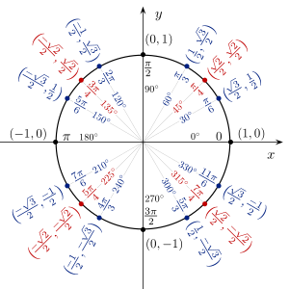
Sin/Cos/Tan of an Angle are Line Lengths

Slide 38
Sin/Cos/Tan of an Angle are Line Lengths

Slide 39
Sin/Cos/Tan of an Angle are Line Lengths

Slide 40
Sin/Cos/Tan of an Angle are Line Lengths
$$Cos30°=\frac{\frac{\sqrt{3}}{2}}{1}$$
$$Cos30°= \frac{\sqrt{3}}{2}$$
Also,
$$Sin30°=\frac{\frac{1}{2}}{1}$$
$$Sin30°= \frac{1}{2}$$

Slide 41
Sin/Cos/Tan of an Angle are Line Lengths
$$Cos30°=\frac{\frac{\sqrt{3}}{2}}{1}$$
$$Cos30°= \frac{\sqrt{3}}{2}$$
Also,
$$Sin30°=\frac{\frac{1}{2}}{1}$$
$$Sin30°= \frac{1}{2}$$
$$\text{Sin}30°= \frac{1}{2}$$
$$Cos30°= \frac{\sqrt{3}}{2}$$

Slide 42
Consider the following right angled triangle..
10
6
5
3
4
8

Slide 43
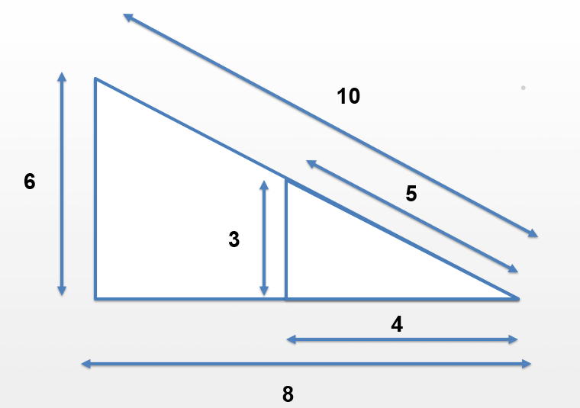
Similar Triangles

Slide 44
Similar Triangles
Ratio of Corresponding Sides
$$\frac{3}{6}=\frac{5}{10}=\frac{4}{8}…=\frac{1}{2}$$

Slide 45
Similar Triangles
Ratio of Corresponding Sides
$$\frac{3}{6}=\frac{5}{10}=\frac{4}{8}…=\frac{1}{2}$$
Ratio of Base to Hypotenuse
$$\frac{8}{10}=\frac{4}{5}…=0.80$$

Slide 46
Similar Triangles
Ratio of Corresponding Sides
$$\frac{3}{6}=\frac{5}{10}=\frac{4}{8}…=\frac{1}{2}$$
Ratio of Base to Hypotenuse
$$\frac{8}{10}=\frac{4}{5}…=0.80$$
Ratio of Height to Hypotenuse
$$\frac{6}{10}=\frac{3}{5}…=0.60$$

Slide 47
Similar Triangles
Ratio of Corresponding Sides
$$\frac{3}{6}=\frac{5}{10}=\frac{4}{8}…=\frac{1}{2}$$
Ratio of Base to Hypotenuse
$$\frac{8}{10}=\frac{4}{5}…=0.80$$
Ratio of Height to Hypotenuse
$$\frac{6}{10}=\frac{3}{5}…=0.60$$
Ratio of Height to Base
$$\frac{6}{8}=\frac{3}{4}…=0.75$$

Slide 48
In a right-angled triangle, the ratio of the lengths of sides to the angle are the same regardless of the length of the side.
We have fixed ratios that we use to calculate
i) The size of the angle
ii) The length of the side
These ratios are known sin, cos and tan.

Slide 49
Trigonometric Ratios
We can see that there is a relationship between the trigonometric functions (Sin/Cos/Tan) and the ratios of two of the sides of a right angle triangle.
$$\operatorname{Sin}{θ}=\frac{Opposite}{Hypotenuse}$$
Hypotenuse
Opposite
$$\operatorname{Cos}{θ}=\frac{Adjacent}{Hypotenuse}$$
Reference Angle
θ
$$\operatorname{Tan}{θ}=\frac{Opposite}{Adjacent}$$
Adjacent

Slide 50
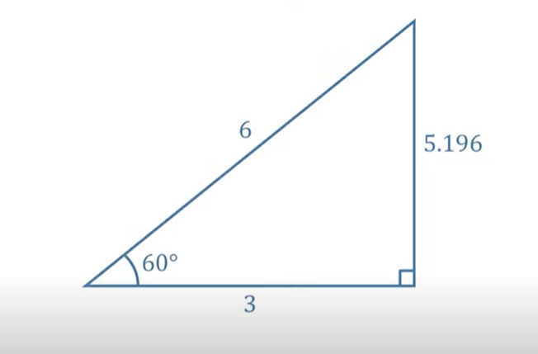
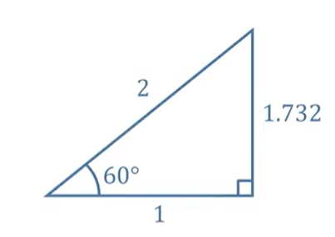
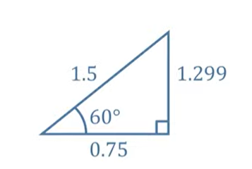
$$Sin 60=0.866…$$

Slide 51
$$Sin 60=0.866…$$
Hypotenuse
Hypotenuse
Opposite
Opposite
Hypotenuse
Opposite
Adjacent
Adjacent
Adjacent

Slide 52
$$Sin 60=0.866…$$
Hypotenuse
Hypotenuse
Opposite
Opposite
Hypotenuse
Opposite
Adjacent
Adjacent
Adjacent
$$\frac{Opposite}{Hypotenuse}$$
$$\frac{1.732}{2}$$
$$0.866$$

Slide 53
$$Sin 60=0.866…$$
Hypotenuse
Hypotenuse
Opposite
Opposite
Hypotenuse
Opposite
Adjacent
Adjacent
Adjacent
$$\frac{Opposite}{Hypotenuse}$$
$$\frac{Opposite}{Hypotenuse}$$
$$\frac{1.732}{2}$$
$$\frac{5.196}{6}$$
$$0.866$$
$$0.866$$

Slide 54
$$Sin 60=0.866…$$
Hypotenuse
Hypotenuse
Opposite
Opposite
Hypotenuse
Opposite
Adjacent
Adjacent
Adjacent
$$\frac{Opposite}{Hypotenuse}$$
$$\frac{Opposite}{Hypotenuse}$$
$$\frac{Opposite}{Hypotenuse}$$
$$\frac{1.732}{2}$$
$$\frac{5.196}{6}$$
$$\frac{1.299}{1.5}$$
$$0.866$$
$$0.866$$
$$0.866$$

Slide 55
Therefore, Sin of the angle is always equal to the ratio of the opposite and hypotenuse sides ($Sinθ=\frac{O}{H})$
In a similar way, Cos of an angle is always equal to the ratio of the adjacent and hypotenuse sides ($Cosθ=\frac{A}{H})$ and Tan of an angle is equal to the ratio of Sin of the angle and Cos of the angle ($Tanθ=\frac{Sinθ}{Cosθ}=\frac{O}{A})$
These functions and their ratios can be used to find missing angles and sides from various right angled triangles.

Slide 56
Sine Function

Slide 57
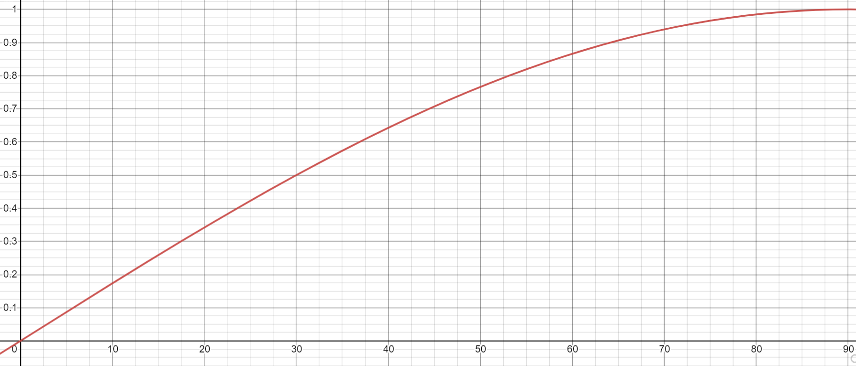
$$Sin 60=0.866…$$
Ratio of Opposite to Hypotenuse (0 – 1)
Angle, $θ$ in degrees ( 0 – 90)

Slide 58
$$Sin 60=0.866…$$
Ratio of Opposite to Hypotenuse (0 – 1)
0.866…
60°
Angle, $θ$ in degrees ( 0 – 90)

Slide 59
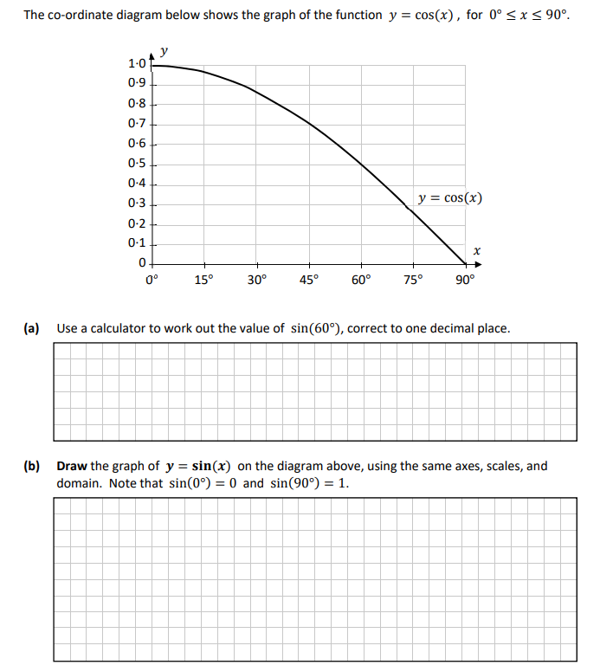
Sin/Cos/ Tan
Questions surrounding Sin/Cos/ Tan has appeared on recent SEC Junior Cycle Sample Papers – underlining the importance of student understanding of this concept

Slide 60
Reflection:
How did you approach teaching Sin/Cos/Tan before?
How might your practice change as a result of this video?
Is there anything from this video that you would like to learn more about?

Slide 61
References:
https://commons.wikimedia.org/wiki/File:Sine_curve_drawing_animation.gif

Slide 62
Trigonometry
Teacher CPD #4: Trigonometric Functions
Relationship between Trigonometric Functions and the Inverse

Slide 63
Inverse Operations
Inverse Operations
+ | –
÷ | x
$${\left( \right)}^{2}$$
Inverse Operations are pairs of mathematical manipulations in which one operation undoes the action of the other.

Slide 64
What is $\sin^{−1}x?$
We know that Sin/Cos/Tan of an angle correspond to a ratio of the sides of the triangle.
$$Sin\left(Angle\right)=\frac{Opposite}{Hypotenuse}$$
$$\left(Angle\right)=Sin^{−1} (\frac{Opposite}{Hypotenuse})$$

Slide 65
What is $\sin^{−1}x?$
We know that Sin/Cos/Tan of an angle correspond to a ratio of the sides of the triangle.
$$Sin\left(Angle\right)=\frac{Opposite}{Hypotenuse}$$
$$\left(Angle\right)=Sin^{−1} (\frac{Opposite}{Hypotenuse})$$
It answers the question… What angle has a $Sin$ of $\frac{Opposite}{Hypotenuse}$

Slide 66
Inverse Sine Function
$$SinA=\frac{O}{H}$$
$$Sin A=\frac{6}{10}$$
$$A=Sin^{−1}(\frac{6}{10})$$
$$A=36.87°$$
10
6
A

Slide 67
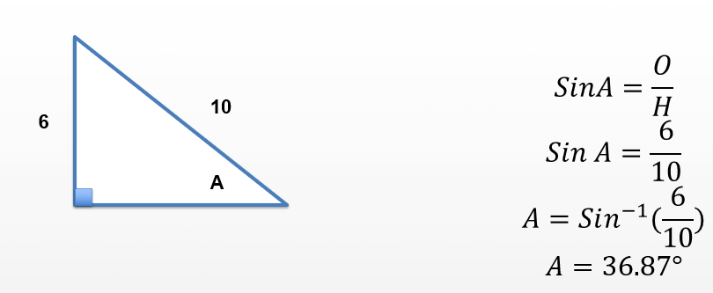
Sine Function

Slide 68
Sine Function
Output
Input

Slide 69
Sine Function
Ratio of Opposite to Hypotenuse (0 – 1)
Output
Input
Angle ( 0 – 90)

Slide 70
Inverse Trigonometric Functions

Slide 71
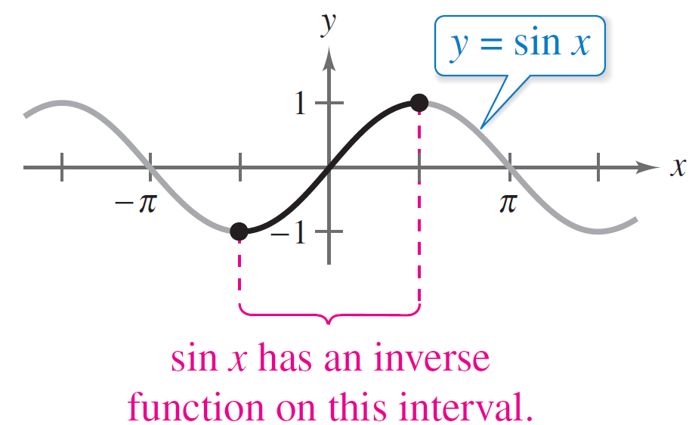
Inverse Sine Function
For a function to have an inverse function, it must be one-to-one (bijective)—that is, it must pass the Horizontal Line Test exactly once.
y = sin x does not pass the test because different values of x have the same y-value.
Figure 4.67

Slide 72
Inverse Sine Function
However, when you restrict the domain to the interval – $\frac{π}{2}$≤ x ≤ $\frac{π}{2}$, the function does have an inverse (passes the horizontal line test).

Slide 73
Inverse Sine Function
So, on the restricted domain – $\frac{π}{2}$≤ x ≤ $\frac{π}{2}$, y = sinx has a unique inverse function called the inverse sine function. It is denoted by
y = arcsin x or y = sin^{–1} x.
The notation sin^{–1} x is similar to the inverse function notation f ^{–1}(x).

Slide 74
$$SinA=\frac{O}{H}$$
$$Sin A=\frac{6}{10}$$
$$A=Sin^{−1}(\frac{6}{10})$$
$$A=36.87°$$
10
6
A

Slide 75
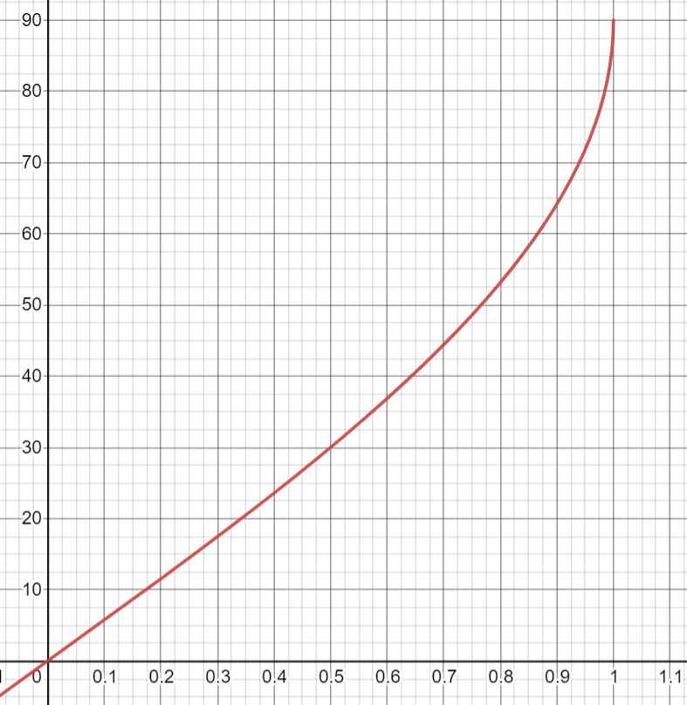
Inverse Sine Function
Angle $θ$ ( 0 – 90 degrees)
Ratio of Opposite to Hypotenuse
(0 – 1)

Slide 76
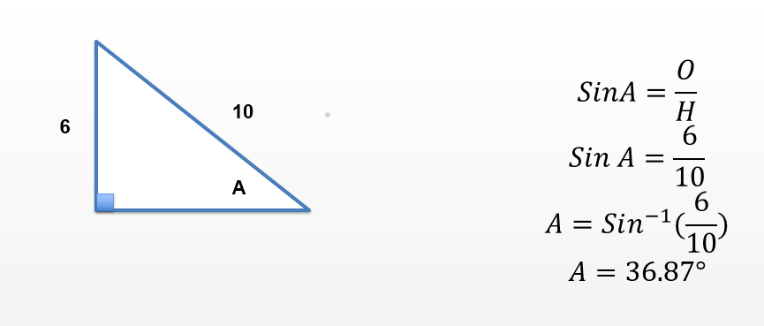
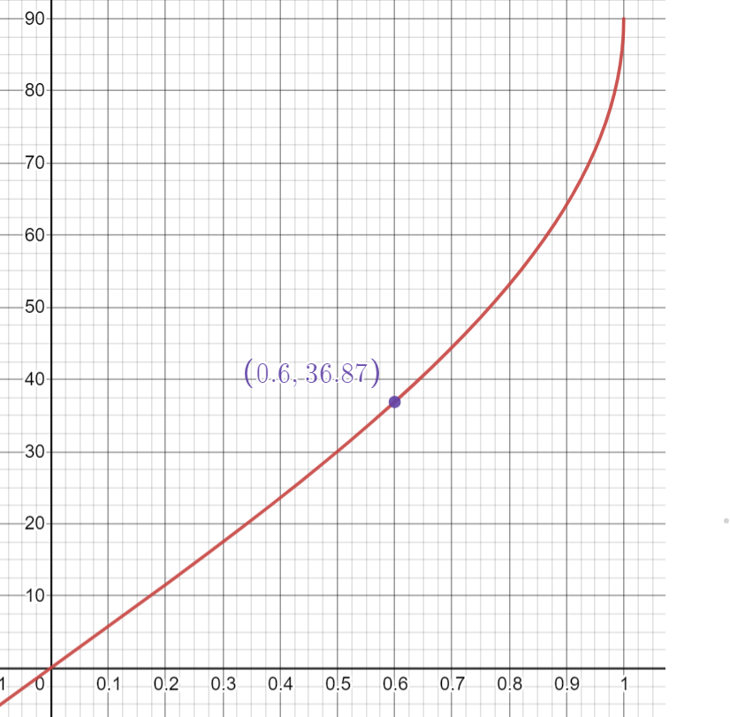
Inverse Sine Function

Slide 77
Inverse Sine Function
Input

Slide 78
Inverse Sine Function
Input
Output

Slide 79
Inverse Trig Functions
In a similar way, this process can also be applied to Cos and Tan functions and their respective inverses.
As teachers, it is important for us to understand the link between the various trigonometric functions and their inverses in order for us to teach in a way that promotes conceptual understanding of the concept.
Students will require a knowledge of trigonometric graphs and their inverses as part of the Higher Level Leaving Cert Course.

Slide 80
Reflection:
How did you approach teaching Inverse Functions before?
How might your practice change as a result of this video?
Is there anything from this video that you would like to learn more about?

Slide 81
Trigonometry
Teacher CPD #5: Classroom Based Assessments
Building Learning Experiences using the Problem Solving Cycle

Slide 82
CBA 1 Mathematical Investigation
End of 2nd Year
Define a problem
Decompose/simplify it into manageable parts
Engage with the problem using mathematical strategies.
Interpret any findings

Slide 83
Teach Content
Facilitate Learning Experiences
Classroom-Based Assessment
SLAR

Slide 84
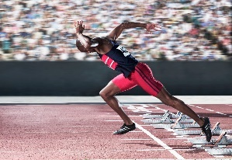
Learning Experience
Learning Outcome | N.3 b. Investigate situations involving proportionality so that they can solve problems involving average speed, distance and time.
Topic | Distance, Speed, Time
Investigation | How fast can humans run?

Slide 85
Problem-Solving Cycle
Define a Problem
Translate to Maths
Engage & Solve
Interpret

Slide 86
Define a Problem
Translate to Maths
Engage & Solve
Interpret
What is the problem?
Why does it interest you?
How many answers are you expecting?
What elements are you trying to focus on?
What steps will you follow?
What ideas have you thought about using so far?
Why have you decided not to use some strategies?
Why do you think other strategies will be more effective?
What units/ quantities are relevant?
Where did you get those numbers?
What pictures, graphs or diagrams might help represent your ideas?
What mathematical ideas did you use? Why did you use them?
How do you know your calculations are correct? Do they always work?
When might it not work and why?
What could you have done differently?
Has your solution generated more problems? What kind?

Slide 87
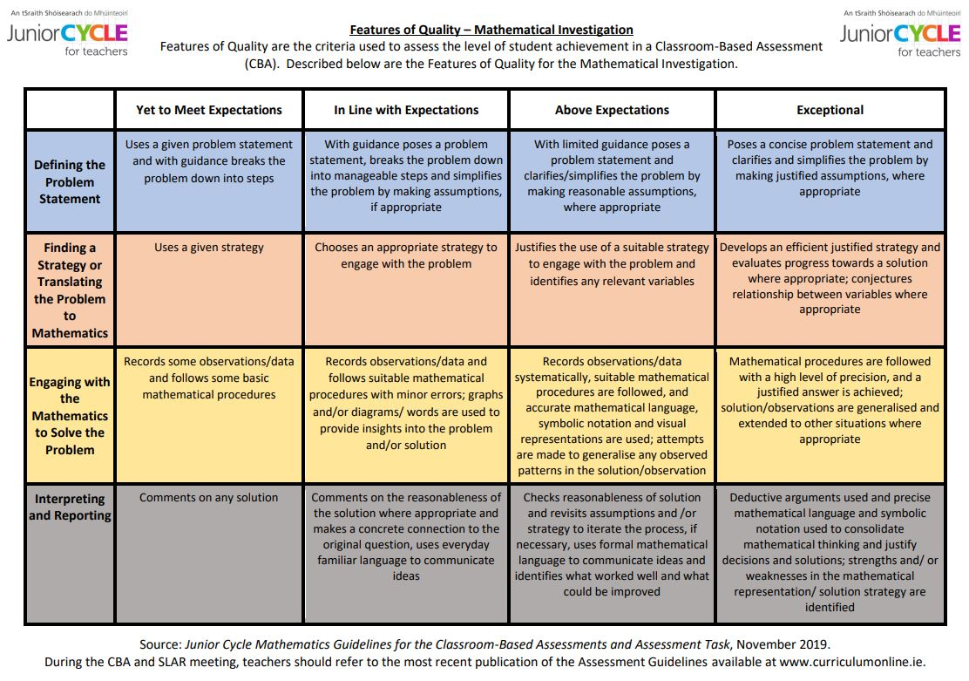

Slide 88
How can you simplify the problem?
What assumptions do you need to make?
Is there any potential problems?

Slide 89
How can you simplify the problem?
What assumptions do you need to make?
Is there any potential problems?
Which strategy would be most effective?
What have you decided not to use, why?
What units/quantities are you using?

Slide 90
How can you simplify the problem?
What assumptions do you need to make?
Is there any potential problems?
Which strategy would be most effective?
What have you decided not to use, why?
What units/quantities are you using?
How accurate are our solutions?
Are the solutions always correct?
What other situations might this work or not work?

Slide 91
How can you simplify the problem?
What assumptions do you need to make?
Is there any potential problems?
Which strategy would be most effective?
What have you decided not to use, why?
What units/quantities are you using?
How accurate are our solutions?
Are the solutions always correct?
What other situations might this work or not work?
How do you know your work is correct?
What situations does it work/not work?
What other problems/ issues have your solution raised?

Slide 92
Mathematical Investigation | Guiding Questions | Student Activity
Problem | What do we need to consider? Why is this problem relevant? Who does it concern? What can we compare humans with? | Research speeds of top sprinters, animals, etc. Convert all to similar units
Translate to Mathematics | What are the variables? What is changing? What are the constants? What can we keep the same? What assumptions do we need to make? What techniques might we use? What other areas of learning can we link this to? | Discussion on what to keep constant (distances), and what is changing. Discussion on why assumptions are important (same terrain, etc). Link to graphing functions and functions.
Engage & Solve | What experiment can we set up? What information can we collect? What other things do we need to consider? Can we represent our findings using graphs, tables, diagrams? | Bring outside, measure distance, record times and find speed. Convert to similar units m/s, km/h. Graphing results using a linear graph. Could include discussion on average speed and not instantaneous speed. Create a table/ graph to represent results. Average speed of teenager, adult, sprinter. How does that compare to an animal.
Interpret | How accurate is our answer? Can we extend our work in anyway to make it better? What situation may our answer not work in? How does our work compare to what it tells us online? What limitations are there to our research? | Limitations that might have existed – terrain, gear, etc. Discussion on differences in speed between humans (teenagers and sprinters) and animals.

Slide 93
Learning Experiences
There are no “right” answers.
Problems can be extended as the students see fit, allowing them to show off various extensions to the task.
Problems allow students to look at a problem from a number of different perspectives and build a number of different solutions.
Allows a chance for argumentation and discussion to develop.

Slide 94
Scaffolding CBA’s Questioning
Preparation

Slide 95
Scaffolding CBA’s Questioning
Preparation
Use Features of Quality

Slide 96
Scaffolding CBA’s Questioning
Preparation
Use Features of Quality
Wait Time

Slide 97
Scaffolding CBA’s Questioning
Preparation
Use Features of Quality
Wait Time
Student Questions

Slide 98
Scaffolding CBA’s Questioning
Preparation
Use Features of Quality
Wait Time
Student Questions
Groupwork Activities

Slide 99
Reflection:
How did you use Learning Experiences or Problem Solving before?
How might your practice change as a result of this video?
Do you see these types of classes as beneficial to your students?

