Slide 1
Laboratory Management and Safety in Post Primary Schools (III) Guidelines on storing and labelling chemicals, laboratory design
Narrator: Martina Brennan, St. Flannan's College, Ennis, Co. Clare.
R&D Officer, EPI.STEM
Funded by HEA Performance Study

Slide 2
Outline
New EU Chemical Label Pictograms (Hazard Symbols)
Storage Groups according to Hazard
Storage of Chemicals – Segregation
Resources and Ideas on laboratory Design
Labelling Solutions
Safety Apparatus in the laboratory

Slide 3
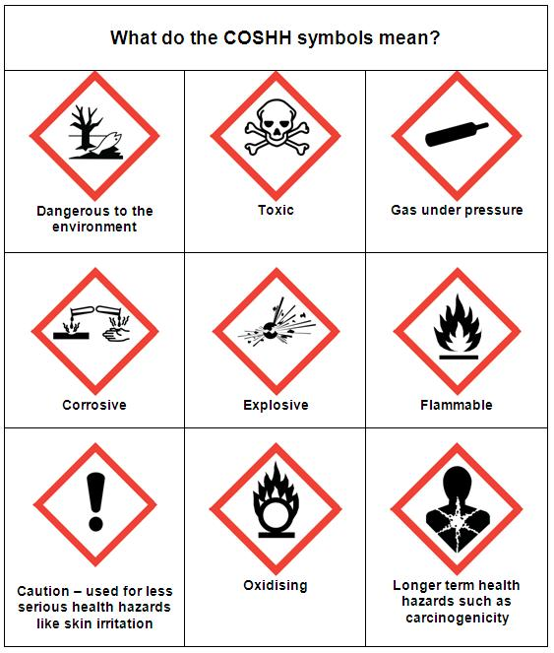
Hazard Symbols
COSHH stands for the Control of Substances Hazardous to Health Regulations. The COSHH regulations require employers to take actions to prevent or significantly reduce their workers' exposure to any substances that would be hazardous to their health.
Old Hazard Symbol
New Hazard Symbol
Source: https://ec.europa.eu/environment/chemicals/labelling/index_en.htm

Slide 4
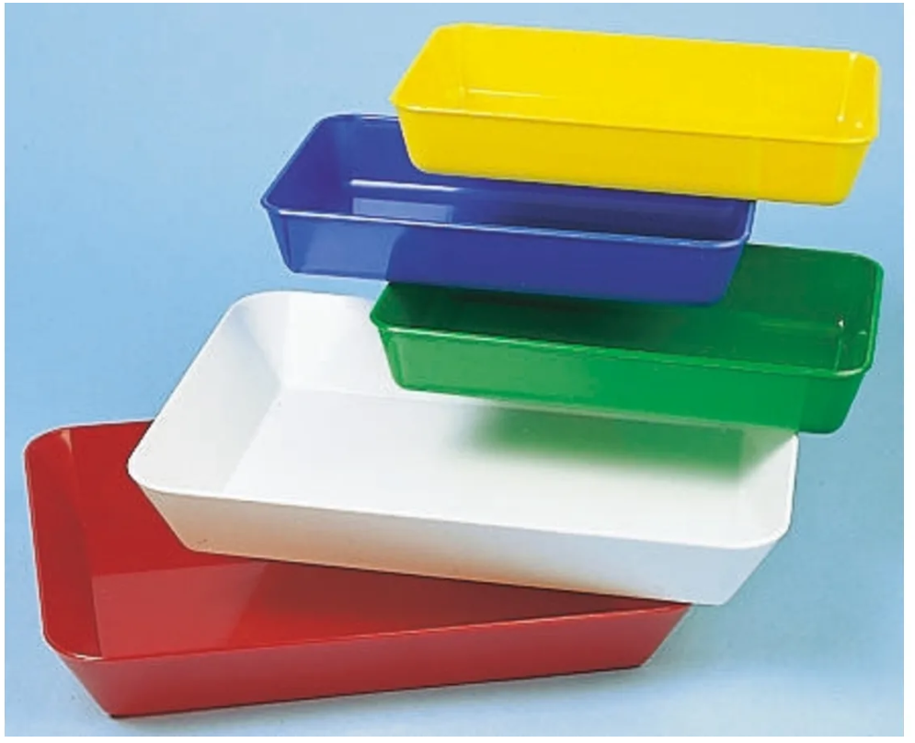
Storage Groups
.
Colour | Hazard
RED | Flammable
GREY | General chemicals no particular storage hazard
BLUE | Toxic or health hazard
YELLOW | Oxidising Chemicals
WHITE | Corrosive - acids
GREEN | Corrosive – alkaline
Source: https://www.pdst.ie/sites/default/files/ch_sd_safetyandstorage.pdf

Slide 5
Storage of Chemicals - Segregation
Chemicals should not be stored in alphabetical order as this can result in incompatible neighbouring of chemicals.
Flammable liquids should be stored separately from flammable solids.
Oxidising chemicals should be stored away from flammable chemicals.
Toxic Chemicals should be stored away from flammable and oxidising agents.
Corrosive substances should be stored away from flammable liquids and gases, and organic peroxides.

Slide 6
Suggested Storage Layout (DES-2011)
TOXIC
GENERAL
OXIDISING
GENERAL
Flammable
GENERAL
GENERAL
Chemical Safety Data Sheets - Available on the App Store
Type in the name of the chemical
Email information
Flammable
Chemical Safety Data Sheets - Available on the App Store
Type in the name of the chemical
Email information
GENERAL
GENERAL
GENERAL
Flammable
Cabinet
Organic and Corrosive mineral acids
Corrosive Alkaline
Source: Health & Safety in the laboratory, Chem Ed Conference 2011 (M.Horgan Inspectorate DES)

Slide 7
Association for Science education (ase.org.uk)
Resources and ideas in designing lab space
Laboratory 21 – teaching and learning in science for the 21st Century.
Source: https://www.ase.org.uk/resources/lab-design

Slide 8
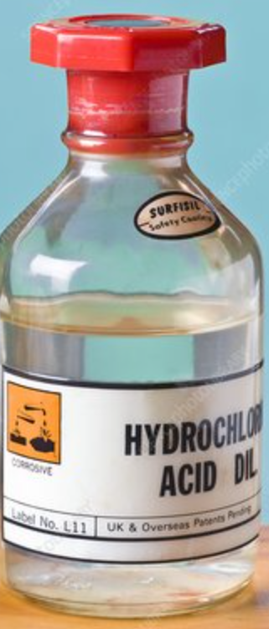
Labelling Solutions
When preparing solutions for experiments from stock, the container must have a label detailing the following:
Name of the Chemical – e.g. Hydrochloric Acid
Concentration
Hazard symbol
Name of teacher & date prepared
Source: https://www.pdst.ie/sites/default/files/ch_sd_stockcontrol.pdf

Slide 9
Safety Apparatus in the Lab
Each lab should have the following:
Safety screen
Face Shield
Eye Wash
Fire Extinguisher (CO₂ & dry powder)
Fire Blanket
Fire bucket
First Aid kit
Chemical spill clean-up kit
Source: Health & Safety in the laboratory, Chem Ed Conference 2011 (M.Horgan Inspectorate DES)

Slide 10
References & Resources
www.hsa.ie
https://pdst.ie/post-primary/sc/chemistry
www.rsc.org
www.ase.org.uk

Slide 11
Contact details
Web Link: https://epistem.ie
Twitter handle: @EPISTEM_UL
Email: epistem@ul.ie

