Slide 1
Leaving Certificate Physics Electricity Part 3 – Resistance & Semiconductors
Tara Ryan: Tara Ryan
EPI Stem Project: Resources

Slide 2
Leaving Cert Physics Learning Outcomes
Notes:
*****Change this LO*******

Slide 3
Leaving Cert Physics Learning Outcomes
Notes:
*****Change this LO*******

Slide 4
Overview of Topics
Resistance
Resistors in Series
Resistors in Parallel
Wheatstone Bridge
Effects of Electric Current
Domestic Wiring
Semiconductors
Part 3
Resistance & Semiconductors

Slide 5
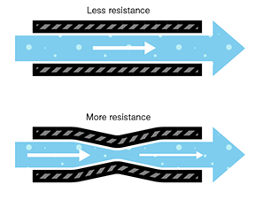
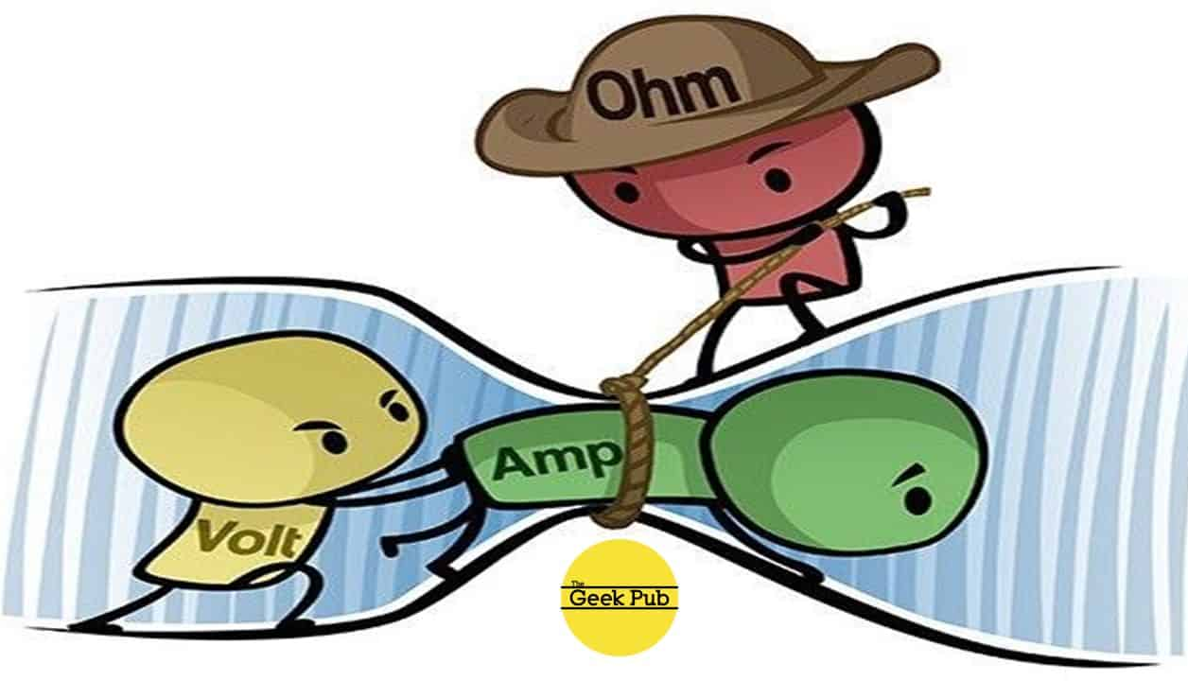
Resistance
Notes:
Ohm’s law states that for a metallic conductor at a constant temperature, the current will be proportional to the voltage. From this, we get the formula shown here, where V is the voltage, measured in volts, I is the current, measured in amps, and R is the resistance measured in ohms.
The resistance of an object within an electrical circuit is defined as the ratio of voltage across it to the current flowing through it.
The resistance on an object depends on its temperature. The variation of resistance with temperature is varies for different materials.

Slide 6
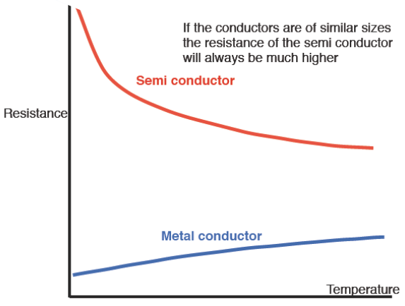
Ohm’s Law
V = (I)(R)
Voltage = (Current)(Resistance)
Voltage
(V)
Current
(A)
Resistance
(Ω)
Notes:
Ohm’s Law states that the current through a conductor between two points is directly proportional to the voltage across the two points. Its formula is shown here. Voltage, measured in volts, is equal to current, measured in amps, multiplied by resistance, measured in ohms.
The resistance of an object within an electrical circuit is defined as the ratio of voltage across it to the current flowing through it.
The resistance on an object depends on its temperature. The variation of resistance with temperature is varies for different materials.

Slide 7
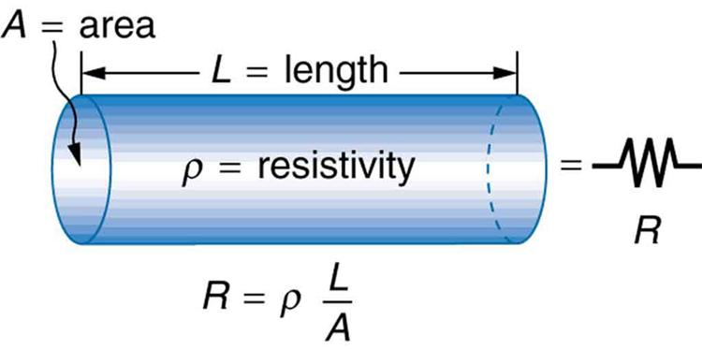
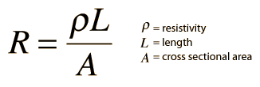
Resistivity
Notes:
The resistance of an object also varies with:
The length of an object. Increasing the length, increases the resistance.
The cross sectional area of an object. A wider object, lowers the resistance.
The material an object is made from. We refer to this property as the resistivity.
The formula of resistivity is shown here. The resistance of an object is equal to the multiple of the resistivity and length of an object, divided by its cross sectional area. The symbol for resistivity is the Greek letter rho, and its units are ohm-meter.

Slide 8
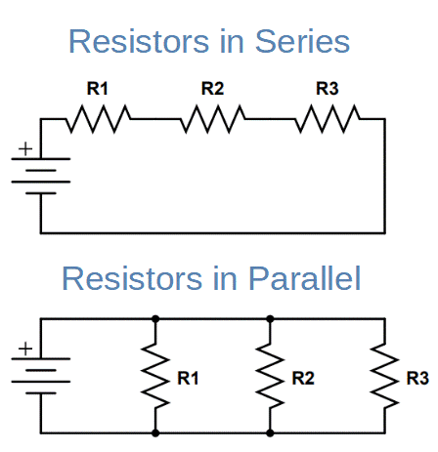
Resistors in Series
R total = R1 + R2 + R3
Notes:
The diagram shows three resistors connected in series. To calculate the total resistance, it is the sum of each resistors.

Slide 9
Resistors in Parallel
$\frac{1}{\text{R}\text{total}}$ = $\frac{1}{\text{R}\text{1}}$ + $\frac{1}{\text{R}\text{2}}$ + $\frac{1}{\text{R}\text{3}}$
Notes:
To calculate the total resistance for series connected in parallel, the formula is shown here.

Slide 10
Potential Divider
Potential Divider Simulation
Notes:
The longer a resistor is, the lager its resistance becomes. If current flows only across a section of a resistors, the resistance is proportionally reduced.
From the formula V = IR, we can see that the potential drop across a resistor is also in proportion to the fraction of a resistor across which a current flows.
A potential divider works this way, making two connections to a resistor across which a current is flowing. In this way, smaller voltages can be supplied.

Slide 11
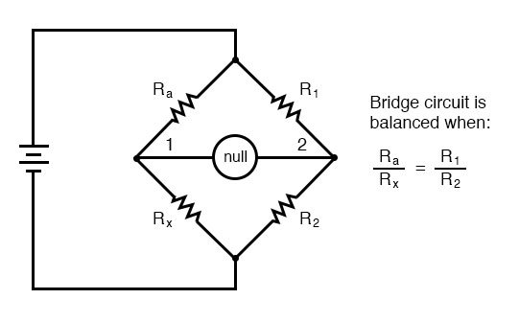
Wheatstone Bridge
Notes:
A Wheatstone bridge is an electrical circuit used to measure an unknown electrical resistance by balancing two legs of a bridge circuit, one leg of which includes the unknown component. The primary benefit of the circuit is its ability to provide extremely accurate measurements (in contrast with something like a simple voltage divider). One of the Wheatstone bridge's initial uses was for soil analysis and comparison.
When balanced, the resistors don’t allow current to flow through the galvanometer in the centre. When this happens, the formula shown applies.
Wheatstone bridges are still used in thermostats to measure unknown resistance, for example to regulate the current flowing through an oven of a set temperature.

Slide 12
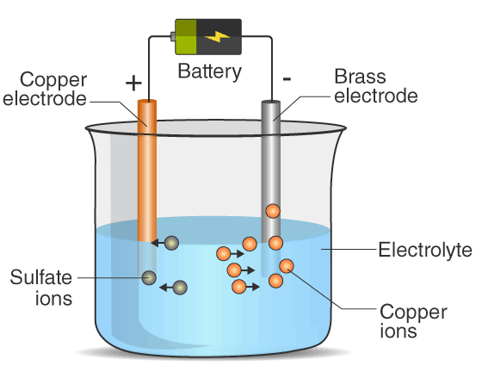
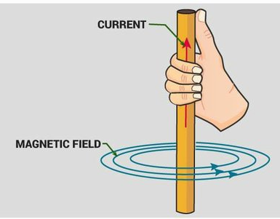
Effects of an Electric Current
Notes:
There are three effects of an electric current:
The chemical effect
The magnetic effect
The heating effect
The chemical effect occurs when the current (carried by ions) flows through a system. For example, during electrolysis.
The magnetic effect is caused by the movement of electric charge.
The heating effect is seen in household appliances when electrical and kinetic energy is converted into heat energy.

Slide 13
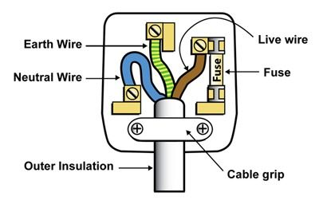
Domestic Wiring
Notes:
Households are connected to the electricity network by two wires.
The live wire, which is 230V and the neutral wire at 0V.
When a connection is made between the two wires, a current will flow from high to low voltage.
There is also an Earth wire used to protect you from an electric shock. It does this by providing a path (a protective conductor) for a fault current to flow to earth. It also causes the protective device (either a circuit-breaker or fuse) to switch off the electric current to the circuit that has the fault.
A fuse is a short piece of weak wire designed to break if the current exceeds the et safety limit, it will break the circuit and stop the flow of current.

Slide 14
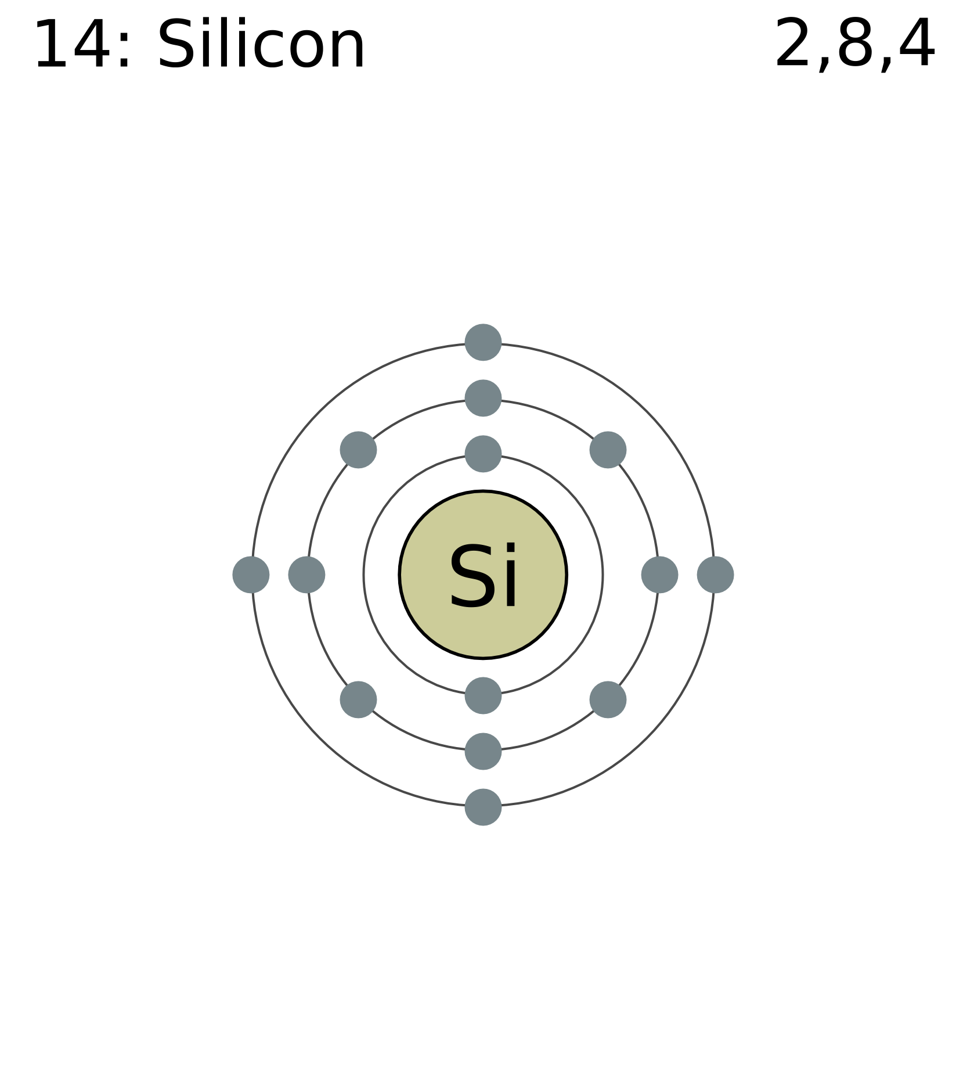
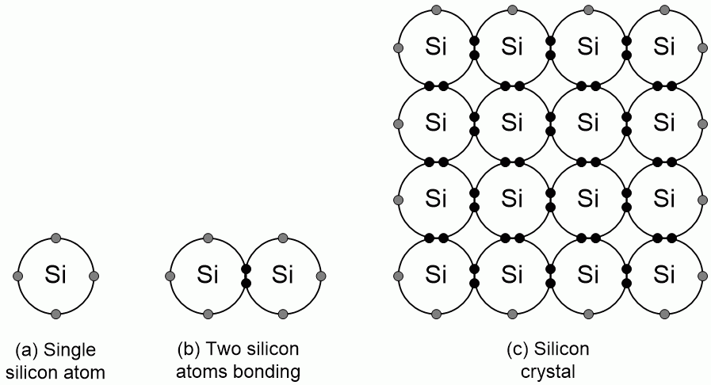
Semiconductors
Notes:
A semiconductor is a material whose resistivity is between that of a conductor and an insulator.
Silicon is an example of a semiconductor. It has 14 electrons per atom, 4 of which are on the outer, or valence shell. The octet rule states that atoms tend to prefer to have 8 electrons on its valence shell. In order for silicon to achieve this, it will arrange itself in a crystal structure, so that each atom shares an electron with each of four neighbours.
At temperature 0K, silicon is a perfect insulator. No electrons are free to move, and are unable to carry a current.

Slide 15
Semiconductors
Notes:
At temperature 0K, silicon is a perfect insulator. No electrons are free to move, and are unable to carry a current.
Above 0K, the added heat energy is distributed throughout the crystal as kinetic energy. When an electron gains enough energy to escape from its place and move through out the crystal, it leaves a positive empty space, or a ‘hole’ behind.

Slide 16
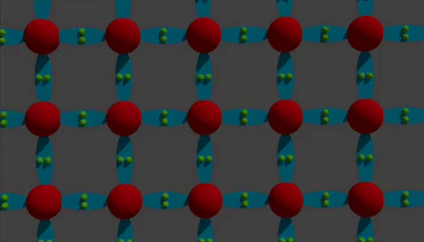
Intrinsic Conduction
Notes:
Conduction in a pure semiconductor due to electrons moving from negative to positive and an equal number of holes moving in the opposite direction is called intrinsic conduction.
The resistivity of an intrinsic conductor is relatively high. A piece of pure silicon wire pf 1mm in diameter and 1cm in length has a resistance of approximately 8 million ohms at 0 degrees Celsius. To reduce the resistivity and increase the conductivity of a semiconductor, the number of mobile charge carriers must be increased.
This can be done by:
Increasing the temperature.
Increasing light exposure.
Addition of certain impurities.
Doping is the addition of small controlled amounts of certain impurities to a pure semiconductor to increase its conductivity.

Slide 17
Extrinsic Conduction
Notes:
Extrinsic conduction is the increased conduction in a semiconductor due to the addition of certain impurities.
An n-type semiconductor is one in which impurities are added to produce more free electrons available for conduction. For example, phosphorous in silicon.
A p-type semiconductor is a semiconductor in which the impurities added produce extra holes which are available for conduction, such as boron in silicon.

Slide 18
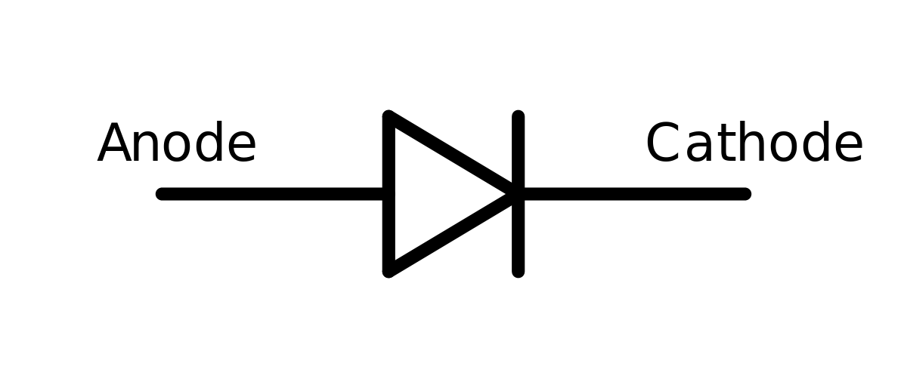
P-N Junction
Notes:
A p-n junction is a piece of semiconductor with part of it doped p-type and the other part doped n-type. A basic example of it is a diode.
At the junction where the two materials meet, the extra free electrons tend to occupy the extra free holes. This is called the depletion layer. It acts as a block of insulating material of the diode.

Slide 19
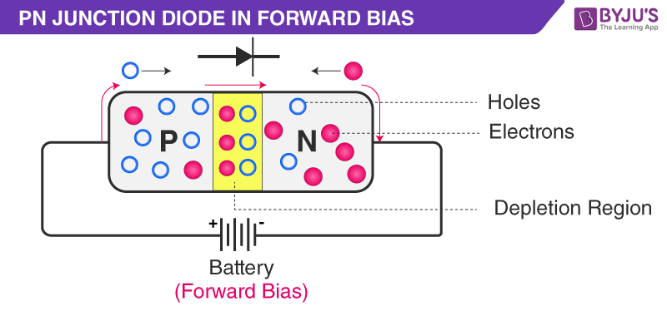
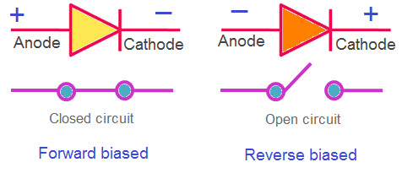
Forward Biased P-N Junction
Notes:
In forward bias, the diode is placed in a circuit so that the p-type material is attached to a positive connection. Current will flow. This is because the electrons are drawn towards the positive and the holes to the negative. The depletion layer shrinks.

Slide 20
Reverse Biased P-N Junction
Notes:
For reverse bias, the p-type material is attached to the negative terminal, and the n-type to the positive. The electrons are drawn backwards from the centre and the depletion layer grows. A current is unable to flow.

Slide 21
Exam Q - 2016 LC Physics HL Q10

Slide 22
Contact details
Web Link: https://epistem.ie
EPI Stem Project: Resources
Tara Ryan: Tara Ryan
Email: tarasmb12@yahoo.ie

Slide 23
Image Sources
https://www.fizzics.org/electrical-resistance-and-temperature/
http://www-materials.eng.cam.ac.uk/mpsite/properties/non-IE/resistivity.html
https://www.texasgateway.org/resource/33-resistance-and-resistivity
https://electronicsreference.com/module3/dc-resistors-parallel/
https://commons.wikimedia.org/wiki/File:Electron_shell_014_silicon.png
https://study.com/academy/lesson/silicon-element-lewis-structure-facts-discovery.html
https://www.eeweb.com/how-semiconductors-work/
https://www.thegeekpub.com/243163/what-is-resistance-ohms-electricity-basics/
https://learn.sparkfun.com/tutorials/voltage-current-resistance-and-ohms-law/resistance
https://www.falstad.com/circuit/e-voltdivide.html
https://www.quora.com/What-is-the-magnetic-effect-of-an-electric-current
https://www.google.com/url?sa=i&url=https%3A%2F%2Fwww.123rf.com%2Fphoto_109504605_red-hot-coil-spring-glowing-in-the-dark.html&psig=AOvVaw0J4JfdwSt-7cVOOgNaJwgM&ust=1654858370717000&source=images&cd=vfe&ved=0CAwQjRxqFwoTCMCXzoKaoPgCFQAAAAAdAAAAABAD

Slide 24
Image Sources
https://www.pinterest.ie/pin/781022760359548784/
https://gfycat.com/flashyfoolisharcticwolf
https://www.dw.com/en/silicon-semiconductors-to-convert-heat-into-power/a-16091377
https://www.elprocus.com/ideal-diode-circuit-working-characteristics/
https://en.wikipedia.org/wiki/Diodes_%28disambiguation%29

