Slide 1
Leaving Certificate Physics Electricity Part 2
Tara Ryan: Tara Ryan
EPI Stem Project: Resources

Slide 2
Leaving Cert Physics Learning Outcomes

Slide 3
Overview of Topics
Capacitance
Electric Current
Potential Difference
Voltage-Current Graphs
Electricity & Magnetism
Part 2
Capacitance & Electric Current

Slide 4
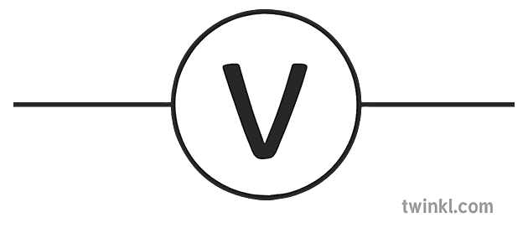
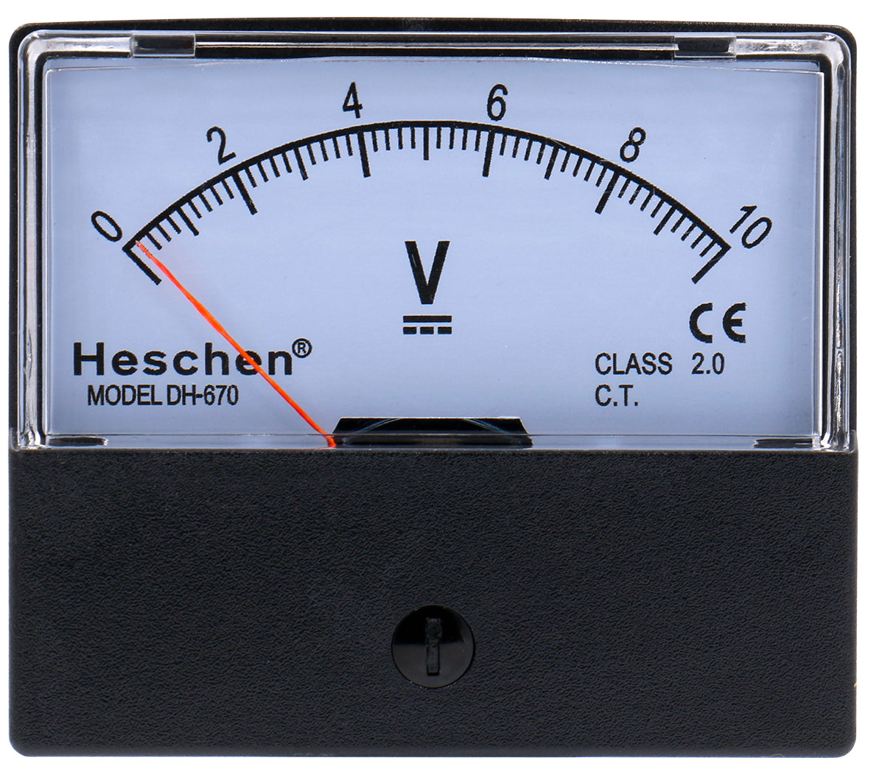
Potential Difference
Notes:
The potential difference between two points is the work done in moving a unit positive charge from one point to another. Potential difference is measured in volts. The potential difference between two points is 1 volt if the work done is 1 joule. From this we get the formula W=QV.
Usually, we are only interested in measuring potential difference between two points, rather than the actual level of potential, we still need something to measure it against. The earth is always taken as being at zero potential for this reason.
Potential difference can be measured accurately with a voltameter, or approximately with an electroscope, by taking the size of divergence between the two leaves.

Slide 5
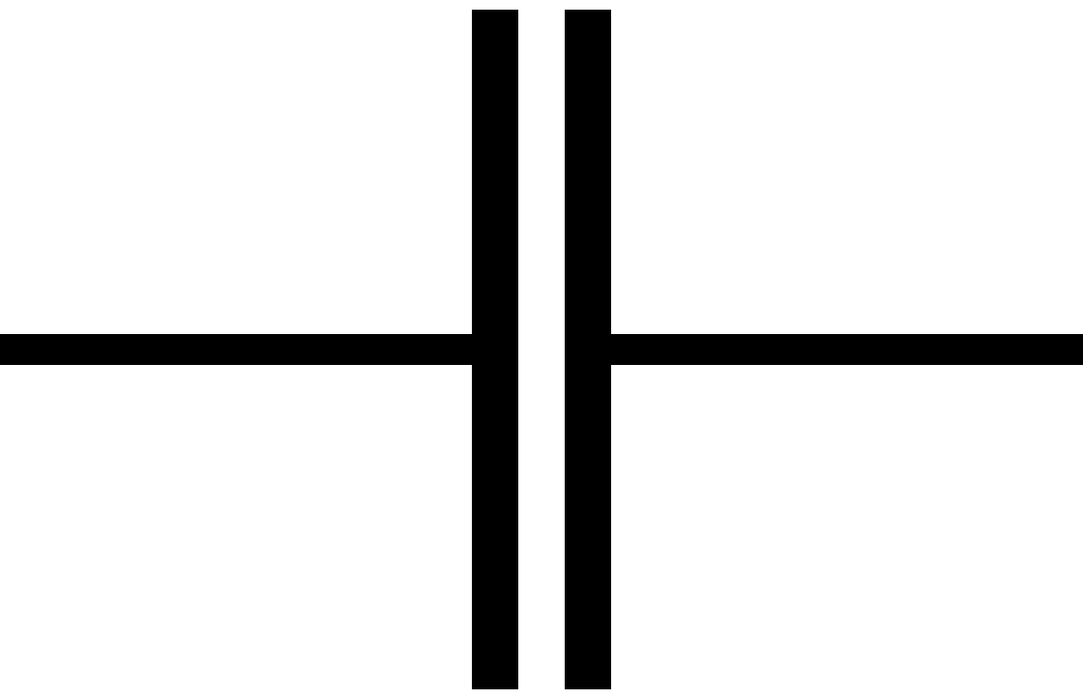
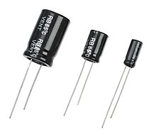
Capacitance
Notes:
Capacitance is the ratio of charge on a body to its potential. Its formula is shown here. The capacitance, measured in farads, is equal to the charge stored, measured in coulombs, divided by the voltage across the capacitor, measured in volts.
A capacitor is used to measure the capacitance in a circuit.

Slide 6
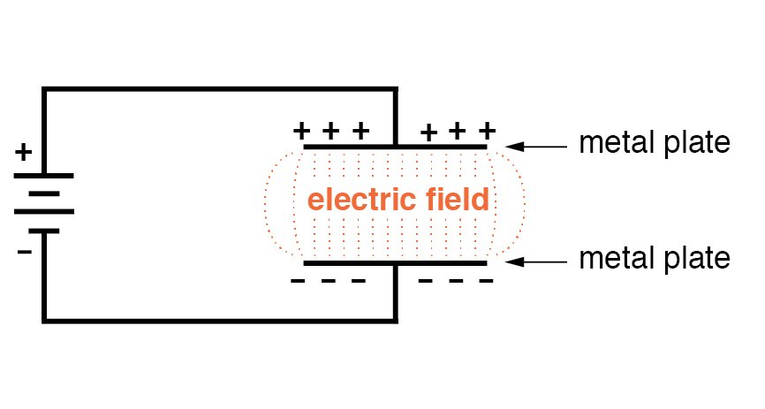
Parallel Plate Capacitor
Capacitor Simulation
Notes:
A parallel plate capacitor consist of two parallel plates separated by an insulator, called a dielectric. A typical convention used to increase capacitance and store electric charge is the parallel plate capacitor. This device stores electrical energy. When it is charged, the plates carry equal amount of charge, but of opposite sign.
Your students can carry out an experiment to show this. You’ll find a link to a free simulation for them to try.
Some uses of capacitors include flashes on cameras and tuning radios.

Slide 7
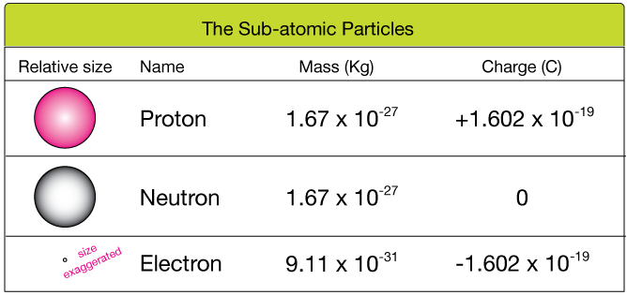
Electric Current
Notes:
Electric current is the flow of electric charge. A conductor is a substance through which electric charge can flow, such as copper. An insulator is a substance through which an electric charge cannot flow, such as wood.
The size of an electric current is the amount of charge passing any point of a substance per second.
Electricity is the flow of electrons. The charge on one electron is - 1.6 X 10*-19 C, due to electrons having a negative charge.

Slide 8
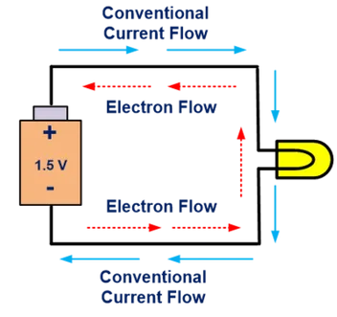
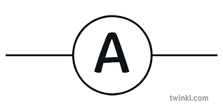
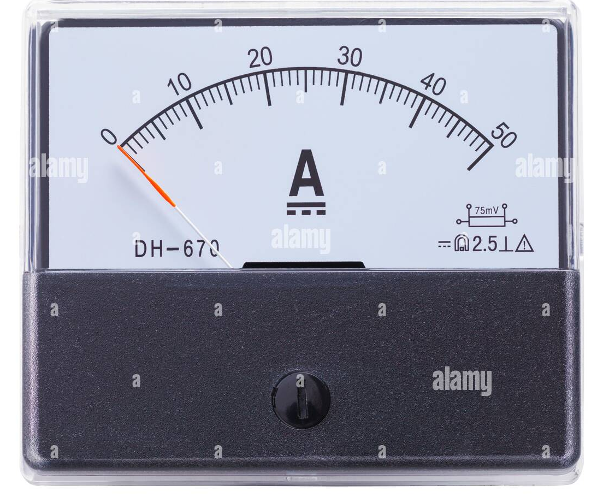
Flow of Current
Notes:
When we discuss the flow of current, we can mean two things.
Conventional current assumes that current flows out of the positive terminal, through the circuit and into the negative terminal of the source. This was the convention chosen during the discovery of electricity. This was later discovered to be incorrect.
Electron flow is what actually happens, and electrons flow out of the negative terminal, through the circuit and into the positive terminal of the source.
An ammeter is used to measure current. It must be connected in series with the circuit.

Slide 9
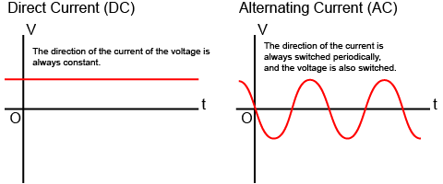
Flow of Current: AC Vs DC
Notes:
Direct current is one-directional flow of electric charge. An electrochemical cell, or battery, is a prime example of DC power. Direct current may flow through a conductor such as a wire, but can also flow through semiconductors, insulators, or even through a vacuum as in electron or ion beams.
Alternating current is an electric current which periodically reverses direction and changes its magnitude continuously with time. It is generated by using a device known as an alternator. The alternator is a device which generates an alternating current from a source of motion, such as a turbine powered by steam.

Slide 10
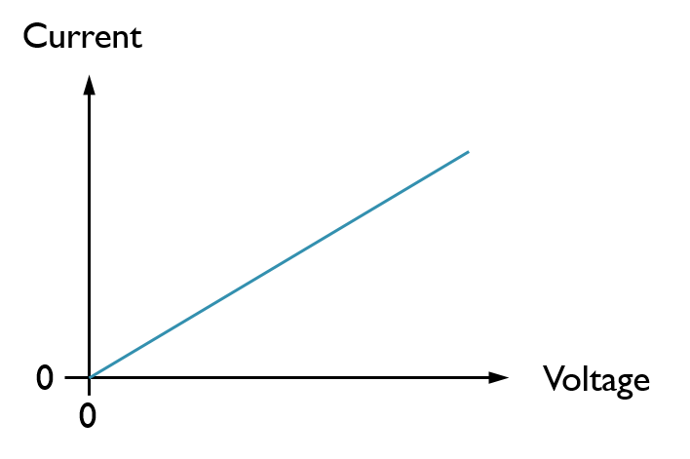
Ohm’s Law
V = (I)(R)
Voltage = (Current)(Resistance)
Voltage
(V)
Current
(A)
Resistance
(Ω)
Notes:
Ohm’s Law states that the current through a conductor between two points is directly proportional to the voltage across the two points. Its formula is shown here. Voltage, measured in volts, is equal to current, measured in amps, multiplied by resistance, measured in ohms. At the end, we will look an exam question to practice these calculations.

Slide 11
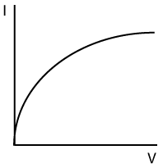
Voltage-Current Graphs
Metal | Filament Bulb | Gases
Notes:
In a standard electric circuit, where electrons are passing through a metal, Ohm’s law is obeyed. The voltage is proportional to the current. However, there are some cases where Ohm’s law is not obeyed.

Slide 12
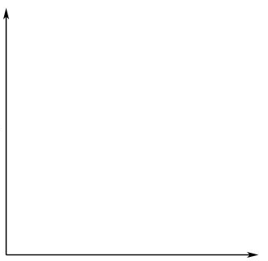
Voltage-Current Graphs
Vacuum | Electrolysis (inactive electrodes) | Electrolysis (active electrodes)
I
I
V
V
Notes:
In a standard electric circuit, where electrons are passing through a metal, Ohm’s law is obeyed. The voltage is proportional to the current. However, there are some cases where Ohm’s law is not obeyed.

Slide 13
Electricity & Magnetism
Notes:
Magnetism is created y the movement of electrical charges.
Permanent magnets are made from nickel, cobalt, iron, or alloys, due to their electronic arrangements.
Electromagnets are other materials that can be magnetised by electric currents.

Slide 14
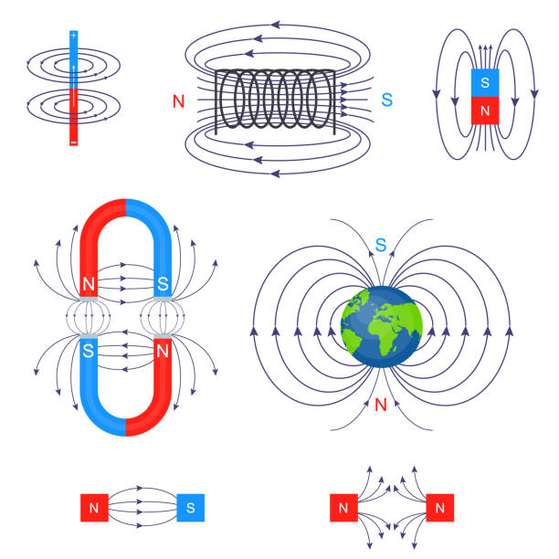
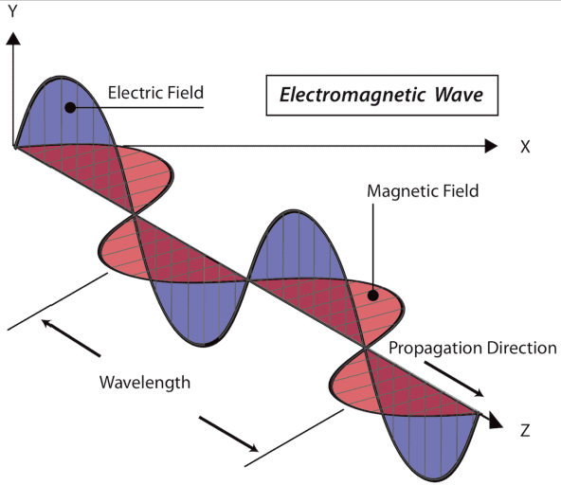
Electricity & Magnetism
Notes:
A magnetic field is the area around a magnet where its effect can be measured It is a vector quantity because it has both strength and direction.
Magnetic field lines are drawn pointing from north to south.
Magnetic fields can be demonstrated with iron filings or with plotting compasses.

Slide 15
Right Hand Grip Rule
Notes:
The right hand grip rule states that if a right handed clasps a conductor with the thumb pointed in the direction of current, then the fingers give the direction of the magnetic field around the conductor. The thumb points in the direction of conventional current (from positive to negative).

Slide 16
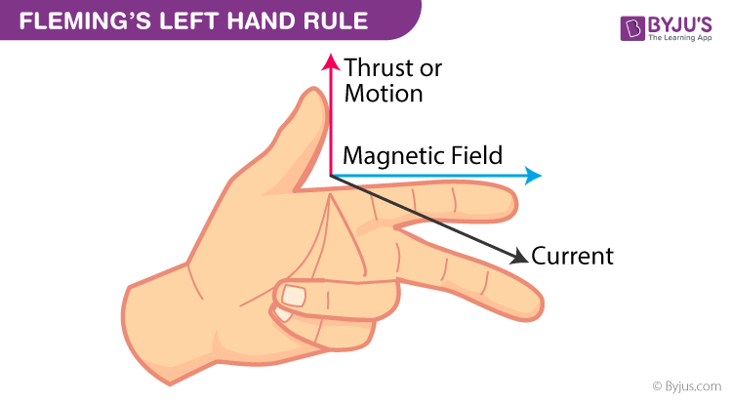
Fleming’s Left Hand Rule
Notes:
Fleming’s left hand rule states that if the thumb, first finger, and second finger on the left hand are held at right angles with the first finger pointing in the direction of the magnetic field and the second finger pointing in the direction of the current, then the thumb points in the direction of force. This orientation also follows the direction of conventional current.

Slide 17
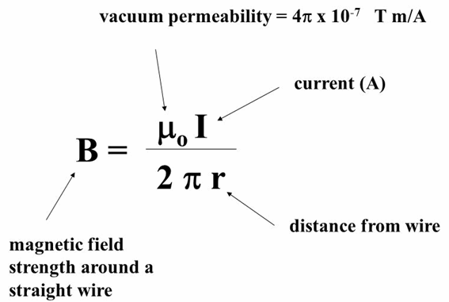
Magnetic Flux Density
Notes:
The magnetic flux density at a point in a magnetic field, is a vector whose magnitude is equal to the force that would be experienced by a conductor of length 1m carrying a current of 1A at right angles to the field at that point and whose direction is the direction of the force on the north pole placed at that point.
The unit of the magnetic flux density is the tesla.
The magnetic flux density at a point is 1 tesla if a conductor of 1m in length carrying a current of 1A experiences a force of 1N when placed perpendicular to the field.

Slide 18
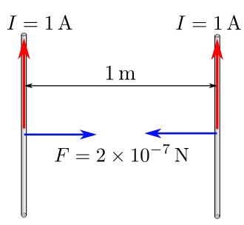
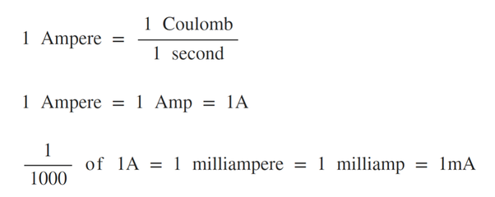
The Ampere & The Coulomb
Notes:
The ampere is a constant current which if maintained in two straight parallel conductors of indefinite length of negligible cross section and placed 1m apart in a vacuum, would produce a force of on each conductor of 2X10*-7 Newtons per meter length.
The Coulomb is the amount of charge that passes any point in a circuit when a current of 1 ampere flows for 1 second.

Slide 19
Exam Q - 2015 LC Physics HL Q5

Slide 20
Contact details
Web Link: https://epistem.ie
EPI Stem Project: Resources
Tara Ryan: Tara Ryan
Email: tarasmb12@yahoo.ie

Slide 21
Image Sources
https://slideplayer.com/slide/10831147/
https://www.twinkl.hu/illustration/voltmeter-symbol-circuits-electricity-science-ks4-bw-rgb
https://heschen.com/es/products/dh-670-dc-10v
https://study.com/learn/lesson/capacitance-units-formula.html
https://en.wikipedia.org/wiki/Capacitor
https://www.allaboutcircuits.com/video-tutorials/inductance-and-capacitance/
https://phet.colorado.edu/sims/html/capacitor-lab-basics/latest/capacitor-lab-basics_en.html
https://www.nicepng.com/ourpic/u2q8a9y3q8t4i1t4_camera-with-flash-icon-camera-with-flash-emoji/
https://www.thoughtco.com/examples-of-electrical-conductors-and-insulators-608315
https://www.onlinemathlearning.com/charge-circuits.html
https://www.alamy.com/stock-photo/ammeter.html
https://www.twinkl.ie/illustration/ammeter-symbol-circuits-electricity-science-ks4
https://www.matsusada.com/column/dc_and_ac.html
https://gfycat.com/annualinsecureafricanjacana
https://www6.slac.stanford.edu/news/2017-01-11-sketching-out-magnetism-electricity.aspx
http://hyperphysics.phy-astr.gsu.edu/hbase/magnetic/elemag.html
https://physics.stackexchange.com/questions/562473/magnetic-field-closed-loop-lines-in-an-electromagnetic-wave

Slide 22
Image Sources
https://www.dreamstime.com/illustration/right-hand-rule.html
https://www.lbq.org/search/Physics?quickRef=11809
https://www.coolmagnetman.com/magfund02.htm
https://www.informationpalace.com/what-is-magnetic-flux/

