Slide 1
Junior Cycle Science Electricity Part 2 Circuits & Energy Transformations
Tara Ryan: Tara Ryan
EPI Stem Project: Resources

Slide 2
Junior Cycle Science Learning Outcomes

Slide 3
Junior Cycle Science Learning Outcomes

Slide 4
Junior Cycle Science Learning Outcomes

Slide 5
Overview of Topics
Circuits
Flow of Current
Electrical Applications
Energy
Energy Transformations
Part 2
Circuits & Energy Transformations

Slide 6
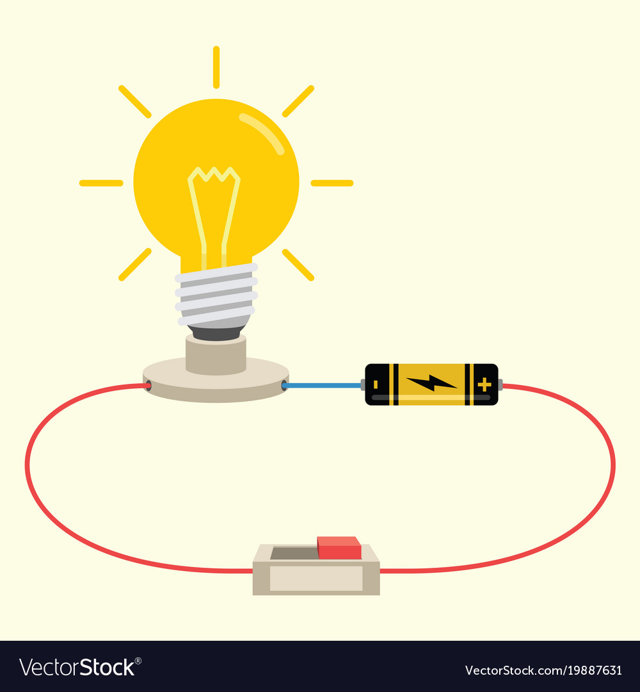
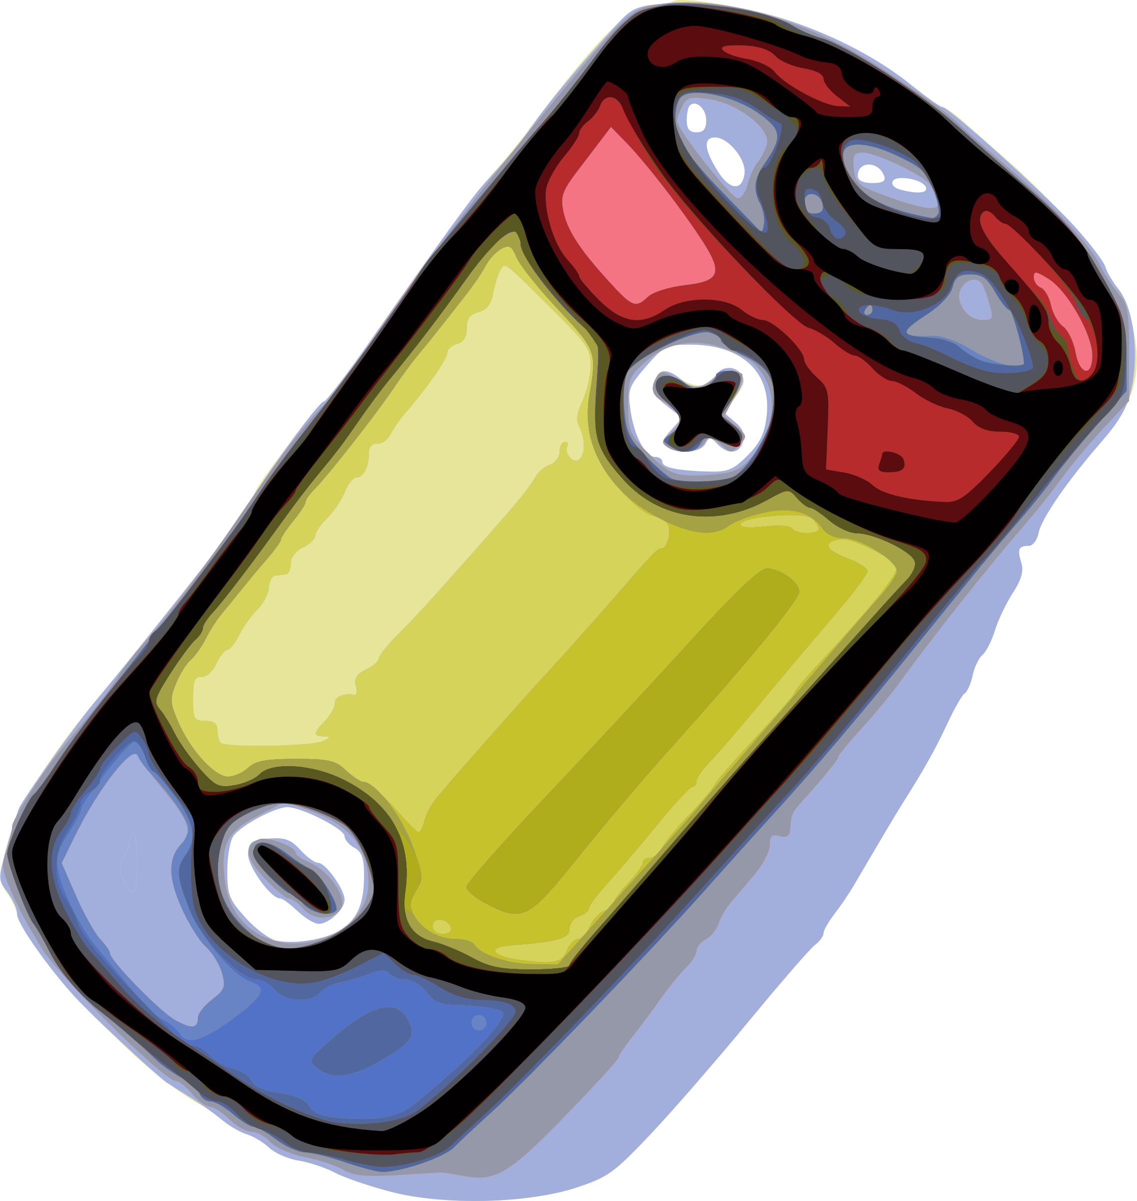
Simple Electric Circuit
Notes:
The most basic functional circuit consists of a power source, wires, a switch, and a device like a light bulb.
Our power source here cell. A collection of cells is called a battery. A battery converts stored chemical energy into electrical. Due to a chemical reaction within the battery, an excess of electrons builds up. This causes an electrical difference between the positive and negative terminals of the battery, and so when connected to a closed circuit, electricity will flow.
As mentioned previously, a circuit needs to be closed in order to allow the flow of electricity. If there is a break in the circuit, either due to an open switch or the wires not being connected properly, electricity will be unable to flow. Switches can be very helpful. They allow us to decide when we want to turn the lights on in our houses, ring a door bell, and provide a safety feature in trip switches that will automatically break a circuit if there is a surge of power, preventing fires and devices from breaking.
We can tell that the circuit is complete and electricity is flowing when our device is activated. Here, a light bulb produces light. You could also use other devices like windmills, motors, or buzzers.

Slide 7
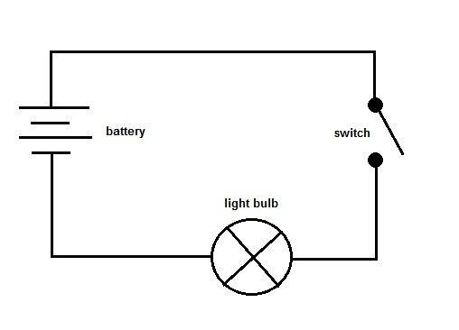
Simple Electric Circuit
Notes:
A circuit can also be represented as an electronic schematic. The battery is shown as parallel lines of alternating lengths. The longer lines represent the positive terminals of the battery, and the shorter lines represent the negative terminals.
The wires are just the continuous lines connecting the circuit and the switch is where there is a break in the wires with a dot either side.
Finally, the light bulb is drawn as a circle with an X in the center of it.

Slide 8
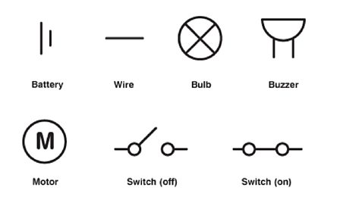
Simple Electric Circuit
Notes:
Shown here are the schematic representations of some basic circuit components.

Slide 9
Circuit Simulation
Circuit Simulation
Notes:
Here is a link to a simulation that your students can use to build their own circuits.

Slide 10
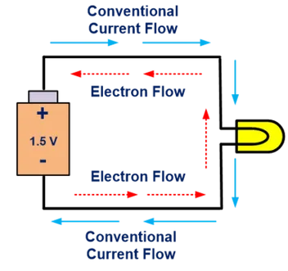
Flow of Current
Notes:
When we discuss the flow of current, we can mean two things.
Conventional current assumes that current flows out of the positive terminal, through the circuit and into the negative terminal of the source. This was the convention chosen during the discovery of electricity. This was later discovered to be incorrect.
Electron flow is what actually happens, and electrons flow out of the negative terminal, through the circuit and into the positive terminal of the source.

Slide 11
Simple Electric Circuit Calculations
P = (V)(I)
Power = (Voltage)(Current)
Power
(W)
Voltage
(V)
Current
(A)
Notes:
Here is a helpful formula for circuit calculations. Power measured in watts, is equal to voltage, measured in volts, multiplied by current, measured in amps.

Slide 12
Simple Electric Circuit Calculations
V = (I)(R)
Voltage = (Current)(Resistance)
Voltage
(V)
Current
(A)
Resistance
(Ω)
Notes:
Another helpful formula is shown here. Voltage, measured in volts, is equal to current, measured in amps, multiplied by resistance, measured in ohms. At the end, we will look an exam question to practice these calculations.

Slide 13
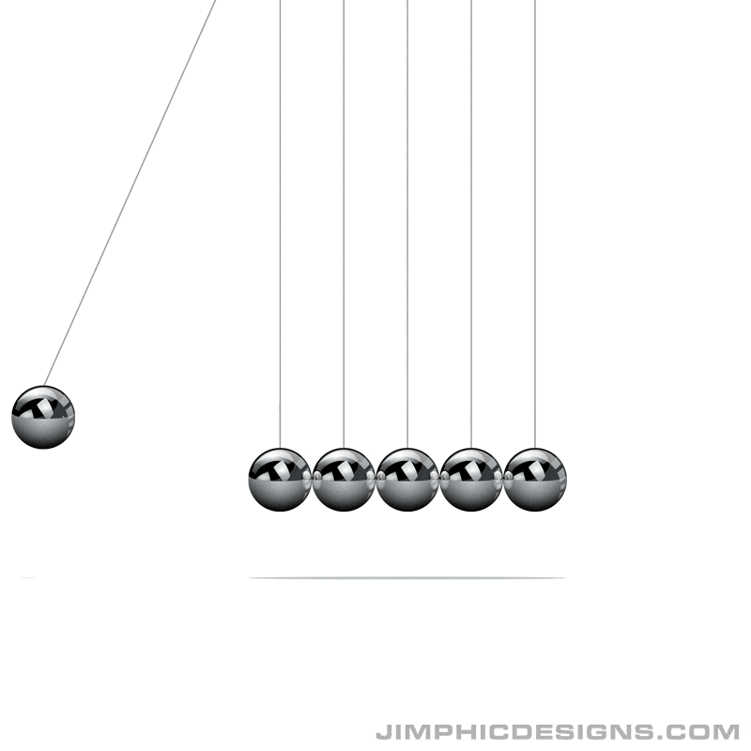
What is Energy?
Notes:
Energy is the ability to do work. It is measured in Joules (J). Energy is all around us, but where does it come from? The law of conservation of energy states that energy can neither be created nor destroyed, but only converted into different forms. An example of this is a Newton’s cradle. A metal ball at one end is lifted and released. Its energy is then transferred through the other metal balls in the middle of the device, until it reaches the metal ball on the opposite side, and it is free to move. This process will continue. In a perfect system, this device would remain in motion indefinitely. However, realistically it will come to an eventual stop, due to imperfections, such as defects on the device, or external influences, such as wind.

Slide 14
Forms of Energy
Notes:
As previously mentioned, energy can be converted into many different forms. The diagram classifies these different types.

Slide 15
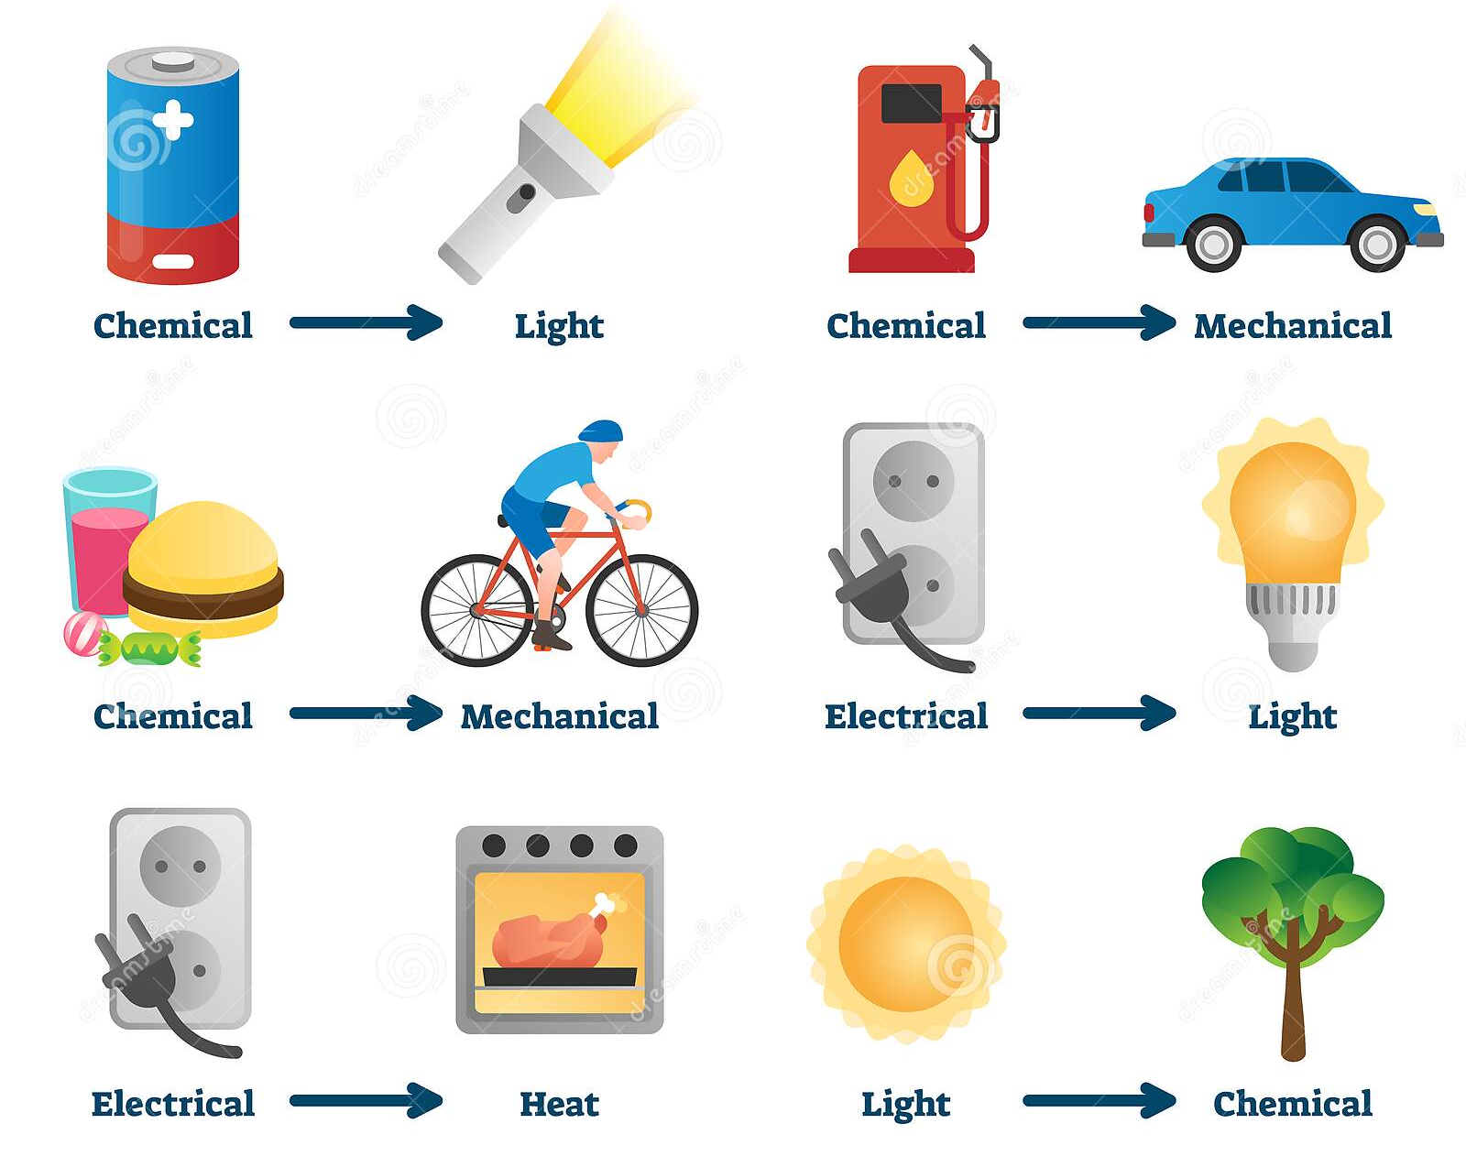
Energy Transformations
Notes:
Here is a poster showing some energy transformations.
A torch converts chemical energy in the battery to light energy in the bulb.
When we fill up our cars with petrol or diesel, this converts chemical energy to mechanical, which causes the car to move. A similar process occurs when we eat.
Our ovens convert electrical energy into heat energy.

Slide 16
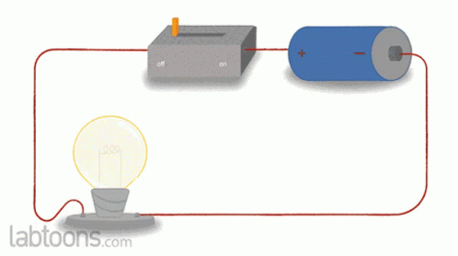
Energy Transformations
Notes:
Can you think of some devices of energy transformations that you can build in the classroom? In this circuit the chemical energy stored in the battery, is converted into electrical energy that flows along the wires, and becomes light and heat energy in the bulb.

Slide 17
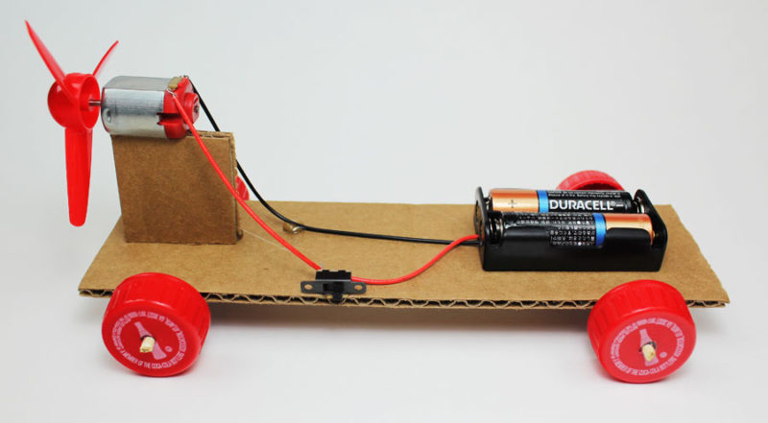
Energy Transformations
Notes:
Students can build their own cars from cardboard for the body and bottle caps for the wheels. Students can build different types of cars with a motor, with a propellor, and with both. Encourage your students to build obstacle courses and run experiments to test which type of cars run faster, last longer, can navigate slopes better, ect.

Slide 18
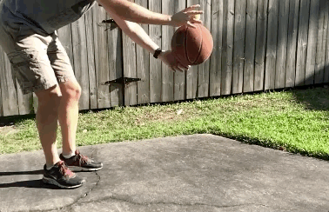
Energy Transformations
Notes:
A tennis ball is stacked on top of a basketball. Both are released and bounce off the ground, but the tennis ball bounces much high. Why does this happen? They were both dropped at the same time and at the same speed right before they hit the ground. As we saw earlier with the Newton’s cradle, potential energy was converted into kinetic energy. The tennis ball has a lower mass, so more of the kinetic energy is transferred to it, allowing it to bounce higher.

Slide 19
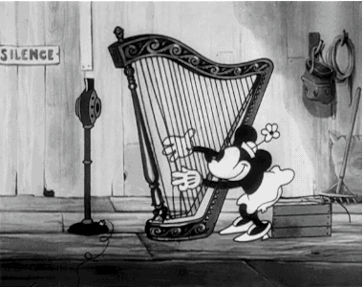
Energy Transformations
Notes:
Students can make their own harps by fixing elastic bands of varying lengths at two points. When the taught strings are static, they hold potential energy. This is then converted to kinetic energy when they are plucked, and finally sound energy when a noise is produced.

Slide 20
Sample Exam Question
JC Science 2019 Q13
Notes:
Here is a question taken from the 2019 junior cycle science exam to test your students’ understanding of the topic.

Slide 21
Sample Exam Question
JC Science 2019 Q13
Notes:
Here is a question taken from the 2019 junior cycle science exam to test your students’ understanding of the topic.

Slide 22
Sample Exam Question
JC Science 2019 Q13
Notes:
Here is a question taken from the 2019 junior cycle science exam to test your students’ understanding of the topic.

Slide 23
Contact details
Web Link: https://epistem.ie
EPI Stem Project: Resources
Tara Ryan: Tara Ryan
Email: tarasmb12@yahoo.ie

Slide 24
Image Sources
https://www.jimphicdesigns.com/downloads/download-page.php?id=43
https://www.dreamstime.com/energy-transformation-example-vector-illustrations-physics-educative-explanation-guide-chemical-to-light-electrical-heat-image173736281
https://tenor.com/view/simple-electric-circuits-electric-circuits-electric-science-physics-gif-20641440
https://www.makerspaces.com/propeller-car/
https://www.wired.com/story/why-a-tennis-ball-goes-flying-when-bounced-on-a-basketball/
https://giphy.com/gifs/wEhenh88KJ8Na

